Slide 1


Open Education Research : Overview, Benefits and Challenges
Dr. Rob Farrow @philosopher1978
Open Education - does it work? 22nd February 2017 International Centre for Eye Health / London School of Hygiene and Tropical Medicine

Slide 2

@oer_hub

Slide 3
The Team
Notes:
Note that what follows is a summary of the survey data plus the reflections of the various groups from the F2F sessions

Slide 4
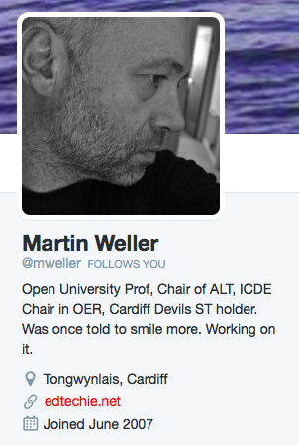


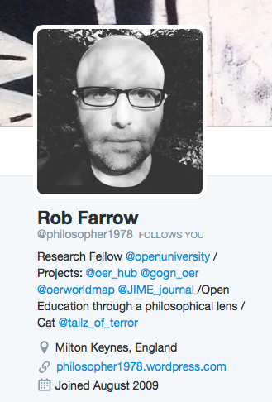
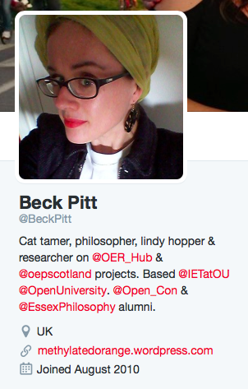
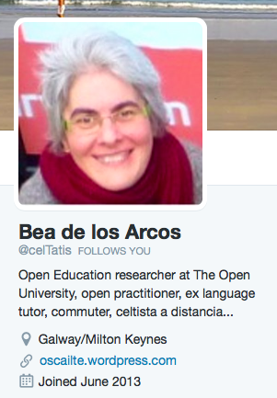
Who we are
http://oerhub.net/working-with-us/the-team/

Slide 5
Our Trajectory
Notes:
Note that what follows is a summary of the survey data plus the reflections of the various groups from the F2F sessions

Slide 6


2012
2013
2014
Evidence report published
2015
2016
ExplOERer (Erasmus+)
2017
Global OER Graduate Network
OER Research Hub: Collaboration across School/K12; College; Higher Education & Non-formal learning
OER World Map (IV)
BizMOOC
Models for Open, Online, Flexible & Technology Enhanced (OOFAT)
Open Education Research Hub
Open Research Agenda
Data report published
Survey data explorer
OU Engaging Research award
OER Impact Map
Twitter 101
Open Research textbook
OER World Map (III)
OER Research Hub: Collaboration across School/K12; College; Higher Education & Non-formal learning
OER Research Hub fellowship programme
OER Research Hub fellowship programme
ACE Award for Research Excellence
Researcher Toolkit
Bridge to Success
BC Campus Open Textbooks
P2PU Open Research
OER Wales Cymru
Opening Educational Practice in Scotland
OER World Map (II)

Slide 7
2012
2013
2014
Evidence report published
2015
2016
ExplOERer (Erasmus+)
2017
Global OER Graduate Network
OER Research Hub: Collaboration across School/K12; College; Higher Education & Non-formal learning
OER World Map (IV)
BizMOOC
Models for Open, Online, Flexible & Technology Enhanced (OOFAT)
Open Education Research Hub
Open Research Agenda
Data report published
Survey data explorer
OU Engaging Research award
OER Impact Map
Twitter 101
Open Research textbook
OER World Map (III)
OER Research Hub: Collaboration across School/K12; College; Higher Education & Non-formal learning
OER Research Hub fellowship programme
OER Research Hub fellowship programme
ACE Award for Research Excellence
Researcher Toolkit
Bridge to Success
BC Campus Open Textbooks
P2PU Open Research
OER Wales Cymru
Opening Educational Practice in Scotland
OER World Map (II)

Slide 9



















Project Co-PILOT

Slide 10
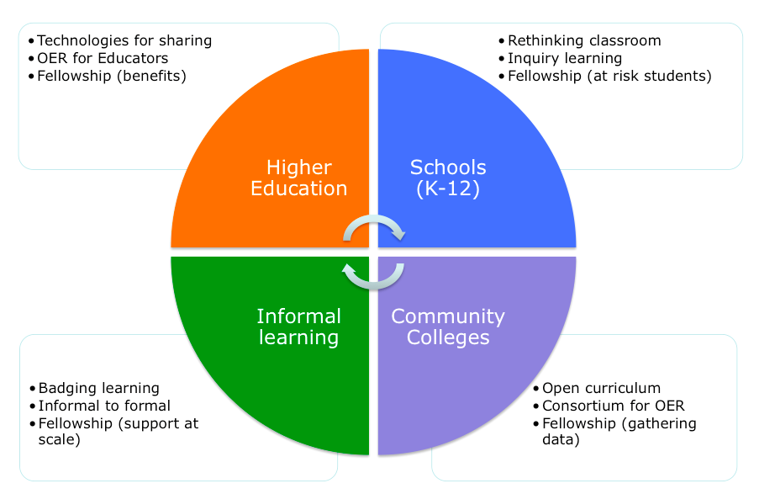
Collaboration Model
Collaboration Model

Slide 11
Keyword | Hypothesis
Performance | OER improve student performance/satisfaction
Openness | People use OER differently from other online materials
Access | OER widen participation in education
Retention | OER can help at-risk learners to finish their studies
Reflection | OER use leads educators to reflect on their practice
Finance | OER adoption brings financial benefits for students/institutions
Indicators | Informal learners use a variety of indicators when selecting OER
Support | Informal learners develop their own forms of study support
Transition | OER support informal learners in moving to formal study
Policy | OER use encourages institutions to change their policies
Assessment | Informal assessments motivate learners using OER

Slide 12


Slide 13
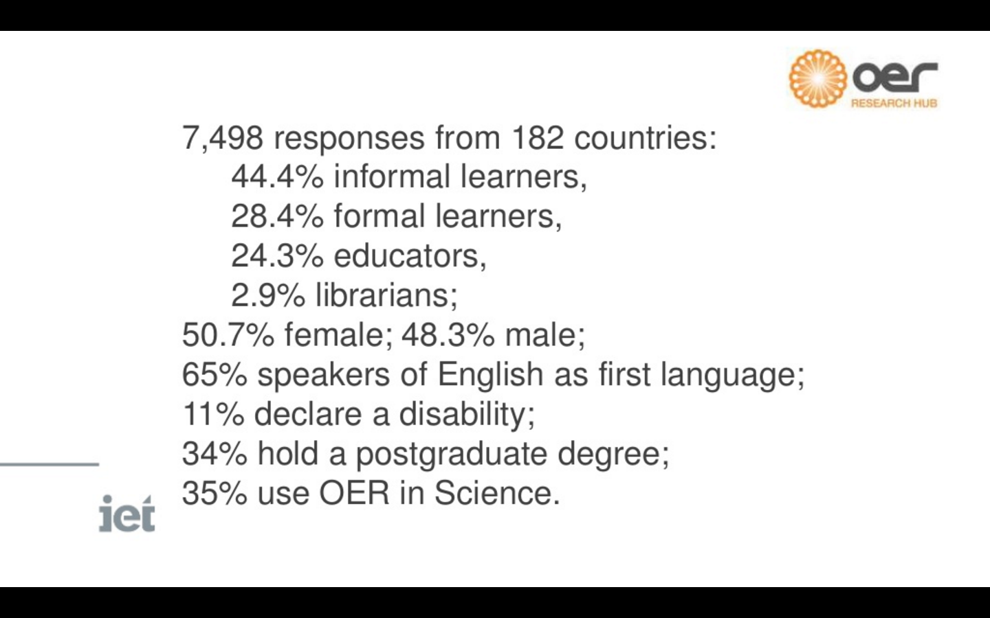

Slide 14
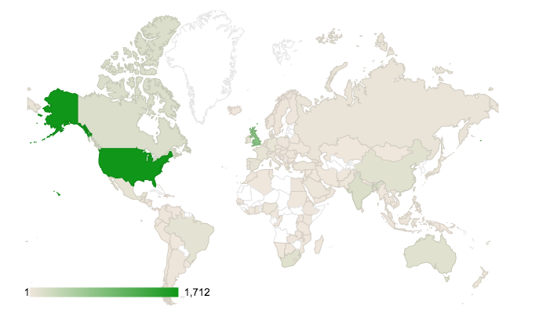
Geographical spread of research participation
Notes:
Most responses came from the USA (n=862) or the UK (n=473) though India (n=117) Canada (n=87) and Brazil (n=84) also contributed significant amounts of data. Most countries were represented and people from every continent contributed information. Excluding Africa, only Bolivia, French Guyana, Greenland, Kyrgyzstan, Suriname, Turkmenistan, Uzbekistan, and Venezuela were not represented. Most countries recorded between 5 and 40 responses.

Slide 15
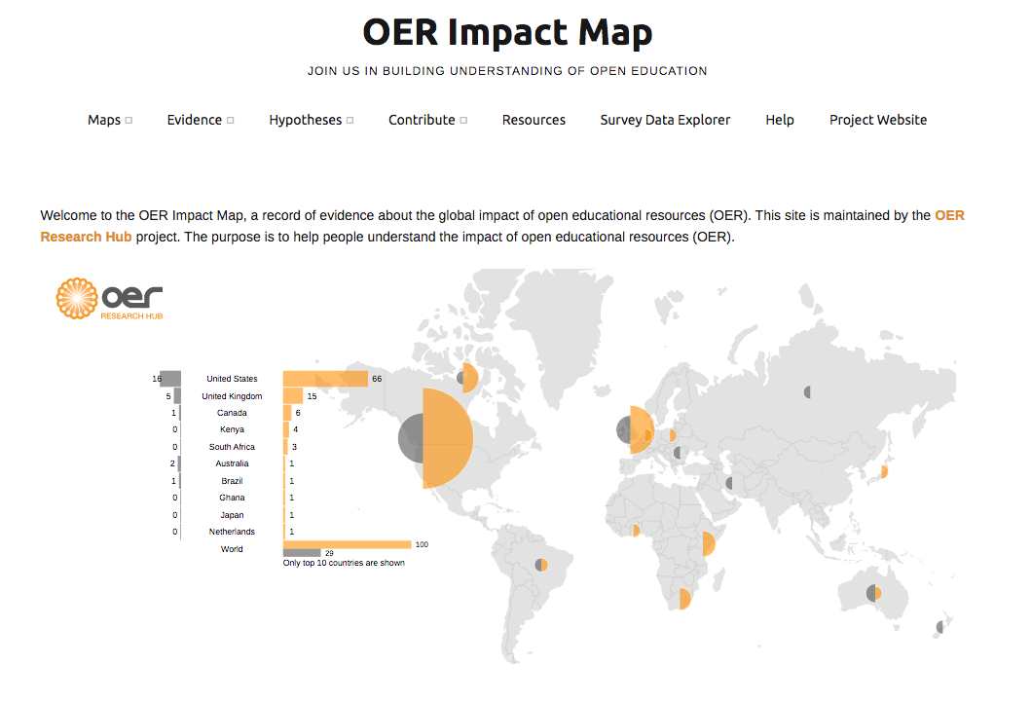
Notes:
Most responses came from the USA (n=862) or the UK (n=473) though India (n=117) Canada (n=87) and Brazil (n=84) also contributed significant amounts of data. Most countries were represented and people from every continent contributed information. Excluding Africa, only Bolivia, French Guyana, Greenland, Kyrgyzstan, Suriname, Turkmenistan, Uzbekistan, and Venezuela were not represented. Most countries recorded between 5 and 40 responses.

Slide 16
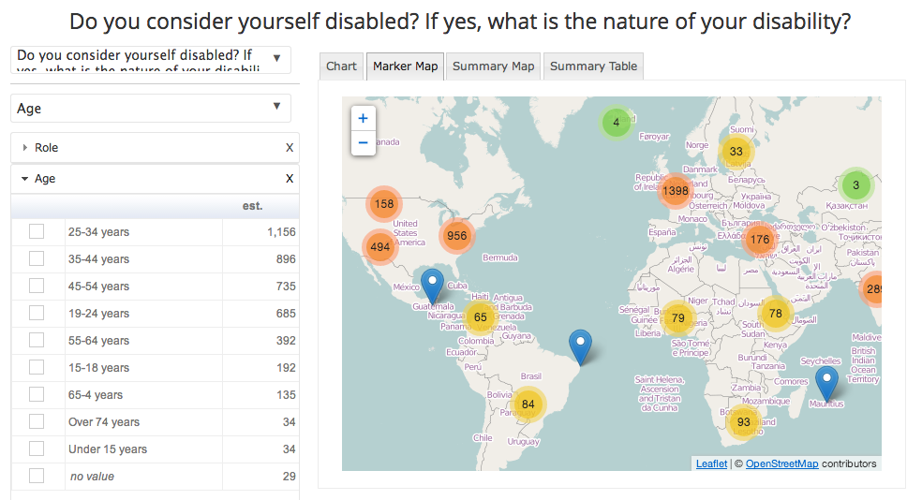
Survey Data Explorer

Slide 17

OER Evidence Report 2014
OER Data Report 2015
http://oerhub.net/reports/

Slide 18
2012
2013
2014
Evidence report published
2015
2016
ExplOERer (Erasmus+)
2017
Global OER Graduate Network
OER Research Hub: Collaboration across School/K12; College; Higher Education & Non-formal learning
OER World Map (IV)
BizMOOC
Models for Open, Online, Flexible & Technology Enhanced (OOFAT)
Open Education Research Hub
Open Research Agenda
Data report published
Survey data explorer
OU Engaging Research award
OER Impact Map
Twitter 101
Open Research textbook
OER World Map (III)
OER Research Hub: Collaboration across School/K12; College; Higher Education & Non-formal learning
OER Research Hub fellowship programme
OER Research Hub fellowship programme
ACE Award for Research Excellence
Researcher Toolkit
Bridge to Success
BC Campus Open Textbooks
P2PU Open Research
OER Wales Cymru
Opening Educational Practice in Scotland
OER World Map (II)

Slide 19
2012
2013
2014
Evidence report published
2015
2016
ExplOERer (Erasmus+)
2017
Global OER Graduate Network
OER Research Hub: Collaboration across School/K12; College; Higher Education & Non-formal learning
OER World Map (IV)
BizMOOC
Models for Open, Online, Flexible & Technology Enhanced (OOFAT)
Open Education Research Hub
Open Research Agenda
Data report published
Survey data explorer
OU Engaging Research award
OER Impact Map
Twitter 101
Open Research textbook
OER World Map (III)
OER Research Hub: Collaboration across School/K12; College; Higher Education & Non-formal learning
OER Research Hub fellowship programme
OER Research Hub fellowship programme
ACE Award for Research Excellence
Researcher Toolkit
Bridge to Success
BC Campus Open Textbooks
P2PU Open Research
OER Wales Cymru
Opening Educational Practice in Scotland
OER World Map (II)

Slide 20
Our Objectives
Building capacity in the OER research domain
Conducting research into open education and OER
Producing resources for the open education research community
Acting as champions for open practices in research and scholarship

Slide 21
Notes:
Note that what follows is a summary of the survey data plus the reflections of the various groups from the F2F sessions

Slide 22












BizMOOC tackles the European challenge of enabling businesses, labour force and HEIs to increase their activities and exploitation (economies of scale) of the MOOC potential.

Slide 23








Designing an open online course to train teachers in OER reuse.
Experiential approach.
Modelling reuse strategies & behaviours
Focus on skills needed to move beyond simple access to content
Translation and localisation to Polish and Swedish, and delivery in three languages
Guidelines for translation and localisation of open content

Slide 24

A global network of PhD students involved in projects, policy development and implementation strategies on open educational resources (OER) including MOOC, open data, open licensing and open access publishing. The aim of the GO-GN is to both raise the profile of OER research, and offer support for those conducting PhD research in this area.
Supporting good quality PhD research into open education
Connecting researchers and their projects to form a global knowledge network
Developing and exploring new, cross-disciplinary knowledge in the OER field
Monitoring and evaluating outcomes of institutional, national and international OER initiatives

Slide 25
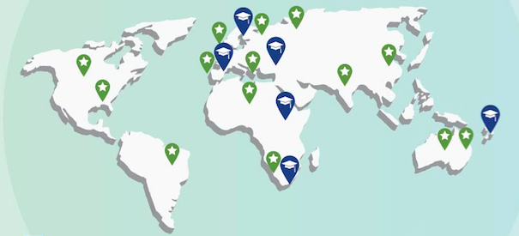

45 PhD researchers in 14 countries; 7 alumni since 2015
CC BY 4.0, Open Education Consortium http://www.oeconsortium.org/at-a-glance/global-oer-graduate-network/

Slide 26
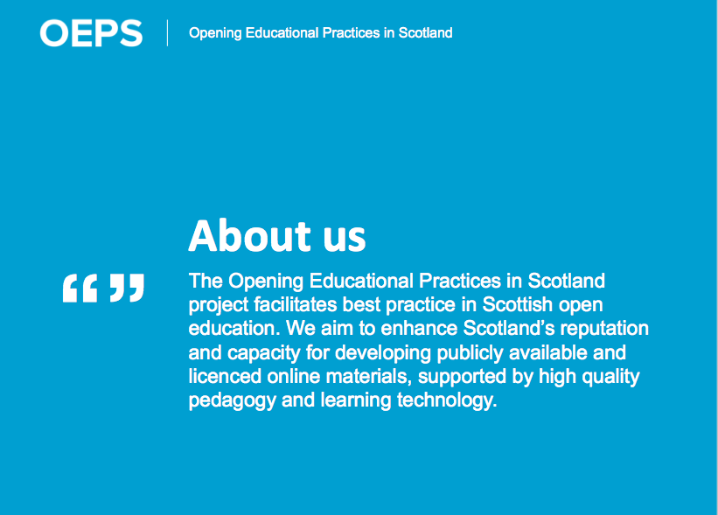

Slide 27

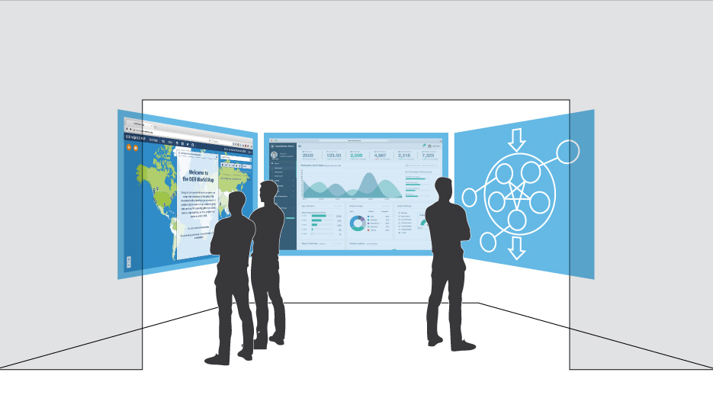





The OER World Map

Slide 28
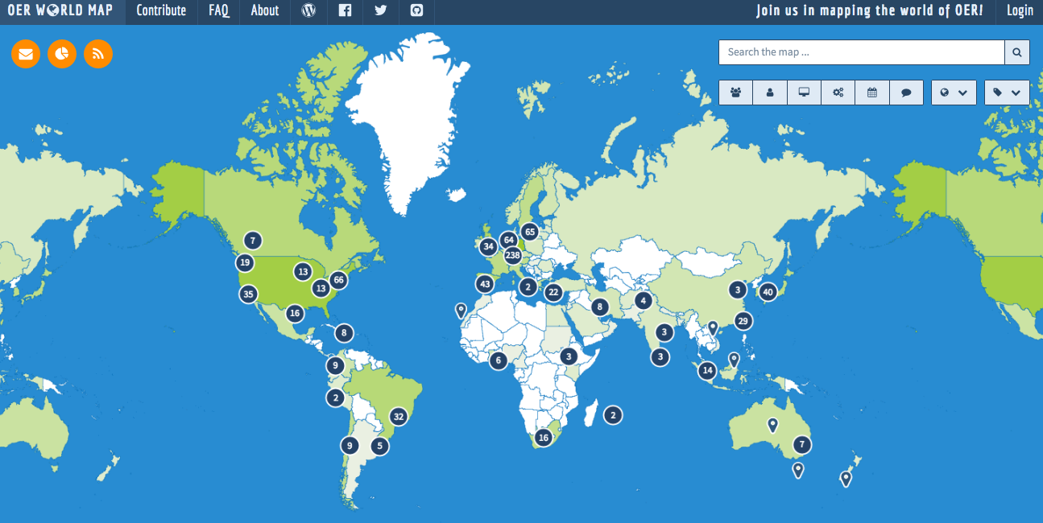
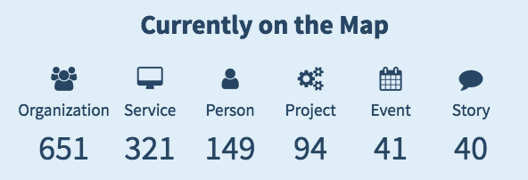
oerworldmap.org
Notes:
What kind of data is included?
Give a short explanation what services are
Point out that the map includes stories as well and that it is a special aspect of the world map architecture that it combines narrative information with data
Announce that we are working on the second level right now, e.g. for stories:
Country Reports
Personal Stories
Policies
Case Studies / Good Practice
Project Reports
Law Cases
Event Documentation

Slide 29
OER World Map: Three Main Use Cases
As an OER actor I would like to find other OER actors and connect with them, so that I can cooperate, coordinate and share resources and knowledge
As a teacher or learner I would like to access qualified, complete and current lists of existing OER offerings, so that I can easily find context-appropriate open resources
As an OER policy maker I would like to get meaningful statistics and overviews on the status of the OER movement in order to take and defend decisions about OER
Notes:
At this stage of the project we could say pretty well, what the project should provide, but not yet, what the OER World Map actually is.

Slide 30
“The OER World Map aims at accelerating the development of the global OER movement by strengthening the ability of the OER community to organize itself.”

Slide 31
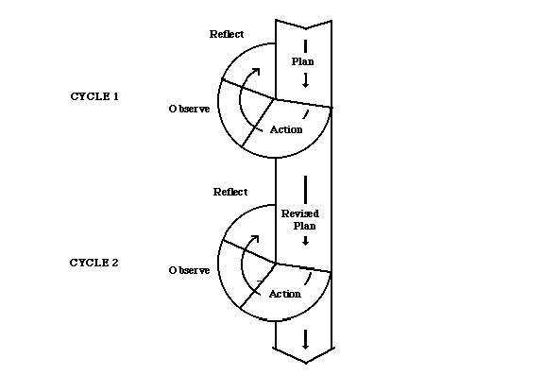
The Open Research Agenda
Blackall & Hegarty (2012:69) identify four key aspects to Participatory Action Research (PAR) which are relevant to the worldwide OER community:
The explicit aim to engage all stakeholders […] in describing the problems
Asking those stakeholders to research the problem and propose solutions
Empowering those stakeholders to carry out their plans
Repeating the cycle, reflecting on lessons learned and publishing the research
Simple Action Research Model
(MacIsaac, 1995)
http://www.slideshare.net/robertfarrow/the-open-research-agenda

Slide 32


OOFAT Models
Through this research we hope to produce an improved understanding of the sustainable business models that will support open and flexible forms of education in the future. According to the acronym of 'OOFAT' it is assumed that these will involve Online, Open, Flexible and Technology-Enhanced methods.
Process:
Collating and systematising a set of between 70 and 100 cases of OOFAT application from around the world
Developing and testing a framework for categorizing these example cases
Producing a synthesis and analysis of current and developing practice based on this framework
We focus on three core aspects of provision:
Content
Delivery
Recognition and assessment

Slide 33

Open Research (2016)
https://openresearch.pressbooks.com/

Slide 34
OER Impact Research: Summary
Notes:
Note that what follows is a summary of the survey data plus the reflections of the various groups from the F2F sessions

Slide 35
Some key findings
 | Educators (n=1125) |  | Formal learners (n=1554) |  | Non-formal learners (n=3151) |  | All responders (N=6046)
 | Count | % | Count | % | Count | % | Count | %
Male | 625 | 55.6 | 845 | 54.4 | 1524 | 48.4 | 3032 | 50.1
Female | 496 | 44.1 | 697 | 44.9 | 1579 | 50.1 | 2947 | 48.7
Transgender | 4 | .4 | 12 | .8 | 48 | 1.5 | 67 | 1.1
There are 180 countries whose citizens report using OER, the highest percentages in the United States (35.3%, n=2236), United Kingdom (19.4%, n=1229), India (3.6%, n=226), Canada (3.3%, n=211), South Africa (2.5%, n=160), Australia (2.3%, n=143) and China (2%, n=125).
Respondents were in general highly qualified, with a majority indicating that they hold a postgraduate (33.3%, n=2035) or undergraduate degree (28.5%, n=1738), and a very small percentage declaring that they have no formal qualification (4.4%, n=266).

Slide 36
Some key findings
37.6% of educators and 55.7% of formal learners say that using OER improves student satisfaction
27.5% of educators and 31.9% of formal learners agree that OER use results in better test scores
79.4% of OER users adapt resources to fit their needs
79.5% of educators use OER to get new ideas and inspiration
8.4% of learners say that the opportunity to study at no cost influenced their decision to use OER
74.9% of informal (non-registered) learners use OER

Slide 37
Some key findings
37.6% of educators and 55.7% of formal learners say that using OER improves student satisfaction
27.5% of educators and 31.9% of formal learners agree that OER use results in better test scores
79.4% of OER users adapt resources to fit their needs
79.5% of educators use OER to get new ideas and inspiration
8.4% of learners say that the opportunity to study at no cost influenced their decision to use OER
74.9% of informal (non-registered) learners use OER

Slide 38
Some key findings
Only 5% of educators say they don’t share information about OER
Yet only 12.4% of educators create resources and publish them on a Creative Commons license
40.9% of all formal learners in our sample consider that OER have a positive impact in helping them complete their course of study
79.6% of formal students think they save money by using OER
31.5% of informal learners say that their interest in using OER is a chance to try university-level content before signing up for a paid-for course
31.3% say their use of OER influenced their decision to register for their current course
83.2% of informal learners say they are more likely to take another free course or study a free open educational resource, and 24.2% say that they would go on to take a paid for course as a result of using OER

Slide 39
Some key findings
Some (general) conclusions:
Implementation of OER can improve student performance, but often indirectly through increased confidence, satisfaction and enthusiasm for the subject
Re-use of OER happens at a large scale, facilitated by open licensing
Using OER encourages reflective practice by educators
Many students used OER informally before registering for formal studies, and continue to use OER to supplement their work
Awareness of OER and Creative Commons is growing, but OER repositories remain relatively unused and unknown compared with other sources of OER like YouTube, Kahn Academy or TED lectures

Slide 40
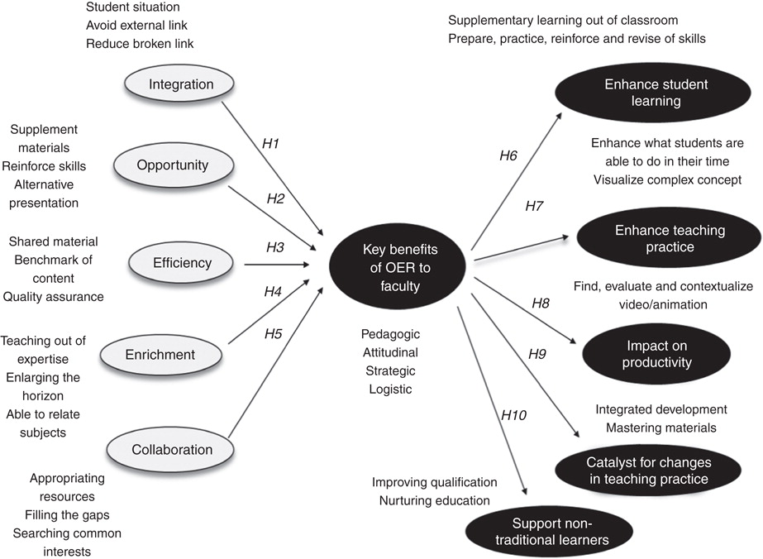
Maximus Gorky Sembiring, (2016) "OER impact study perceived by faculty within ODL framework", Asian Association of Open Universities Journal, Vol. 11 Iss: 1, pp.78 - 89

Slide 41

Thanks for listening!
OER Hub a solid reputation among a community of OER researchers and practitioners as leader, expert, and role model:
Building strong knowledge networks, linking theory and practice
Effect research dissemination and networking through social media
Innovation through openness is central to our approach
Get in touch if you want to know more, or would like to work together
The work of OER Hub has won several awards, including:
ACE Open Research Award (2014)
RCUK/The Open University Engaging Research Award (2015)
ACE Award for Open Education Excellence (2016)

Slide 42
Useful links
Other research groups:
Open Education Group http://openedgroup.org/
ROER4D Project http://roer4d.org/
OER Hub links
OER Hub homepage http://oerhub.net/
OER Hub Twitter https://twitter.com/oer_hub
OER Hub publication list http://oerhub.net/research-outputs/publications/
OER Hub SlideShare http://www.slideshare.net/OER_Hub
Current Projects:
BizMOOC http://bizmooc.eu/
ExplOERer http://www.exploerer.gu.se/
OER World Map https://oerworldmap.org/
OOFAT http://tinyurl.com/OOFATICDE
Opening Educational Practices Scotland (OEPS) https://oepscotland.org/

