Slide 1
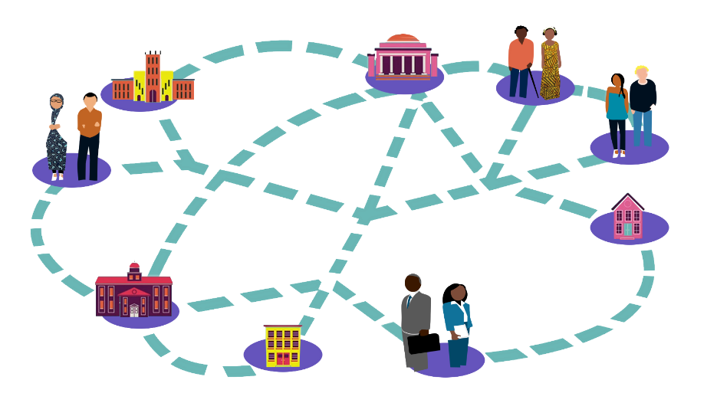
ICEH Open Education webinar series Creating and sharing your own Open Educational Resources May 24th 2017 1-1.45pm UCT
Find out more about the ICEH Open Education programme and webinars
http://iceh.lshtm.ac.uk/oer/
Improving health worldwide
Improving health worldwide
www.lshtm.ac.uk
www.lshtm.ac.uk

Slide 2
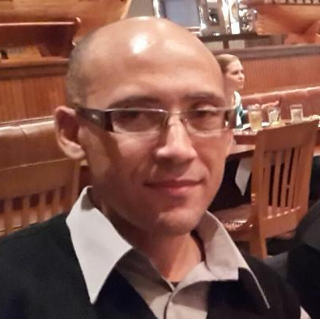
Welcome!
Ms Sally Parsley (Host) Technical lead, Open Education Programme, ICEH, LSHTM, UK
Dr Glenda Cox Senior lecturer, Centre for Innovation in Learning and Teaching, University of Cape Town, South Africa
Mr Gregory Doyle Education technologies manager, Faculty of Health Sciences, University of Cape Town, South Africa
Q&A

Slide 3
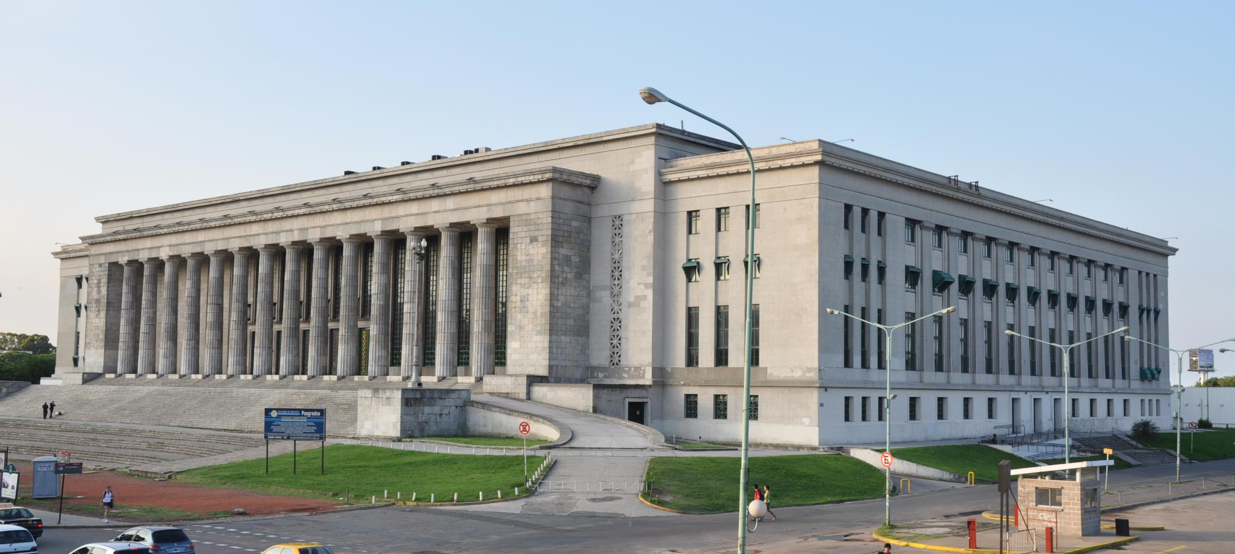
Philosophy of Open: “Knowledge is a public good”
Open Education: Reducing barriers to participation
Notes:
Open Education initiatives have occurred around the world. For example, in third level or Higher Education:
.
The University of South Africa, (UNISA) has offered distance learning to all (even during apartheid) since the end of the Second World . It currently has 330,000 students enrolled
Image: Jorge Láscar from Australia School of Law - University of Buenos Aires. CC By https://www.flickr.com/photos/8721758@N06/4729499370

Slide 4
Open Education Resources (OER)
OER are educational materials with an open copyright license which allows anyone to use, reuse, and redistribute them for free and without asking for permission.
Open courses are free to access, online courses which have OER contents (sometimes!)
Examples of OER materials
an open copyright license

Slide 5
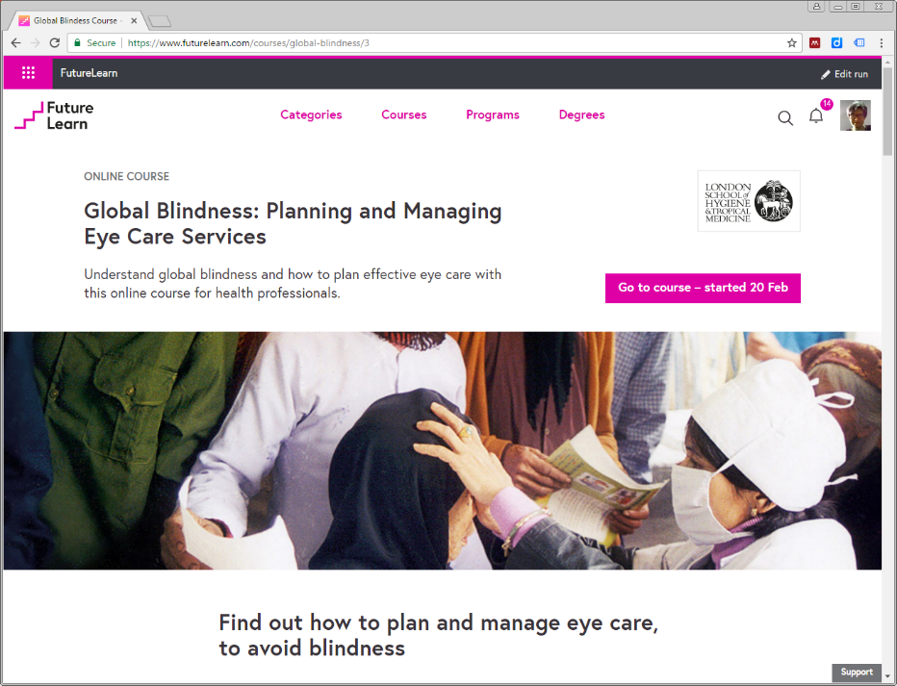
ICEH & OER
In 2014 ICEH created its 1st Open course using OER. Since then:
>6,000 participants in “Global Blindness: Planning and managing eye care services”
Global Blindness course and OER materials have been adapted by educators in many countries for re-use in their own contexts
ICEH is developing 7 more Open courses in key public health eye care topics
ICEH Open course

Slide 6
ICEH Open courses
Current Open courses
Coming soon
Diabetic eye disease - end of 2017
Retinopathy of prematurity – 2018
Research methods in ophthalmology - 2018
Glaucoma – 2019
Global blindness
Ophthalmic epidemiology 1 & 2
Eliminating trachoma

Slide 7
Dr Glenda Cox Senior lecturer, Centre for Innovation in Learning and Teaching, University of Cape Town, South Africa
Mr Gregory Doyle Education technologies manager, Faculty of Health Sciences, University of Cape Town, South Africa

Slide 8
Q&A
Ms Sally Parsley (Host) Technical lead, Open Education Programme, ICEH, LSHTM, UK
Dr Glenda Cox Senior lecturer, Centre for Innovation in Learning and Teaching, University of Cape Town, South Africa
Mr Gregory Doyle Education technologies manager, Faculty of Health Sciences, University of Cape Town, South Africa

Slide 9
Thanks to our funders
Find out more Register for ICEH Open courses and download our webinars
http://iceh.lshtm.ac.uk/oer
Be informed about new ICEH Open courses Sign up to the ICEH email list at http://iceh.lshtm.ac.uk/

Slide 10
© 2017 International Centre for Eye Health, London School of Hygiene & Tropical Medicine. Unless otherwise stated, content is licensed under the Creative Commons Attribution Non-Commercial Share-Alike 4.0 International License https://creativecommons.org/licenses/by-nc-sa/4.0
We encourage the re-use, adaptation and sharing of this material for teaching and learning. Find more eye care Open Educational Resources at http://iceh.lshtm.ac.uk

