Slide 1
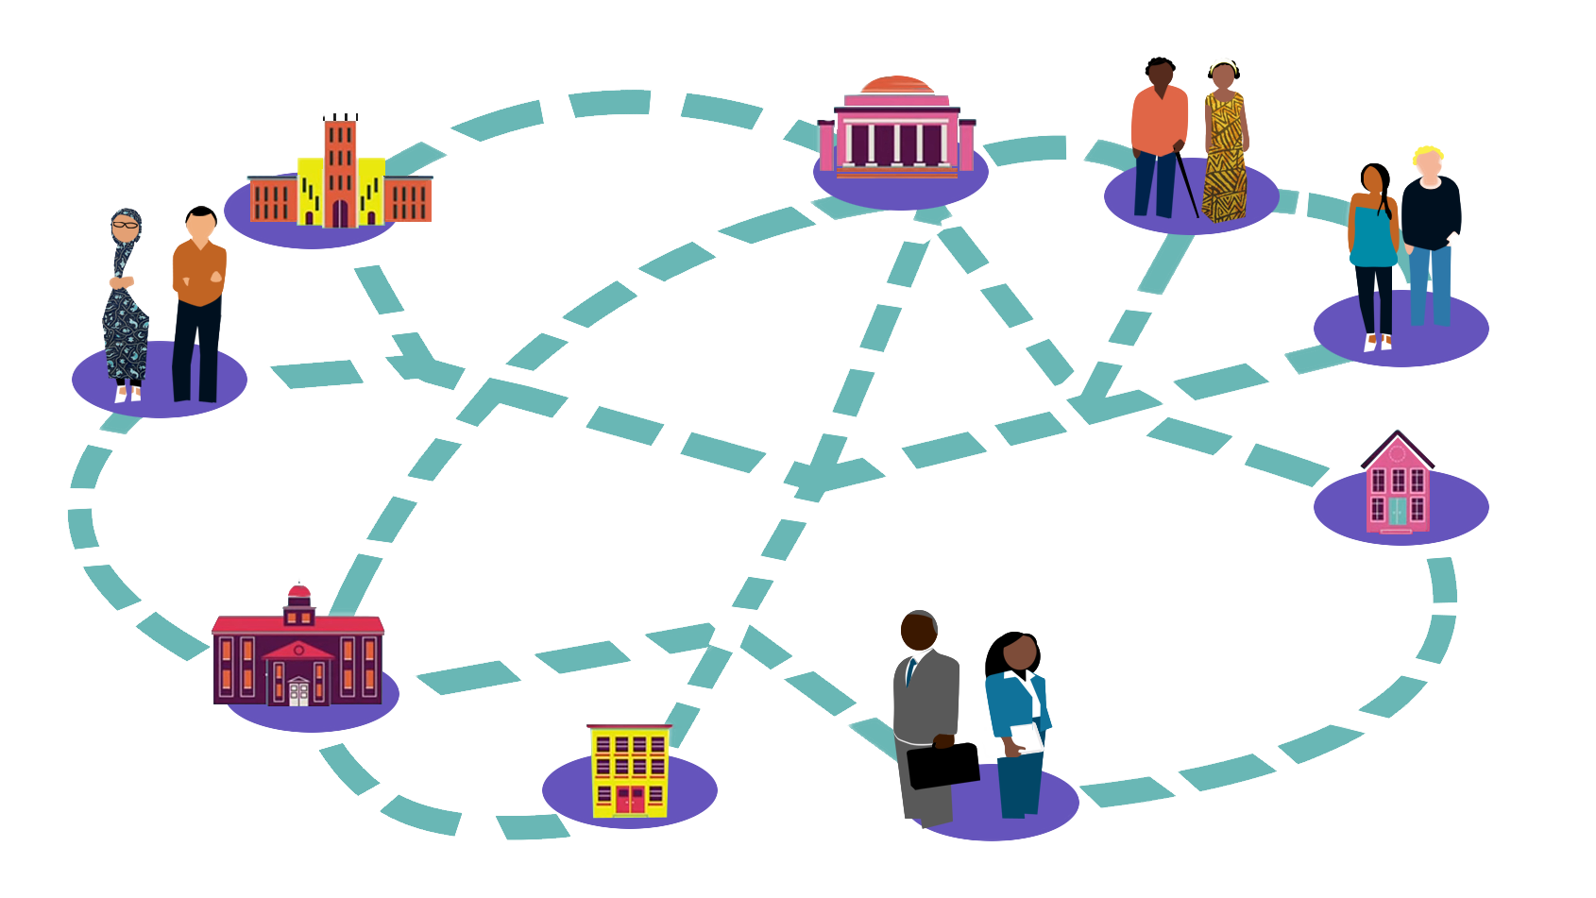

ICEH Open Education webinar series
Where to find and how to use Open courses
March 15th 2017 1-1.45pm UCT
Find out more about the ICEH Open Education webinar series: http://iceh.lshtm.ac.uk/oer/webinars/
Improving health worldwide
Improving health worldwide
www.lshtm.ac.uk
www.lshtm.ac.uk

Slide 2



Welcome!
Overview
Welcome & introductions
Presentation 1. Find and using Open online courses
Jo Stroud
Presentation 2. Demystifying copyright
Astrid Leck
Q & A
Ms Sally Parsley (Host)
Technical lead, Open Education Programme, International Centre for Eye Health, LSHTM
Ms Joanna Stroud
E-learning Manager, LSHTM
Dr Astrid Leck
Research Fellow, LSHTM

Slide 3
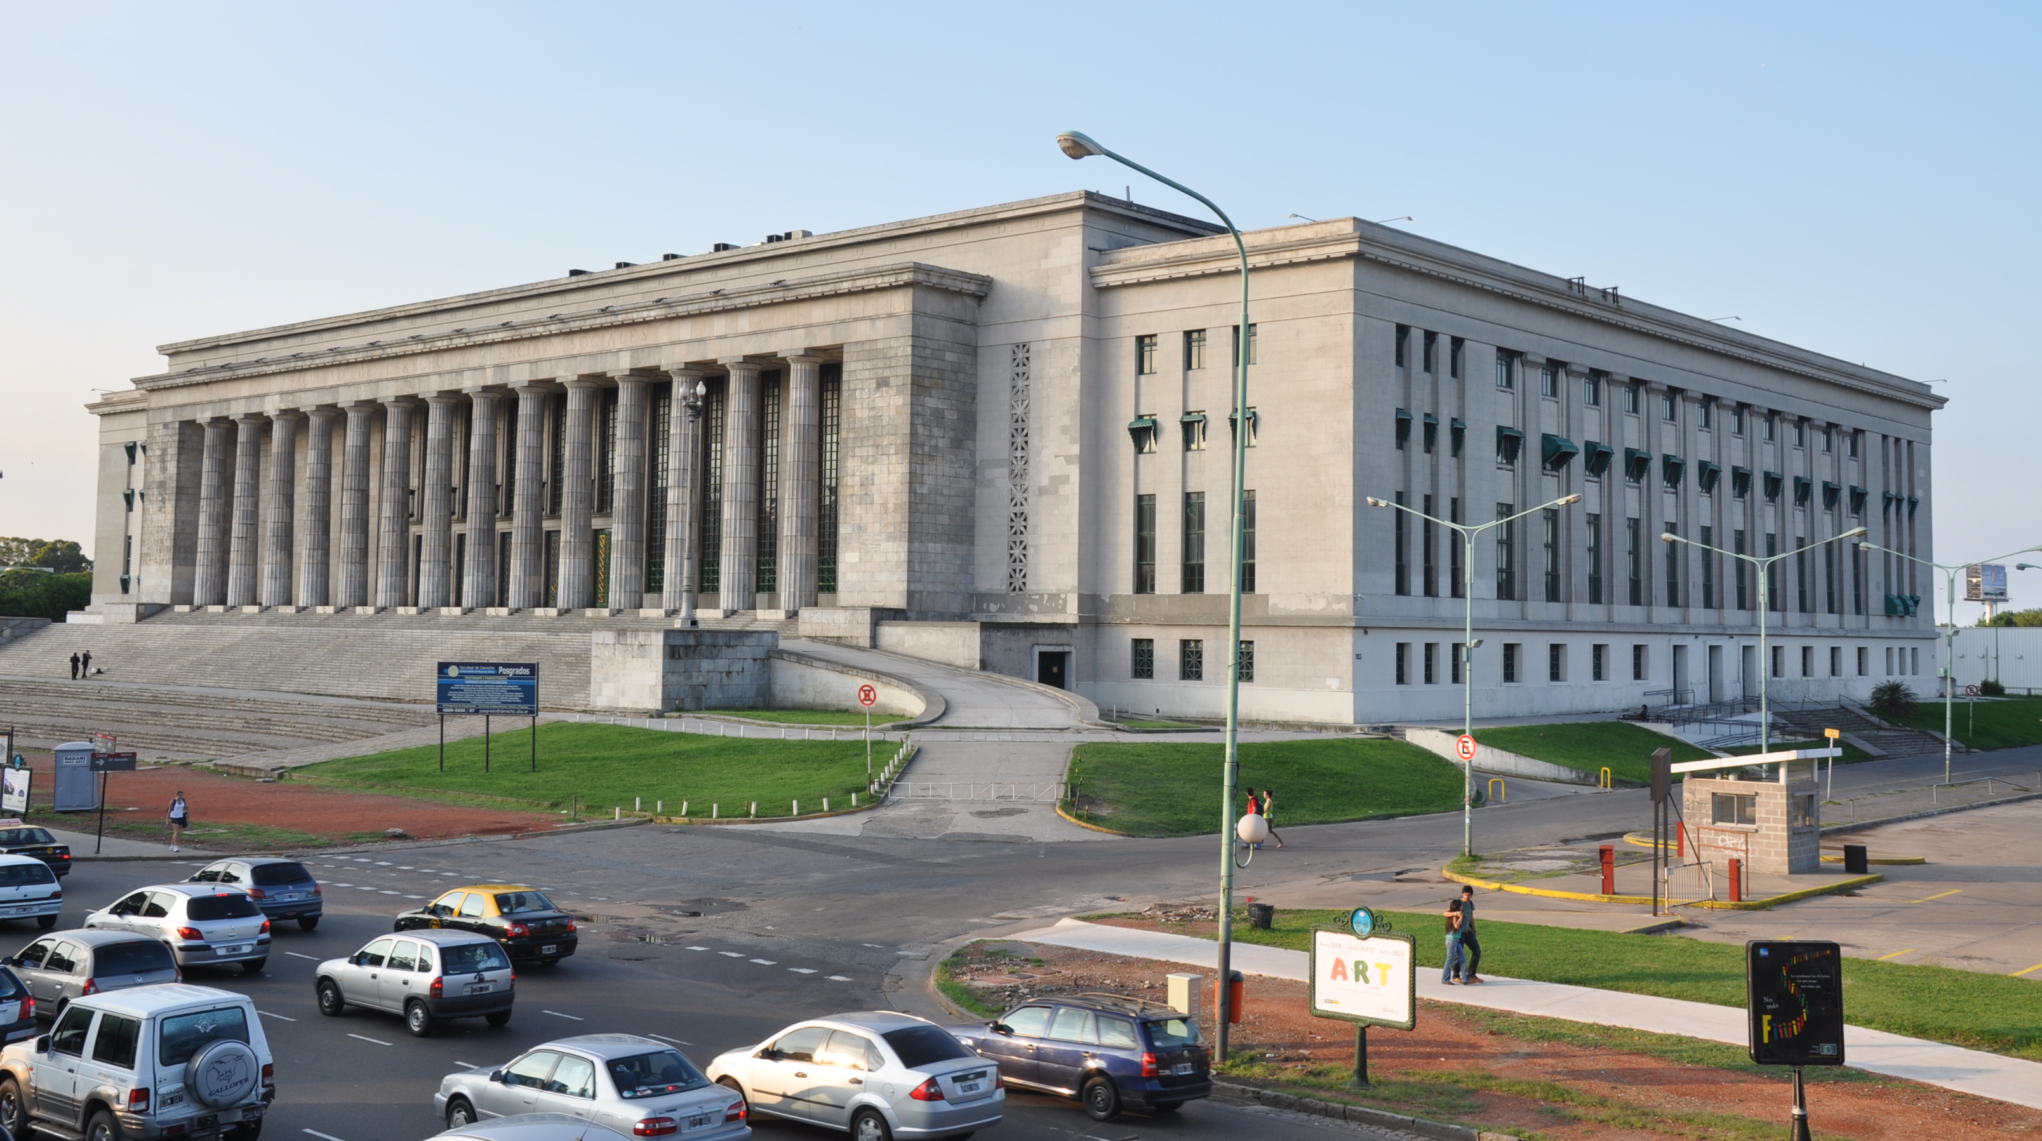

What is Open Education?
Open Education is about reducing barriers to participation in education and learning
Open Education has a long history!
Open Education uses technology but is also about cultural issues
Increasing recognition that, globally, education is being transformed. Open Education can play a significant role.
Open Education Resources are digital materials (e.g. video, quiz, book, photo) which anyone can use, reuse, and redistribute for free and without asking for permission.

Slide 4
Finding and using Open courses
Ms Joanna Stroud
E-learning Manager, LSHTM

Slide 5

Navigating terminology
Lots of terminology bound within “open education”
Open educational resources (OER)
Open Courseware (OCW)

Slide 6
Navigating terminology
Lots of terminology bound within “open education”
Open educational resources (OER)
Open Courseware (OCW)
Open courses
Open Access (OA) research

Slide 7
Open Educational Resources (OER) and Open CourseWare (OCW)
Open Education Consortium (http://www.oeconsortium.org/)
MERLOT (https://www.merlot.org)
OER Commons (https://www.oercommons.org/)

Slide 8
Open Educational Resources (OER) and Open CourseWare (OCW)
OpenCourseWare at the Johns Hopkins Bloomberg School of Public Health (http://ocw.jhsph.edu)
OpenLearn from the Open University (http://www.open.edu/openlearn/)
African Health OER Network (http://www.oerafrica.org/healthoer)

Slide 9
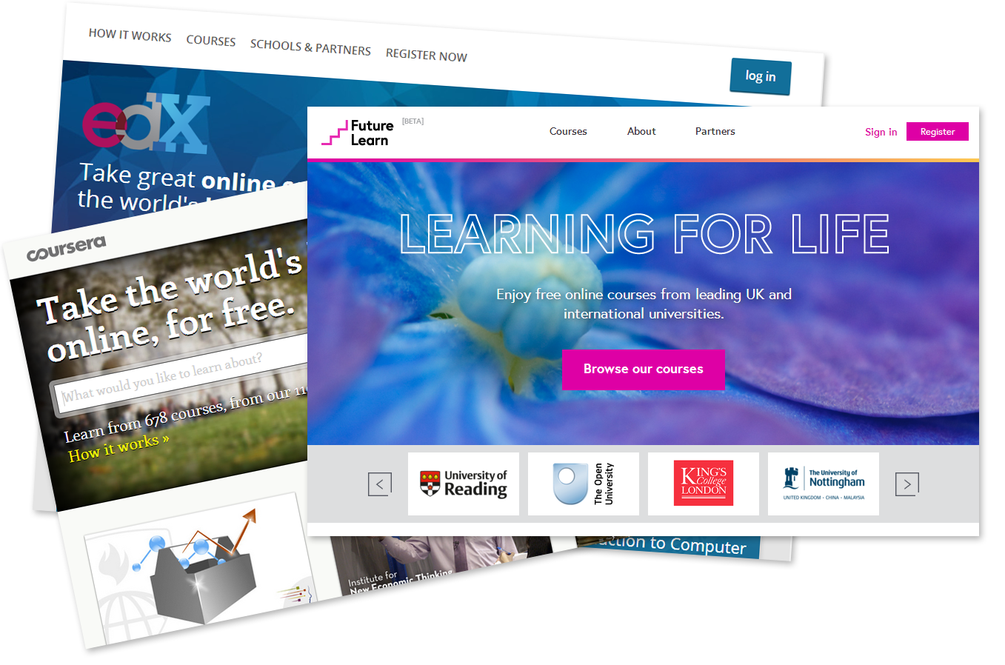
Open courses
Massive open online courses (MOOCs) – Commercial platforms
FutureLearn
Coursera
EdX

Slide 10
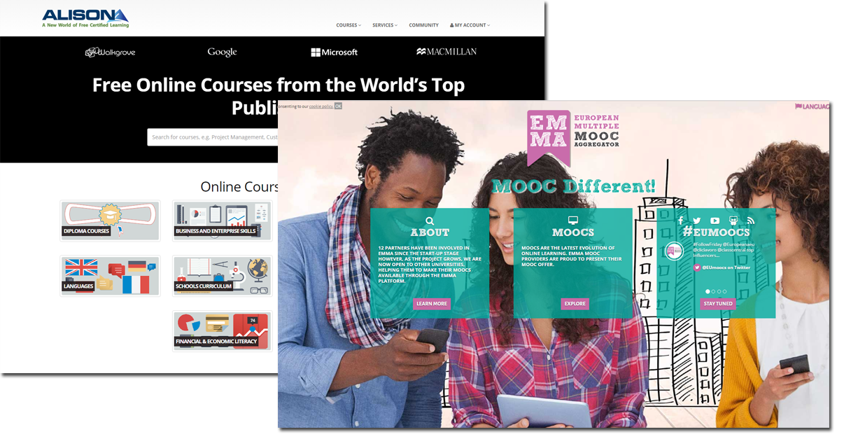
Open courses
EMMA (https://platform.
europeanmoocs.eu/)
ALISON (https://alison.com/)

Slide 11
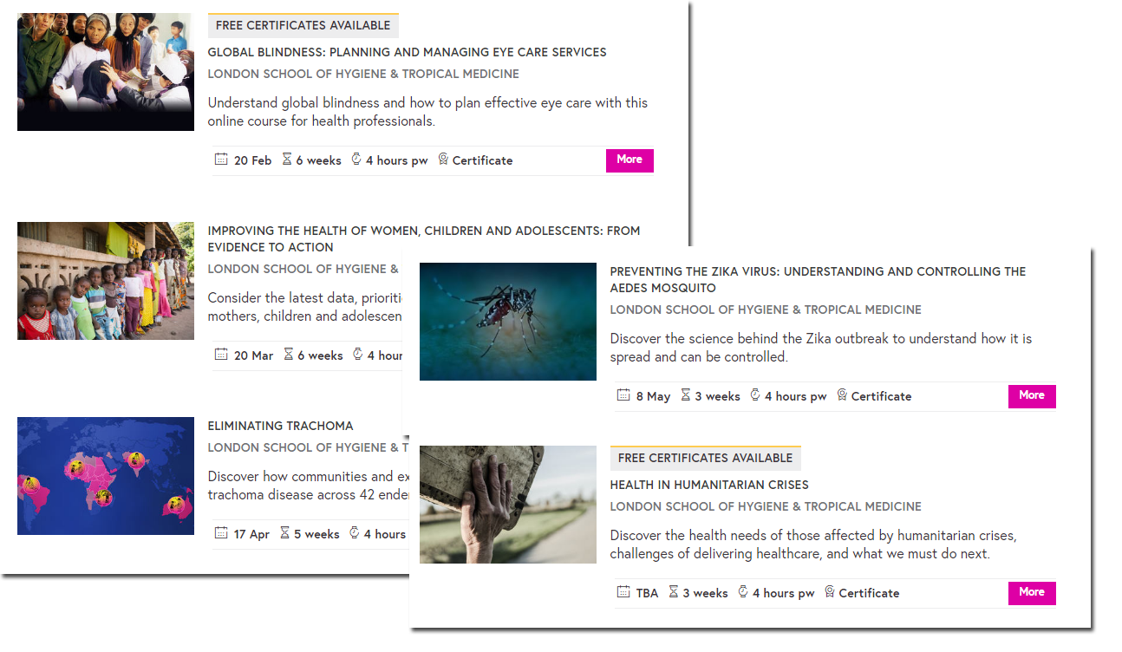
Open education at LSHTM
Delivery of open courses in partnership with FutureLearn
www.Futurelearn.com

Slide 12
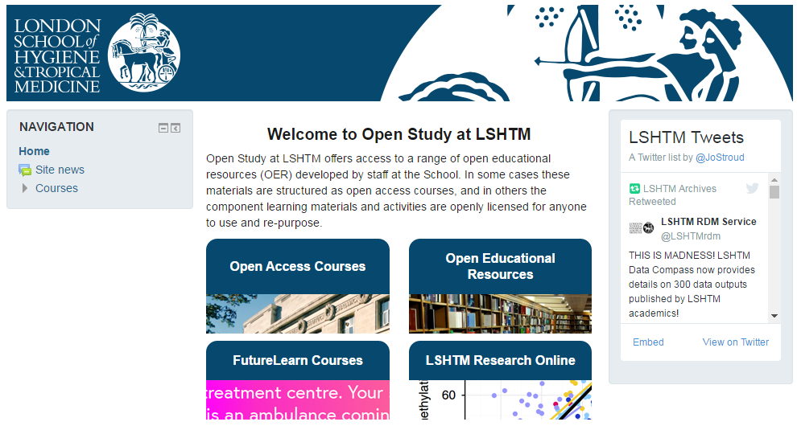
Open education at LSHTM
Our Open Study platform
http://open.lshtm.ac.uk

Slide 13
Demystifying copyright
Dr Astrid Leck
Research Fellow, LSHTM

Slide 14
Demystifying copyright
Understanding copyright - what it means for content development (resource use and re-use)
Using creative commons licenses - selection and terms of engagement
Improving health worldwide
www.lshtm.ac.uk

Slide 15
Understanding copyright – Use of resources
“Normal” practice:
When including direct quotations, images and data (photographs, figures, tables, excerpts from published sources) you must provide the following details:
    Source (including weblink, where applicable)
    Full reference (if the source is from a published article or document)
    Date the source was accessed
    Copyright status (permission details)
Copyright © confers robust protection so that others do not use your work without your permission

Slide 16
MOOCs and Open Courses
The ethos behind the Open Courses which we have developed is to provide a “one-stop” interactive resource which is widely accessible; a high quality learning opportunity which can then applied in practice and for further training
To achieve this the content needs to be free of copyright restrictions to enable the user to freely re-use and adapt the content, to legally use, share, repurpose and remix content for teaching & learning
What we want to do…
Use copyright-free, high quality images to illustrate study material
Use images and data which can be freely distributed and shared in preference to sources which are not “open-access” or copyright-free so we use Creative Commons…

Slide 17

“Creative Commons is a global not-for-profit organization that enables sharing and reuse of creativity and knowledge through the provision of free legal tools”
“Our legal tools help those who want to encourage reuse of their works by offering them for use under generous, standardized terms; those who want to make creative uses of works; and those who want to benefit from this symbiosis. Our vision is to help others realize the full potential of the internet.”
“A Creative Commons (CC) license is one of several public copyright licenses that enable the free distribution of an otherwise copyrighted work. A CC license is used when an author wants to give people the right to share, use, and build upon a work that they have created.”

Slide 18
What is the difference between Creative Commons and Copyright?
Creative Commons is actually a license that is applied to a work that is protected by copyright
It is not separate from copyright, instead it is a way of easily sharing copyrighted work
Creative Commons licensing structures can be used to license copyrighted work to anyone willing to abide by the licensing terms
It makes it easy to share work without giving up total control or spending hours granting permissions

Slide 19





Licensing types
Attribution — must give appropriate credit, provide a link to the license, and indicate if changes were made. You may do so in any reasonable manner, but not in any way that suggests the licensor endorses you or your use.
NonCommercial — You may not use the material for commercial purposes.
No derivatives — You let others copy, distribute, display and perform only original copies of your work. If they want to modify your work, they must get your permission first.
ShareAlike — If you remix, transform, or build upon the material, you must distribute your contributions under the same license as the original.
No additional restrictions — You may not apply legal terms or technological measures that legally restrict others from doing anything the license permits.

Slide 20
Why Creative Commons for Open Education?
Discussion on the type of license for our first course “Planning for Eye Care” resulted in agreement that we should look to apply for an:
Attribution-NonCommercial-ShareAlike CC BY-NC-SA
This license lets others remix, tweak, and build upon your work non-commercially, as long as they credit you and license their new creations under the identical terms
Which means the user is free to:
Share — copy and redistribute the material in any medium or format
Adapt — remix, transform, and build upon the material*
*The licensor cannot revoke these freedoms as long as the license terms are followed.

Slide 21
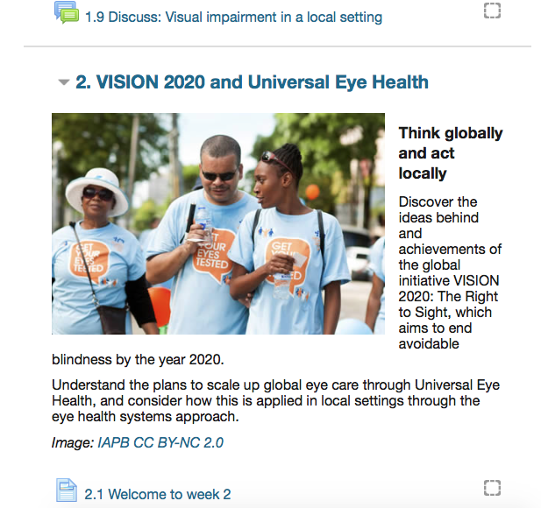
This is an example of attribution:
“VISION 2020 by IAPB is licensed under CC BY-NC 2.0
Because…
Title? “VISION 2020 and Universal Eye Health”
Author? “IAPB”
Source? “VISION 2020 by IAPB” – linked to original Flickr page
License? “CC BY-NC 2.0” – linked to license deed

Slide 22
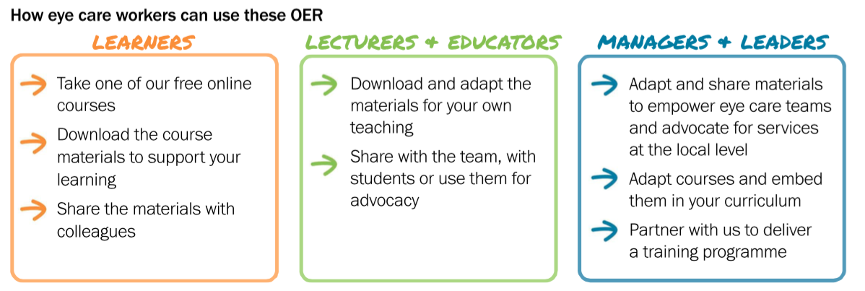
© - How can resources be used?
For Future Learn & OER courses:
Users need to be free to reuse the material without restriction/seeking permission
Obvious benefits for training institutions with whom we work in association with, as well as those we do not know personally
Allows the user to be able to reuse the material as they please

Slide 23
Q&A
Ms Sally Parsley (Host)
Technical lead, Open Education Programme, International Centre for Eye Health, LSHTM
Ms Joanna Stroud
E-learning Manager, LSHTM
Dr Astrid Leck
Research Fellow, LSHTM

Slide 24





Thanks to our funders
Join us next time
Using OER to support local training and capacity building
April 19th 2017 (1-1.45pm UCT)
http://bit.ly/2n9A48K
Find out more about the ICEH Open Education programme: http://iceh.lshtm.ac.uk/oer/

Slide 25

© 2017 International Centre for Eye Health, London School of Hygiene & Tropical Medicine.
Unless otherwise stated, content is licensed under the Creative Commons Attribution Non-Commercial Share-Alike 4.0 International License https://creativecommons.org/licenses/by-nc-sa/4.0
We encourage the re-use, adaptation and sharing of this material for teaching and learning. Find more eye care Open Educational Resources at http://iceh.lshtm.ac.uk

