Slide 1
Using OER to support capacity building and training
Lessons from OER adaptation for COECSA
Dr Nyawira Mwangi

Slide 2

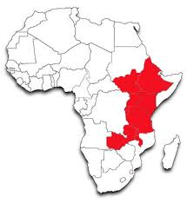
The Great Rift Valley

Slide 3
Opportunities for learning
Access
Participation
Enabling environment
Remove barriers to these aspects of education

Slide 4
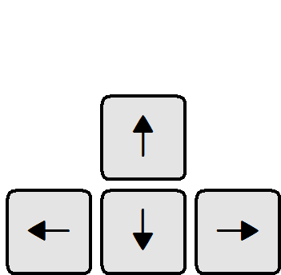
Four questions about adaptation of OER
1 What is the need?
2. What are the options?
3. What are the opportunities?
4. What are the potential barriers/challenges?

Slide 5
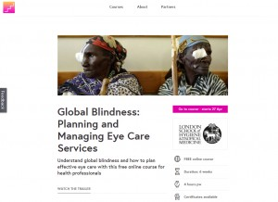
Need
Contextualize for

Slide 6
Need - target
Program officers
Students
Ophthalmic nurses
Ophthalmic clinical officers
Optometrists
Refractionists
Ophthalmic assistants
Non-physician Cataract surgeons
Ophthalmologists
Educators

Slide 7
Options
Course name
Scope and objectives
Sequence of modules
Technical content
Assessments
Time requirements
Language
Flexibility
Self-directed learning
No change

Slide 8
1. Lead educator
2. Some photos
3. Additional video
4. Narration
5. Case studies
Purpose: to contextualise the material so that it reflects the users’ circumstances
What was Changed?

Slide 9

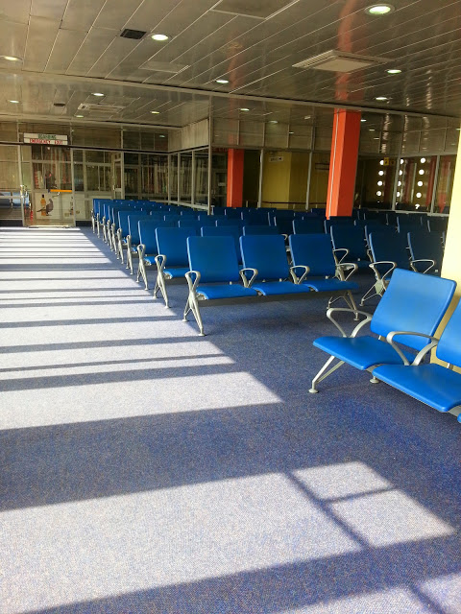
Opportunities
Open licencing
Prior opportunity for active participation in the course
Ease of download + good quality materials
Institutional support
Technical expertise
Collaboration
Funding
Understanding the needs of local users

Slide 10

Potential challenges
Investment-intensive: cost, time, rigour, technology
Quality assurance
Social barriers- digital literacy
Assumptions: The process is not linear
Reaching the target users
Software

Slide 11





Take home
Planning
1
2
3
Technical expertise
Collaboration
Pilot test
Push/ Pull
Champions
Expect surprises

Slide 12






Acknowledgement

Slide 13
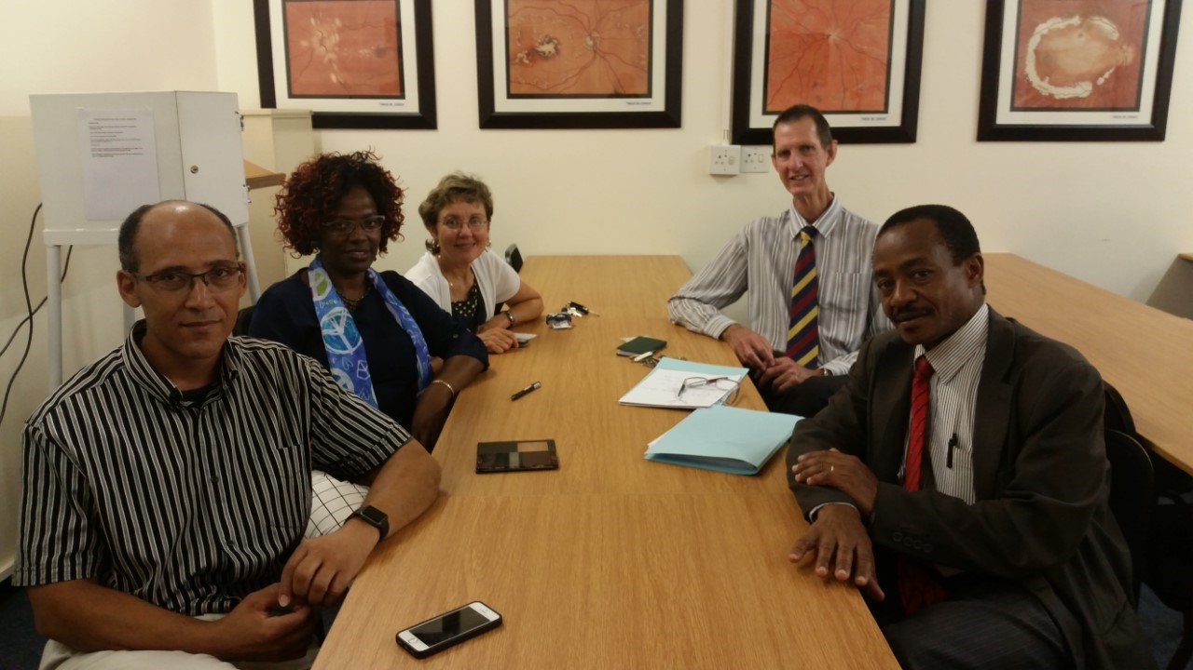
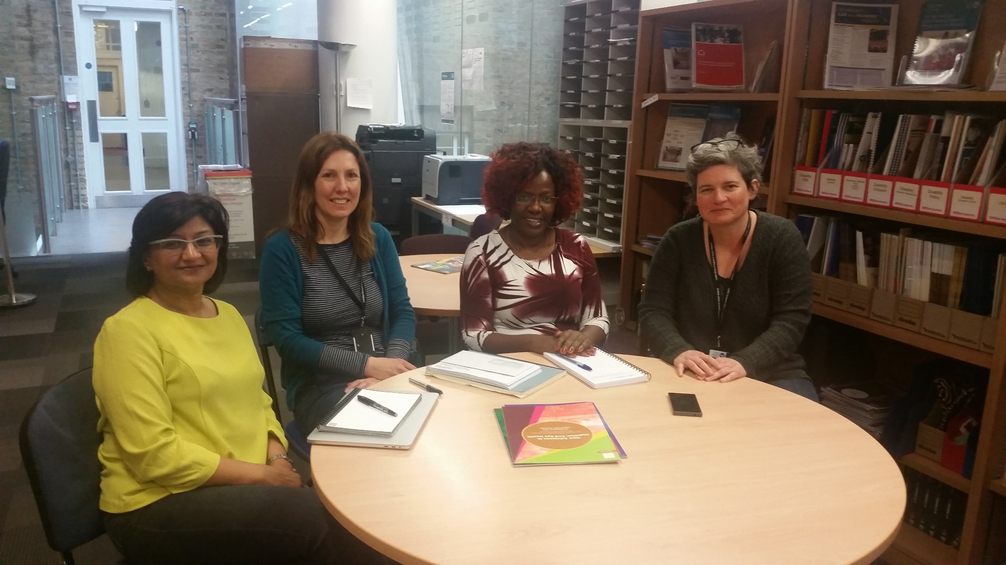
Asante sana…

