Slide 1
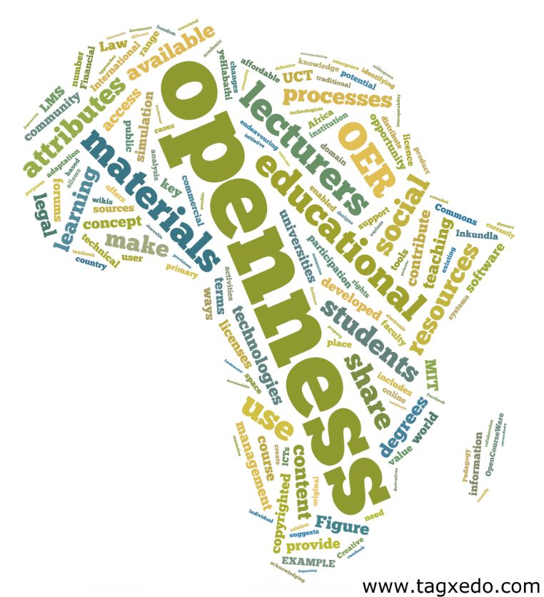
Open Educational Resources
Greg Doyle
University of Cape Town
Part of a webinar series presented by:

Slide 2
Institutionally
CILT
Open Educations Resources
CC awareness
LIBRARY
Open Access
IP LAW
Creative Commons
Support from RCIPS
Repository help and moderation
ROER4D
OER @ Healh Sci @ UCT
2008 CT Open Edu Decl
2011 Berlin Decl
2014 UCT Open Policy
2010 Open Content
2014 Open UCT

Slide 3
Raise OER awareness and interest
(seminars & w/s)
Source content
(volunteers)
Clear copyright & package content
Review OER (internal)
Publish & Publicize OER (repository)

Slide 4
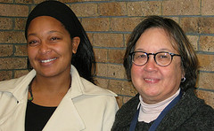
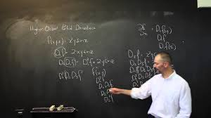
Enabling factors
Collegium culture
Loose institutional policy definition
Innovation at the level of the individual or department.
Individual agency/ control
Maximum flexibility
Champions at different levels
“I’m honoured to announce that I have been awarded the Open CourseWare Consortium 2014 Award for the category Individual Educator for my work on open education.
Previous award winner, Walter Lewin, Physicist at MIT, has been an inspiration and hero of mine and to be a recipient of the same award, is a truly humbling experience for me” http://www.juanklopper.com/

Slide 5
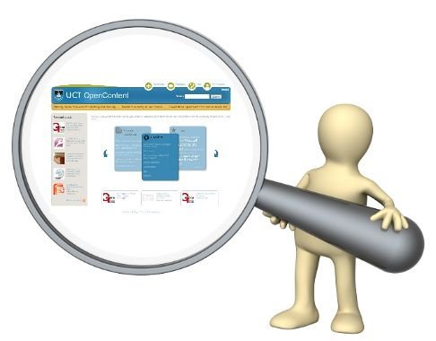
Why?
For departments / units
For individuals
Increase institutional visibility,, attracting students and resources
Promote effective social responsiveness
Improve learning experience by selecting in pedagogically materials
Improve recruitment - helping the right students find the right programmes
Enhance teaching coherence across courses
Ensure better archiving, curation and reuse of teaching materials
Attract alumni as life-long learners
Profile teaching and pedagogical idea sharing
Create record of teaching for teaching portfolio
Foster connections between other colleagues, departments and even other universities
Increase impact of teaching materials
Extend use of teaching materials to high school learners and life-long learners

Slide 6
Questions academics ask
Where will I find time?
What licensing options are there?
Were will I publish it?
How must I package it?
Who will pay for my time?
Where do I find the information?
What software do I need to know
Are my material being downloaded?

Slide 7
Raise OER awareness and interest
(seminars & w/s)
Source content
(volunteers)
Clear copyright & package content
Review OER (internal)
Publish & Publicize OER (repository)
Web Content Developer
Notes:
Web Content Developer

Slide 8
A good OER
findable – it can be in multiple locations
clearly described
clearly licensed (normally through Creative Commons)
from a source you trust
easy to modify
free-standing – it does not assume knowledge of other resources
free of copyright content
being used by/recommended by people like you
not necessarily perfect – it just needs to work for you.

Slide 9
Resource-based approach
Includes:
Entire courses
Individual resources
e-books
Manuals
Presentations
Podcasts
Lecture notes
Animations

Slide 10
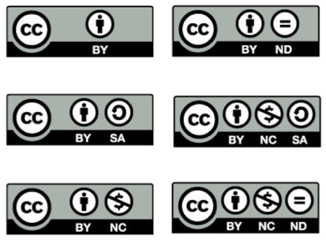
The licenses
Free
No Registration
Non Exclusive
Non Revocable
Operates in Perpetuity

Slide 11
Content – HTML based

Slide 12
Content – Articulate Storyline

Slide 13
Raise OER awareness and interest
(seminars & w/s)
Source content
(volunteers)
Clear copyright & package content
Review OER (internal)
Publish & Publicize OER (repository)
Notes:
Web Content Developer

Slide 14
Individualised approach
Decentralised uploading
Individual academics upload and maintain their resources directly
Pride of authorship
Quality assurance with the individual
Minimal moderation
Copyright compliance
Quality assurance part of broader teaching and learning systems, not separate
UCT Libraries

Slide 15
Raise OER awareness and interest
(seminars & w/s)
Source content
(volunteers)
Clear copyright & package content
Review OER (internal)
Publish & Publicize OER (repository)
Notes:
Web Content Developer

Slide 16
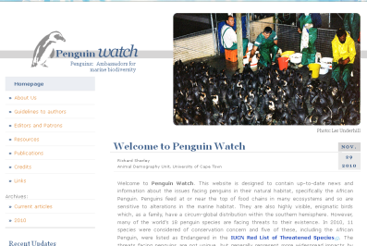
Hosting

Slide 17
How are we found?

Slide 18
Finding OER - reuse

Slide 19
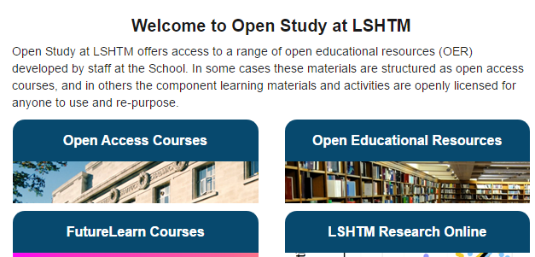
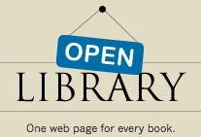
Finding OER - Reuse
Notes:
http://oerqualityproject.wordpress.com/2012/10/22/directory-of-oer-repositories/
http://www.oerafrica.org/african-teacher-education-oer-network-aten/saide-teacher-education-series
- The aim of the Saide ACEMaths project was to pilot a collaborative process for the selection, adaptation and use of OER materials for teacher education programmes in South Africa. A research article on the project entitled Collaborative Design and Use of Open Educational Resources: A Case Study of a Mathematics Teacher Education Project in South Africa by Ingrid Sapire and Yvonne Reed was published in Distance Education vol. 32 no. 2 August 2011.
--------------
http://www.flickr.com/ - This site has a wide variety of both full copyrighted and Creative Commons licensed images. Check each image for the attached usage restriction and make to properly attribute the author in the case of Creative Commons. Provide the title of the image (found directly below the image), provide the username of the user (found in upper right hand corner) and the license (located on the right hand side below tags and above the privacy section. Also remember to provide hyperlinks to the page where you found the image.
To search specifically for Creative Commons: http://www.flickr.com/creativecommons/
To search specifically through public photo collections: http://www.flickr.com/creativecommons/
Site copyright/IP policy: http://info.yahoo.com/copyright/us/details.html
-------
http://openattribute.com/ - This add-on displays license and attribution information for Creative Commons licensed content – it is supported in Chrome, Firefox and Opera browsers.
Firefox: https://addons.mozilla.org/en-US/firefox/addon/openattribute/?src=search
Opera: https://addons.opera.com/en/addons/extensions/details/open-attribute/1.5/?display=en
Chrome: https://chrome.google.com/webstore/detail/ohkidpebfeojnggafnkbafjpagnkgjak
There is also a Open Attribute Wordpress plugin that will allow users to enter licensing information for their blog posts. Get it at http://wordpress.org/extend/plugins/openattribute-for-wordpress/. There is also a Drupal module for this tool, available here http://drupal.org/node/1154150
------------
http://commons.wikimedia.org/wiki/Main_Page - This site hosts a collection of media files that are either licensed in terms of Creative Commons or available as public domain works. Check each image for the license attached to the work and for author information. Site terms and conditions: http://wikimediafoundation.org/wiki/Terms_of_Use
---------

Slide 20
Finding OER
Video | Images | Search Engines | Sounds | Other
Academic Earth Medicine | DryIcons | Google Advance | Free Sound | Feedbook
Khan Academy | Hardin MD Medical | FlickrStorm | Free Loops | SourceForge
Open Video Project | BioDadic | Tag Galaxy |  | Browne Sharpe
 | Public Health Image Library | CompFight |  | BitStrips
Notes:
Images
DryIcons
Hardin MD Medical Gallery
BioDadic
Public Health Image Library
Wellcome Images
Alegri Photos
4 Free Photos
PicDrome
Pixabay

Slide 21
Summary
CHALLENGES
APPROACH
Unaware of OER
Sustainability
Culture of not sharing
Teaching 2nd to research
Labour intensive
Inadequate & part time staff
Not including students
Awareness & advantages
Encourage lecturers
Revised Policy
Self-help, manuals, 1-many
Full time technology expert
Proposals

Slide 22
References
Open Educational Resources at the University of Cape Town – CH Williams
Clearing Copyright & Using Open Images - Shihaam Donnelly
Finding Open Stuff for Health Sciences – Shihaam Shaik
Riding the information Tiger - Tony Carr
Open solutions to a ‘national crisis’: The impact of OER on teacher-education in India - Dr Leigh-Anne Perryman
From Project to Mainstream in a constrained environment: Towards openness at the University of Cape Town. Laura Czerniewicz, Gregory Doyle, Glenda Cox & Cheryl Hodgkinson- Williams
Open Education. Why it matters to South Africa. Laura Czerniewicz
Some of the slides were created by Michael Paskevicius : mike.vicious@gmail.com
Other slides by Sarah Goodier, Cheryl Hodgkinson-Williams and Shireen Davis-Evans
OpenUCT repository - https://open.uct.ac.za/
Roer4D website: http://roer4d.org/

