Slide 1
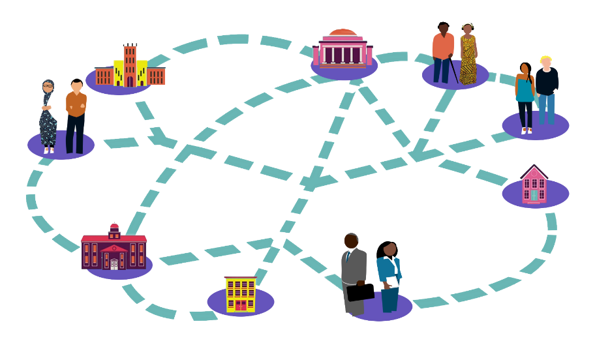
ICEH Open Education webinar series Using Open Education to support local training and capacity building April 19th 2017 1-1.45pm UCT
Find out more about the ICEH Open Education programme and webinars
http://iceh.lshtm.ac.uk/oer/
Improving health worldwide
Improving health worldwide
www.lshtm.ac.uk
www.lshtm.ac.uk

Slide 2
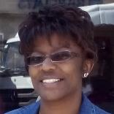
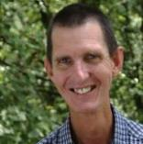
Welcome!
Ms Sally Parsley (Host) Technical lead, Open Education Programme, ICEH, LSHTM
Dr Nyawira Mwangi Principal Lecturer, Kenya Medical Training College/Ministry of Health, Kenya Research fellow, LSHTM
Professor Colin Cook Mauerberger Chair of Ophthalmology, UCT Head: Division of Ophthalmology, Groote Schuur Hospital and Red Cross Children’s Hospital
Q&A

Slide 3
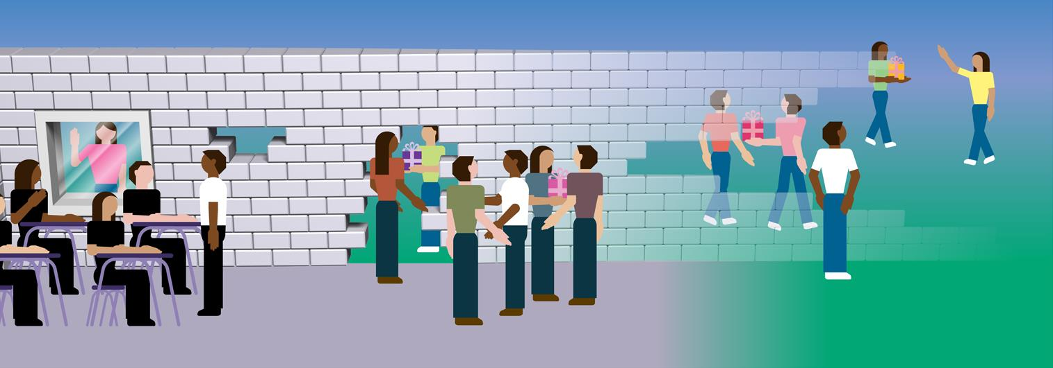
Open Education is about reducing barriers to participation in education and learning
Notes:
Open Education is about reducing barriers to participation in education and learning.
Open Education bridges the gap between formal and informal learning
Alec Couros CC BY NC SA https://creativecommons.org/licenses/by-nc-sa/2.0/ https://flic.kr/p/61Wi9g

Slide 4
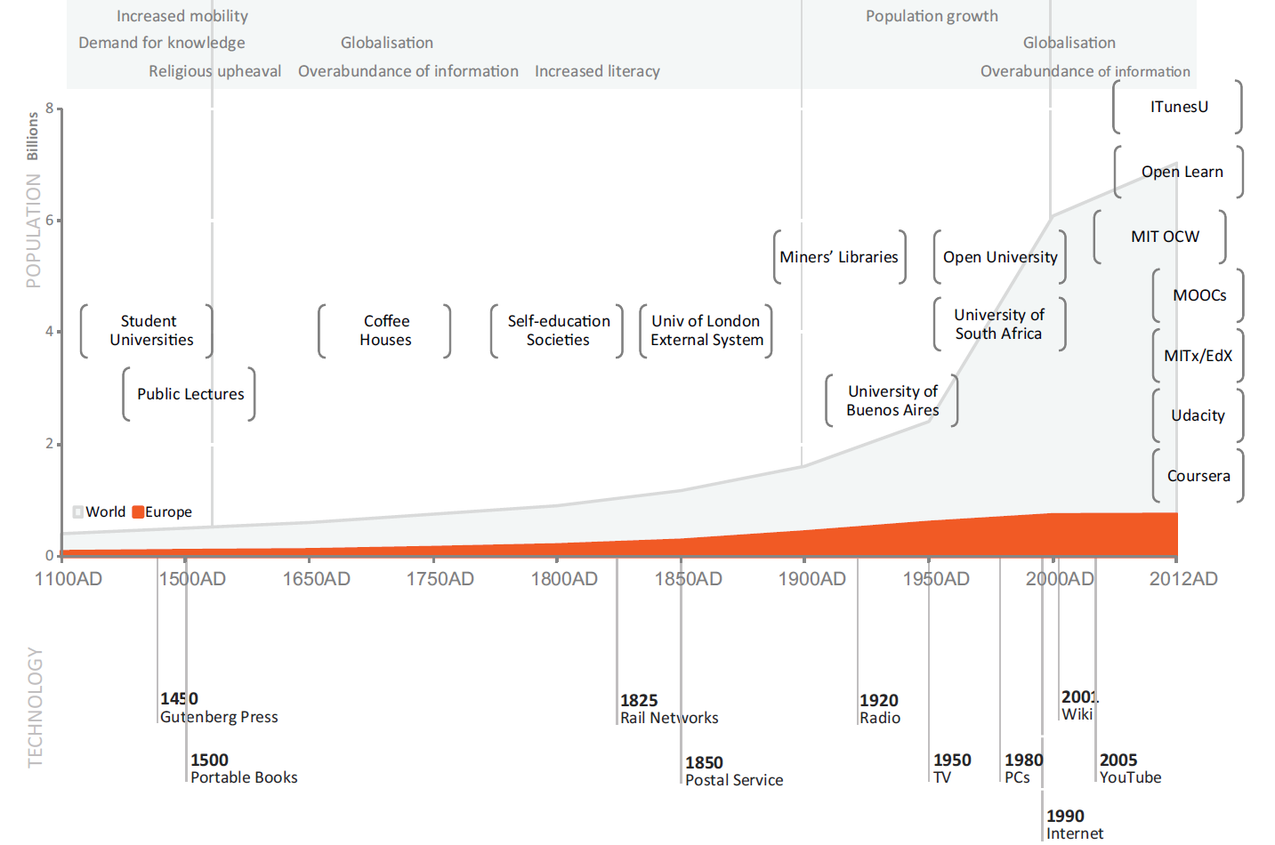
http://openpraxis.org/index.php/OpenPraxis/article/view/23/pdf
Open Courses are free to anyone to register and participate in online
‘On the role of openness in education: A historical reconstruction’ (Peter & Diemann, 2013)
Notes:
‘On the role of openness in education: A historical reconstruction’ Peter & Diemann (2013)
http://openpraxis.org/index.php/OpenPraxis/article/view/23/pdf

Slide 5
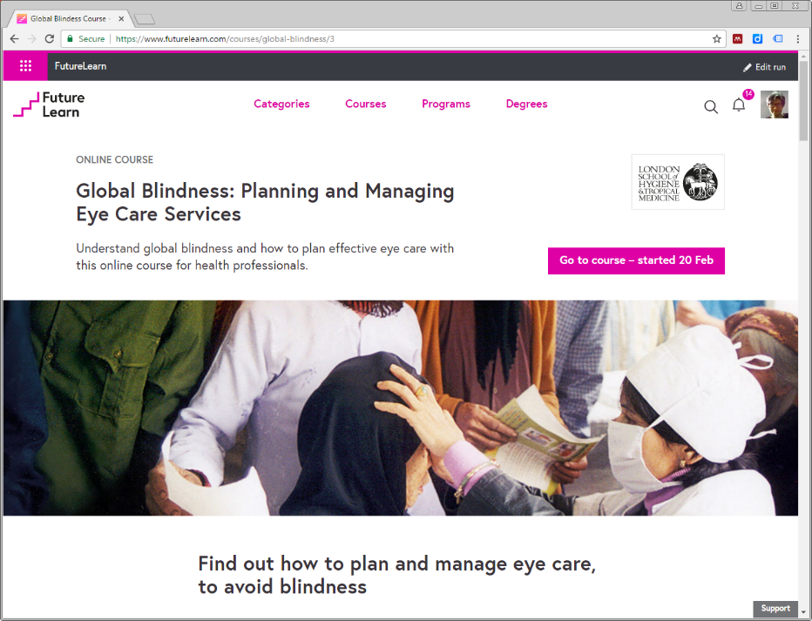
ICEH & Open Education Resources (OER)
OER = digital materials with an open copyright license which allows anyone to use, reuse, and redistribute them for free and without asking for permission.
In 2014 ICEH developed it’s first Open course as an OER “Global Blindness: Planning and managing eye care services”
Since then, course has been adapted by eye care faculty in Kenya, South Africa and Nigeria for optimal use in local context

Slide 6
Adapting the Global Blindness course
Dr Nyawira Mwangi Principal Lecturer, Kenya Medical Training College/Ministry of Health, Kenya Research fellow, LSHTM
Professor Colin Cook Mauerberger Chair of Ophthalmology, UCT Head: Division of Ophthalmology, Groote Schuur Hospital and Red Cross Children’s Hospital

Slide 7
Adapting the Global Blindness course: Kenya experiences
Dr Nyawira Mwangi Principal Lecturer, Kenya Medical Training College/Ministry of Health, Kenya Research fellow, LSHTM

Slide 8
Adapting the Global Blindness course: South Africa experiences
Professor Colin Cook Mauerberger Chair of Ophthalmology, UCT Head: Division of Ophthalmology, Groote Schuur Hospital and Red Cross Children’s Hospital

Slide 9
Q&A
Ms Sally Parsley (Host) Technical lead, Open Education Programme, ICEH, LSHTM
Dr Nyawira Mwangi Principal Lecturer Kenya Medical Training College/Ministry of Health, Kenya Research fellow, LSHTM
Professor Colin Cook Mauerberger Chair of Ophthalmology, UCT Head: Division of Ophthalmology, Groote Schuur Hospital and Red Cross Children’s Hospital

Slide 10
Thanks to our funders
Join us next time
Creating and sharing your own Open Education Resources
May 24th 2017 (1-1.45pm UCT)
http://bit.ly/2o2QwJ6
Find out more about the ICEH Open Education programme: http://iceh.lshtm.ac.uk/oer/

Slide 11
© 2017 International Centre for Eye Health, London School of Hygiene & Tropical Medicine. Unless otherwise stated, content is licensed under the Creative Commons Attribution Non-Commercial Share-Alike 4.0 International License https://creativecommons.org/licenses/by-nc-sa/4.0
We encourage the re-use, adaptation and sharing of this material for teaching and learning. Find more eye care Open Educational Resources at http://iceh.lshtm.ac.uk

