Slide 1
Glasgow Community Health and Wellbeing
Research and Learning Programme:
Investigating the Processes and Impacts of Neighbourhood Change
GoWell is a collaborative partnership between the Glasgow Centre for Population Health, the University of Glasgow and the MRC Social and Public Health Sciences Unit, sponsored by Glasgow Housing Association, the Scottish Government, NHS Health Scotland and NHS Greater Glasgow & Clyde.

Slide 2
Can neighbourhood demolition really be a low impact public health intervention? Complex findings from a UK natural experiment evaluation
M Egan* on behalf of GoWell
* London School of Hygiene & Tropical Medicine

Slide 3
What I’ll cover
Background
Introduce GoWell
Quantitative longitudinal findings
Qualitative and mixed methods findings

Slide 4
What I’ll cover
Background
troduce GoWell
Quantitative longitudinal and cross-sectional findings
Qualitative cross-sectional and longitudinal findings

Slide 5
What is urban regeneration?
Regeneration, renewal, improvement, area-based initiatives
Neighbourhood Demolition
New build
Housing improvement / refurbishment
Economic regeneration
Community empowerment
Tackle social problems
Support vulnerable residents
Physical
Social
Notes:
Poor quality housing in urban areas has long been linked to poor health and other social problems.
The nineteenth century was particulary well known for its programmes of slum clearances and housing improvement – for example the work of the City Improvement Trust in Glasgow.

Slide 6
Assumption: improving homes and neighbourhoods benefits health (& inequalities)
WHO Commission on the Social Determinants of Health (2008) includes sections on housing improvement and urban regeneration.
Marmot review (2010) links regeneration to social determinants and preventative approach to improving health (though mentions possible adverse impacts)
Equally Well (2008) recommends regeneration as part of strategy for reducing health inequalities - and refers specifically to GoWell.

Slide 7
Social harms?
“What the majority of tenants in Pinkston fear is demolition. Our community would be ripped apart and neighbours of 40 years would be separated.”
Paris & Blackaby (1979) note that ”comprehensive redevelopment has frequently been accused of the ‘destruction of communities’ and established neighbourhoods”.
‘Remainers’ spend years living in partially destroyed, emptying neighbourhoods

Slide 8
But evaluation evidence often suggests little impact either way (positive or negative)
Systematic review of housing improvement/relocation (Thomson et al, 2013)
Health benefits strongest for improvements in affordable warmth.
Improvements in respiratory, general and mental health
But effects vary by intervention and study
"potential for health benefits [from housing improvement] may depend on baseline housing conditions and careful targeting of the intervention.”
Systematic review of UK neighbourhood regeneration (Thomson et al, 2006).
Little/inconsistent evidence re-health effects, some adverse impacts
Expert Review: USA (Lindberg 2010, Jacobs 2010)
11 evaluations of effective interventions (1 neighbourhood level)
7 ineffective
34 poorly evidenced/inconclusive

Slide 9
‘Weak’ population level interventions
“…creeping into the literature about health and well-being now is a concern for what could be understood as weak prevention, that is, the recognition that modest or negligible effects have almost become the norm in any large scale programs trying to improve health.”
(Hawe et al 2009)
Methodological shortcomings
Poorly theorised intervention
Poorly implemented intervention
Lack of community involvement
Communities are complex - (multiple and multi-directional outcomes, unexpected consequences)
Rather than focus on outcomes, evaluators should try to identify key theoretical principles that explain successes and failures that tend to occur simultaneously with complex interventions

Slide 10
What I’ll cover
Background: ‘little or no impact’
Introduce GoWell
Quantitative longitudinal and cross-sectional findings
Qualitative cross-sectional and longitudinal findings

Slide 11
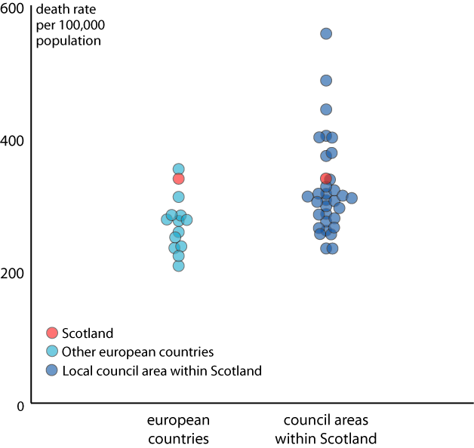
All cause death rates, men 0-64y, 2001
Glasgow City
Inverclyde
West Dunbartonshire
Dundee City
Eilean Siar
Renfrewshire
North Ayrshire
North Lanarkshire
Alastair H Leyland, Ruth Dundas,Philip McLoone & F Andrew Boddy. Inequalities in mortality in Scotland 1981-2001. Glasgow, MRC SPHSU, 2007.

Slide 12
A natural experiment: investment & change in Glasgow
Stock transfer in 2003
80,000 houses changed from Glasgow City Council to community ownership – GHA
£1.4 billion approx to be invested over next 10 years
Variety of initiatives
demolition
new build
neighbourhood renewal
core housing refurbishment
Changing tenancy profile
Focus upon service improvement
Emphasis on community empowerment

Slide 13
GoWell Study Areas

Slide 14
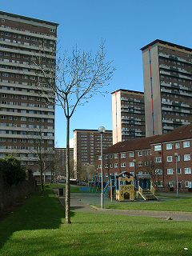
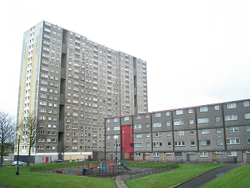
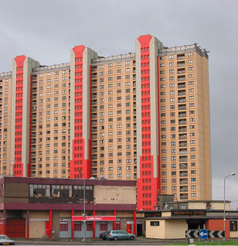
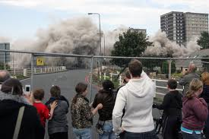
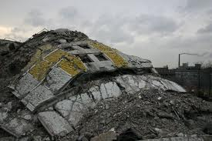
Transformational regeneration areas (TRAs) 20 year programme of clearance, demolition and rebuilding
Shawbridge
Sighthill
Red Road MSFs
Note – as well as undergoing demolition and clearance, GoWell’s demolition areas were also transformed since 2000 by becoming a destination point for first generation migrants (more on this later)

Slide 15
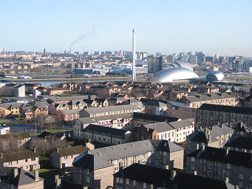
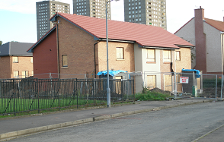
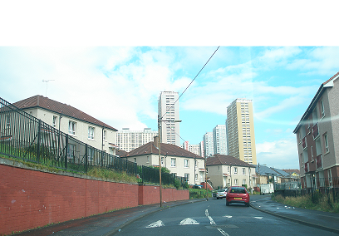
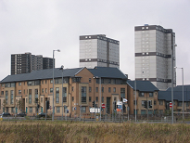
Other area types of area mainly received housing improvement
Govan (HIA)
Drumchapel (PE)
Red Road (WSA)
Gorbals Riverside (LRA)

Slide 16
What I’ll cover
Background: ‘little or no impact’
Introduce GoWell
Quantitative longitudinal findings
Qualitative cross-sectional and longitudinal findings

Slide 17
POPULATION: NUMBER OF HOMES IN ALL GOWELL AREAS
Wave 1 (2006)
n = 17804
Wave 2 (2008)
n = 15870
CROSS-SECTIONAL STUDY SAMPLE FRAME
n = 11970
n = 9804
n = 6008
(50.2% response)
n = 4657
(47.5% response)
ACHIEVED INTERVIEWS
INTERVIEWS WITH WAVE 2 ‘REMAINERS’
n = 3811
NESTED LONGITUDINAL COHORT (IN INTERSECT)
Wave 1 & 2
n = 1041
Wave 2 only
n = 2795
Wave 1 only
n = 4967
Control group
n = 283
Int. group 1
(demolitions):
n = 443
Int. group 2
(improvement):
n = 315
LONGITUDINAL CONTROL AND INTERVENTION GROUPS
GoWell Longitudinal Study Flow Chart

Slide 18
Longitudinal health impacts on ‘Remainers’ after 2 years Multiple regression, mean SF12v2: Higher = Better
SF12v2 (higher = better) |  | Coef. | P value | [95% Conf. | Interval]
Physical health | Control group | 0.00
 | Demolition | -0.24 | 0.859 | (-2.96 | , 2.48)
 | Housing improvement | -0.66 | 0.486 | (-2.57 | , 1.25)
Mental health | Control group | 0.00
 | Demolition | 2.49 | 0.185 | (-1.25 | , 6.23)
 | Housing improvement | 2.41 | 0.047* | (0.03 | , 4.80)
Adjusted for age, gender, tenure, household, ethnicity, building type, education, baseline SF12 score

Slide 19
What I’ll cover
Background: ‘little or no impact’
Introduce GoWell
Quantitative longitudinal and cross-sectional findings
Qualitative and mixed methods findings

Slide 20
GoWell qualitative study of residents just before relocation from demolition area (n=24)
Residents' perceive health affected by
Poor housing
Damp
Expensive to heat
Lack of space
Poor kitchen/cooking facilities
Lack of garden
Feeling ashamed
Poor neighbourhood
Bad reputation/shame
Crime / fear of crime (including racism)
Cultural norms encourage unhealthy lifestyle
Other - especially childhood, family and
relationship problems (lots of these!)
Indepth interviews with adult residents

Slide 21
GoWell qualitative study of residents just before relocation from demolition area (n=24)
Health issues
Asthma/eczema
Various chronic illness
Depression, anxiety
Health behaviours
Injury (from assault)
HIV
Feedback loops
Furthermore, residents believe that poor health contributes further to their poor quality of life, social isolation and lack of opportunities.
Health problems also lead to other health problems

Slide 22
GoWell qualitative study of residents just before relocation from demolition area (n=24)
Health issues
Asthma/eczema
Various chronic illness
Depression, anxiety
Health behaviours
Injury (from assault)
HIV
Feedback loops
Furthermore, residents believe that poor health contributes further to their poor quality of life, social isolation and lack of opportunities.
Health problems also lead to other health problems
Childhood social and addiction prison HIV depression
psychological problems

Slide 23
Qualitative accounts of the migrant and receiving communities
Arrival of migrant communities dominates narratives more than demolition programme
Migrant narratives emphasise resilience and hope for the future
Both migrant and receiving communities suggest that tensions between the two community sub-groups have eased over time.
Both sets of narratives suggest that the migrant sub-community has become stronger and more embedded within the neighbourhood over time – though the some white Scottish participants view with negatively or ambivalently.
Overall impression that the local neighbourhood is main source of social capital for migrant communities, but not for white Scottish communities.

Slide 24
Quantitative evidence that migrant ‘remainers’ started with better mental health (SF-12) - and the gap widened
 | W1 W2 |  | b Coef. | P value | (95% CI)
UK-born (n=819) | 47.61 | 48.08 | 0.00
Migrants (n=222) | 48.82 | 50.11 | 4.05 | 0.001 | (1.82, | 6.48)

Slide 25
Quantitative evidence that migrant ‘remainers’ started with better mental health (SF-12) and the gap widened
 | W1 W2 |  | b Coef. | P value | (95% CI)
UK-born (n=819) | 47.61 | 48.08 | 0.00
Migrants (n=222) | 48.82 | 50.11 | 4.05 | 0.001 | (1.82, | 6.48)
But what happens after the ‘remainers’ move?

Slide 26
Qualitative longitudinal study: one year later
Three types of experience
Little or no improvement in residential environment and no perceived health benefits
Improvement in residential environment and no perceived health benefits
Improvement in residential environment and perceived health benefits

Slide 27
Qualitative longitudinal study: one year later
Migrant residents often happy with improved home but miss their old neighbourhood, continue to make regular visits back, and experience more racism in the new neighbourhood.
White Scottish residents sometimes find that the new neighbourhood makes it easier for friends to visit (less fear), although also a strong narrative of continuing health problems being key cause of isolation.

Slide 28
‘Weak’ population level interventions
“…creeping into the literature about health and well-being now is a concern for what could be understood as weak prevention, that is, the recognition that modest or negligible effects have almost become the norm in any large scale programs trying to improve health.”
(Hawe et al 2009)
Methodological shortcomings
Poorly theorised intervention
Poorly implemented intervention
Lack of community involvement
Communities are complex - (multiple and multi-directional outcomes, unexpected consequences)
Rather than focus on outcomes, evaluators should try to identify key theoretical principles that explain successes and failures that tend to occur simultaneously with complex interventions

Slide 29
Methodological
What kind of bias might reduce positive or negative effect sizes?
Selection bias?
50% response rate, quantitative focus on ‘remainers’
Do the people we’ve missed out have more changeable health (somehow)?
Health outcomes?
Too short term
Problem with SF-12?

Slide 30
Implementation
Scale of intervention
Destroying entire neighbourhoods must be considered ‘large scale’
but perhaps pre-existing social and environmental problems lessened the impact of partial demolition.
Deliberate attempts to limit harm when delivering intervention
Some basic housing improvement works were carried out on ‘remainer’ homes even though they were scheduled for demolition
New housing focused on improving physical environments. Less focus on social and economic regeneration.

Slide 31
Lack of community involvement
Approx 3 in 4 residents support demolition of neighbourhood
Both the housing association and the researchers have engaged and consulted with residents before, during and after the period being studied.
Only a minority of residents want to engage
Those who engage can be unrepresentative (‘save our homes!’)
How much community involvement is enough?

Slide 32
Theory
These might include:
Causal association between place and health
Is association strong enough for ‘place’ based interventions to either worsen or improve health?
Does modifying social determinants of health lead to health outcomes?
Not always
Depends on type and scale of modification
Also depends on the population (see next slide)

Slide 33
How the intervention affects a complex community: some key messages
Aggregated quantitative means in a single outcome may fail to pick up on wildly different experiences across many outcomes.
Do residents rely on their neighbourhood for social capital?
A source of resilience for ‘remainers’
A risk for those who are relocated.
Demolition programmes should seek to identify and provide tailored support to those community sub-groups that rely most on their neighbourhood
Targeting communities with extreme levels of poor health presents challenges for ‘preventative’ public health strategies.
Illness undermines potential to benefit from residential improvements
High prevalence of illness complicates our view of prevention.
Should our main health outcomes be centred round managing ill health rather than preventing it?
Health service support could usefully accompany such interventions

Slide 34
Concluding points
GoWell produces lots of ‘findings’ – assembling them into meaningful narratives is a challenge.
We think that attempting to identify overarching theories is probably more useful than focusing on specific (small) effect sizes – although one informs the other.

Slide 35
www.gowellonline.com

