Slide 1
Instructions and Templates

Slide 2
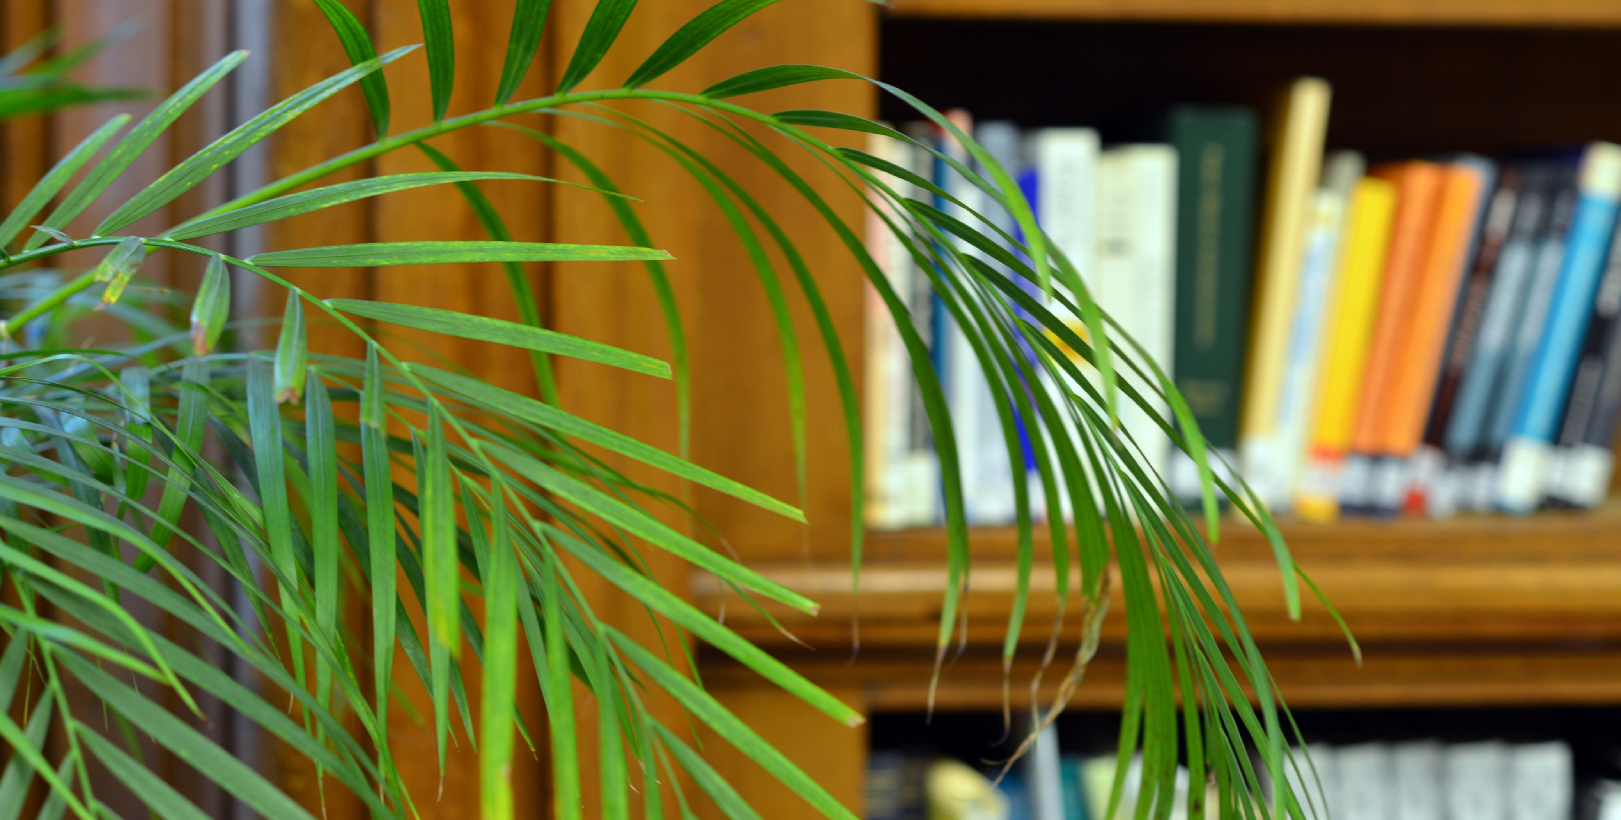
Font is Open Sans, use one of the LSHTM colours (from the ‘Theme colours) with a black border; font colour can be darker or lighter (select from the default options available)
Pick the
Font size
that fits best (and delete the others)
Strapline if needed; Open Sans, 32pt, bold
Text; just put very brief, key information; Open Sans, 28pt, plain or bold direct them to more information e.g a URL or email
Logo must stay in this position and size.
Instructions: To save the slide, go to save as and change file type to JPEG, then choose to save the ‘current slide only’ in the TV Slides folder.
Notify User Services Team who will upload it.
Background image should be simple. Use ‘picture corrections’ options to change saturation or brightness if needed. Space for logo must be clear background to provide contrast. Credit if needed in Open Sans size 12, bottom right hand corner in contrasting colour.

Slide 3
TEXT
TEXT
TEXT
text
text

Slide 4
Finished slides

Slide 5
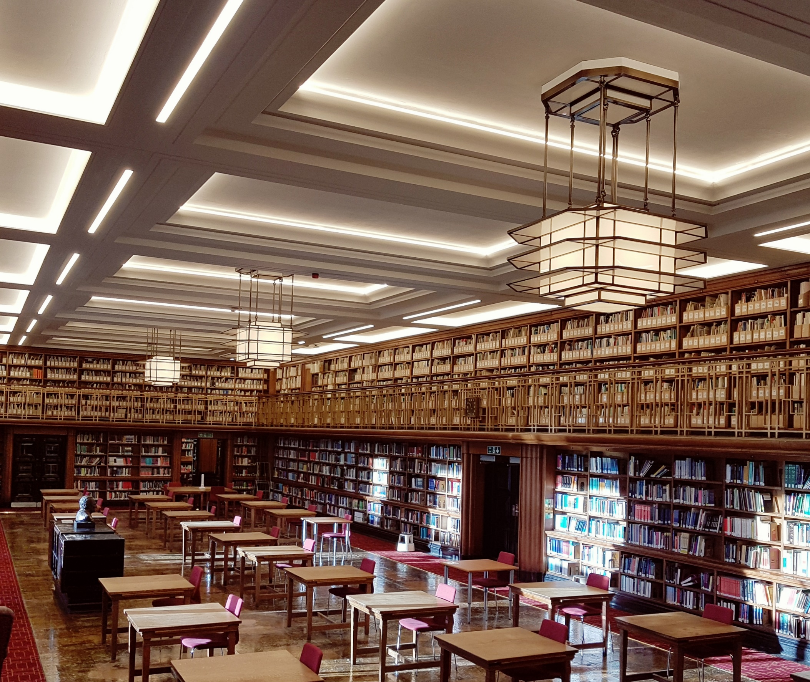
Welcome
to the
Library
Photo by Eloise Carpenter

Slide 6
Opening Hours
Term Time
Monday – Friday | 08:30 – 23:00
Saturday | 09:00 – 20:00
Sunday | 11:00 – 20:00

Slide 7
Opening Hours
Summer Time
Monday – Friday | 08:30 – 20:25
Saturday | 09:00 – 17:00
Sunday | 11:00 – 17:00

Slide 8
Opening Hours
Vacation Time
Monday – Friday | 08:30 – 20:25
Saturday | 09:00 – 12:30
Sunday | Closed

Slide 9
LSHTM Theses
Access digital and print PhD theses from the Library using Discover:
discover.lshtm.ac.uk

Slide 10
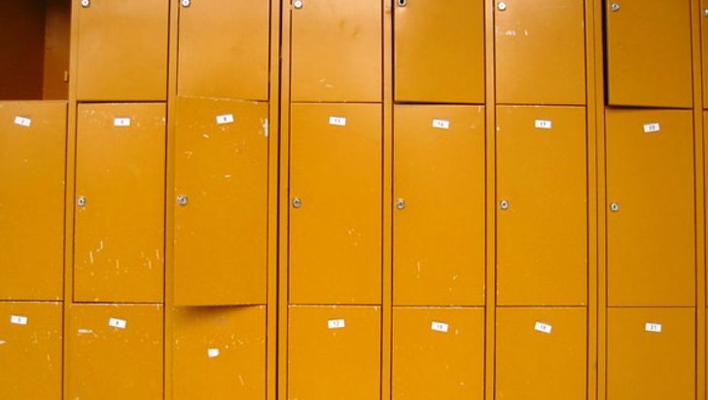
Lockers
Borrow a laptop or bag locker for the day.
Ask Library staff for more information.
Freeimages.com/HolgerDieterich

Slide 11
Bike Tool Library
Short loans of bicycle tools and repair equipment.
Kindly donated by LSHTM cyclists.
Freeimages.com/LukaRister

Slide 12
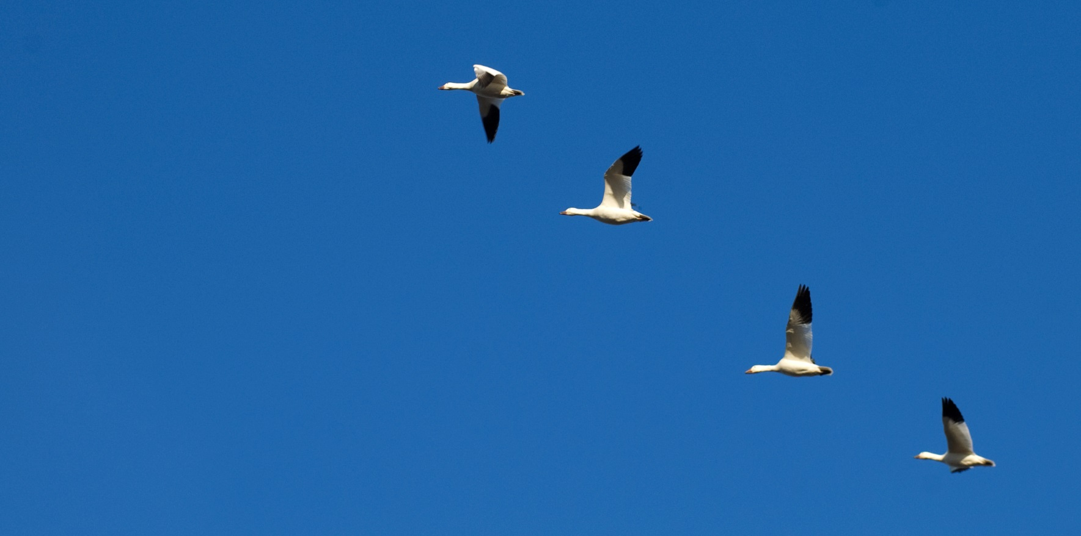
Follow us on Twitter
@LSHTMlibrary

Slide 13
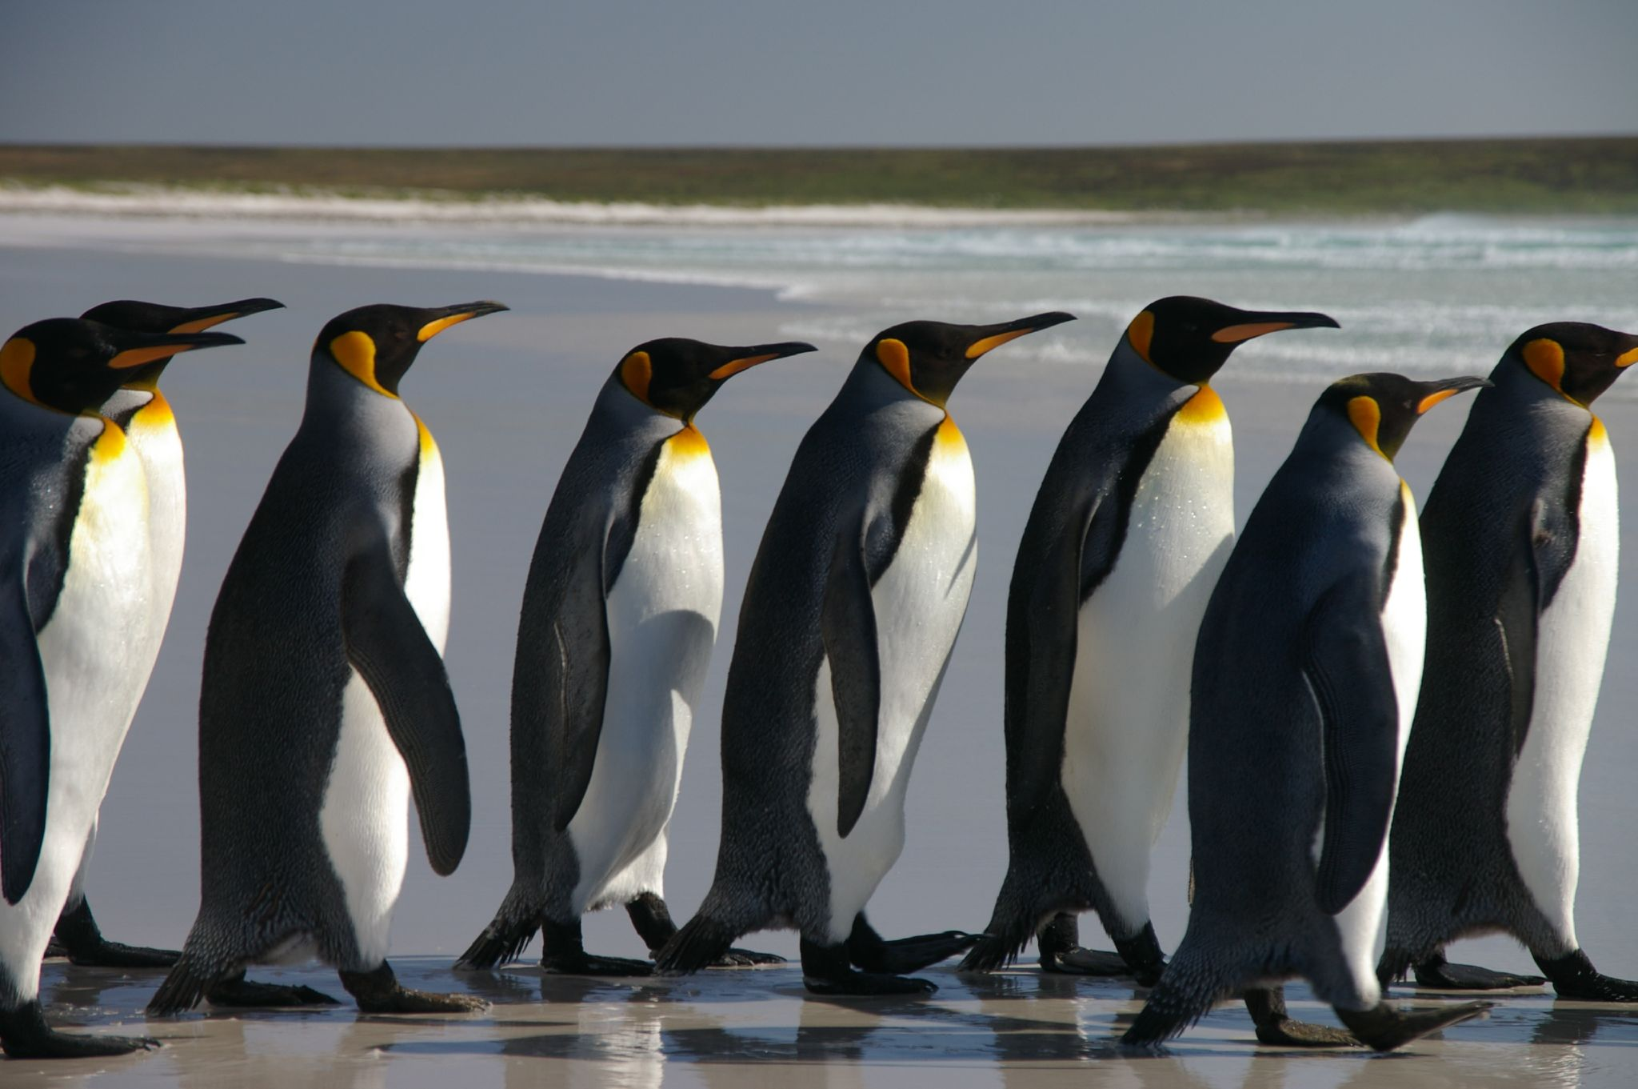
Follow us on Facebook
fb.me/LSHTMlibrary
Sunrise by Nigel Howe. CC BY-NC. Flickr

Slide 14
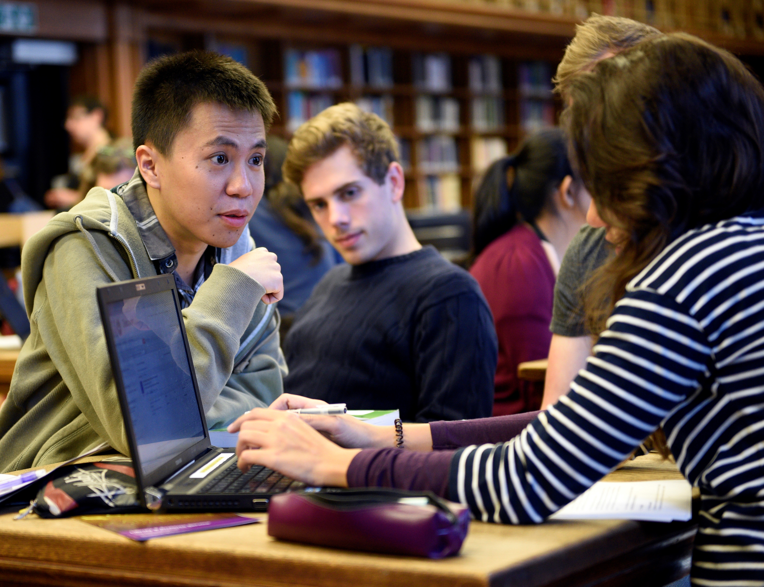
Group Study Area
We have a group study area upstairs in the Library’s Wellcome Gallery.

Slide 15
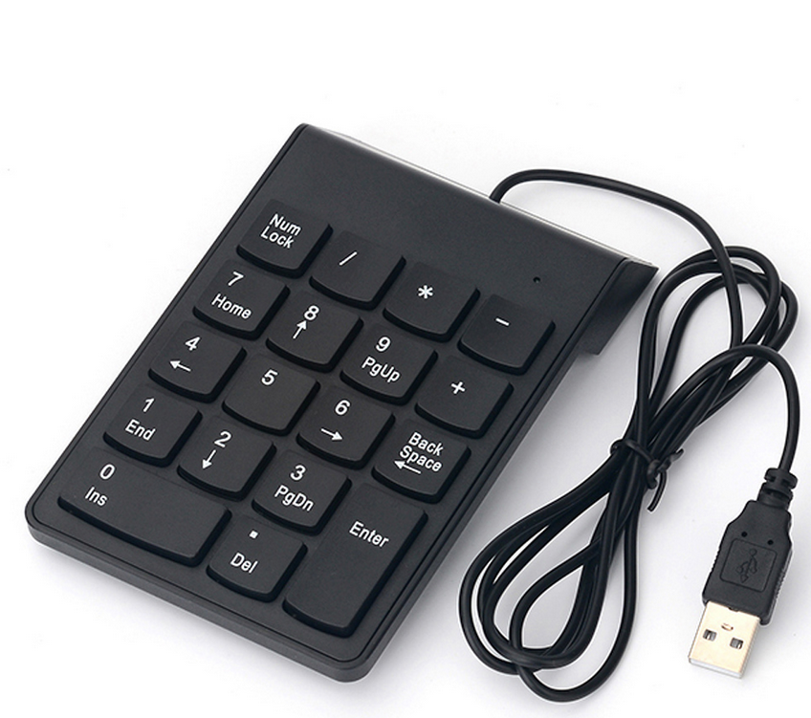
LAPTOP ACCESSORIES AVAILABLE

Slide 16
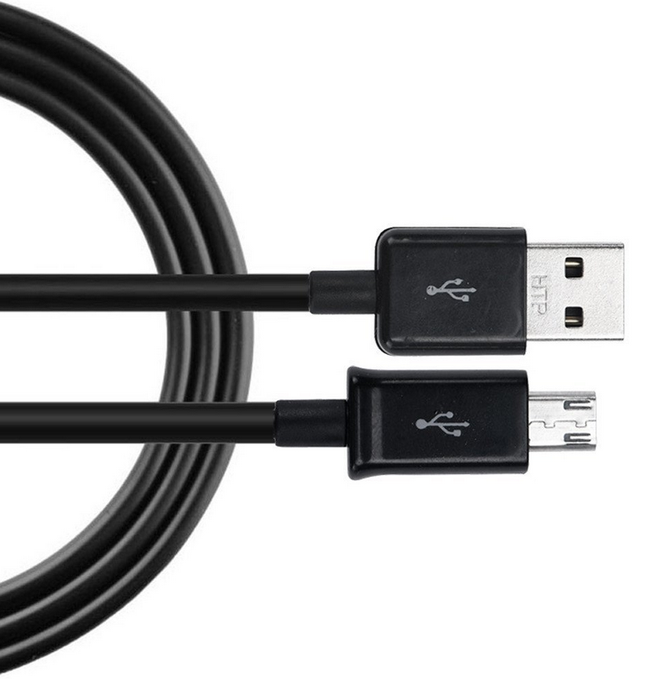
USB CHARGERS AVAILABLE

Slide 17
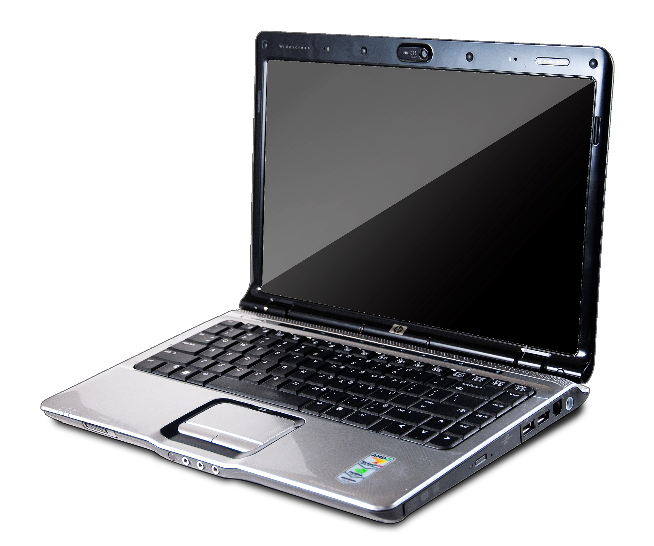
LIBRARY LAPTOPS AVAILABLE
CC-BY-2.0 AaronPatterson

Slide 18
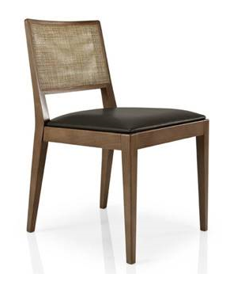
WHAT DO YOU THINK ABOUT THIS CHAIR?
Test out our sample chair in the Reading Room and let us know what you think.

Slide 19
For all your Library & Archives Service needs-
find us on ServiceDesk
http://servicedesk.lshtm.ac.uk

Slide 20
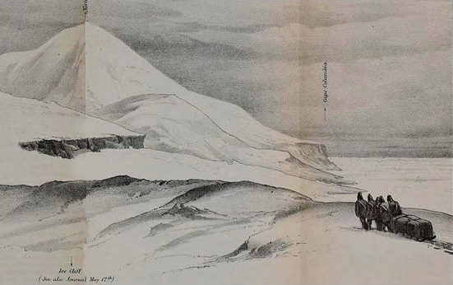
UK Medical Heritage Library
Digitisation Project
Over 2,000 rare books and pamphlets from the library, now fully digitized and available under a Creative Commons license.
www.archive.org/details/lshtmlibrary

Slide 21
Enhance your research impact by sharing research
Find out how data sharing, open access publication, ORCIDs and more can increase your research visibility
https://servicedesk.lshtm.ac.uk
library@lshtm.ac.uk

Slide 22
Research data @LSHTM
Find 500+ reusable resources captured by our researchers across the globe, or publish your own:
http://datacompass.lshtm.ac.uk

Slide 23
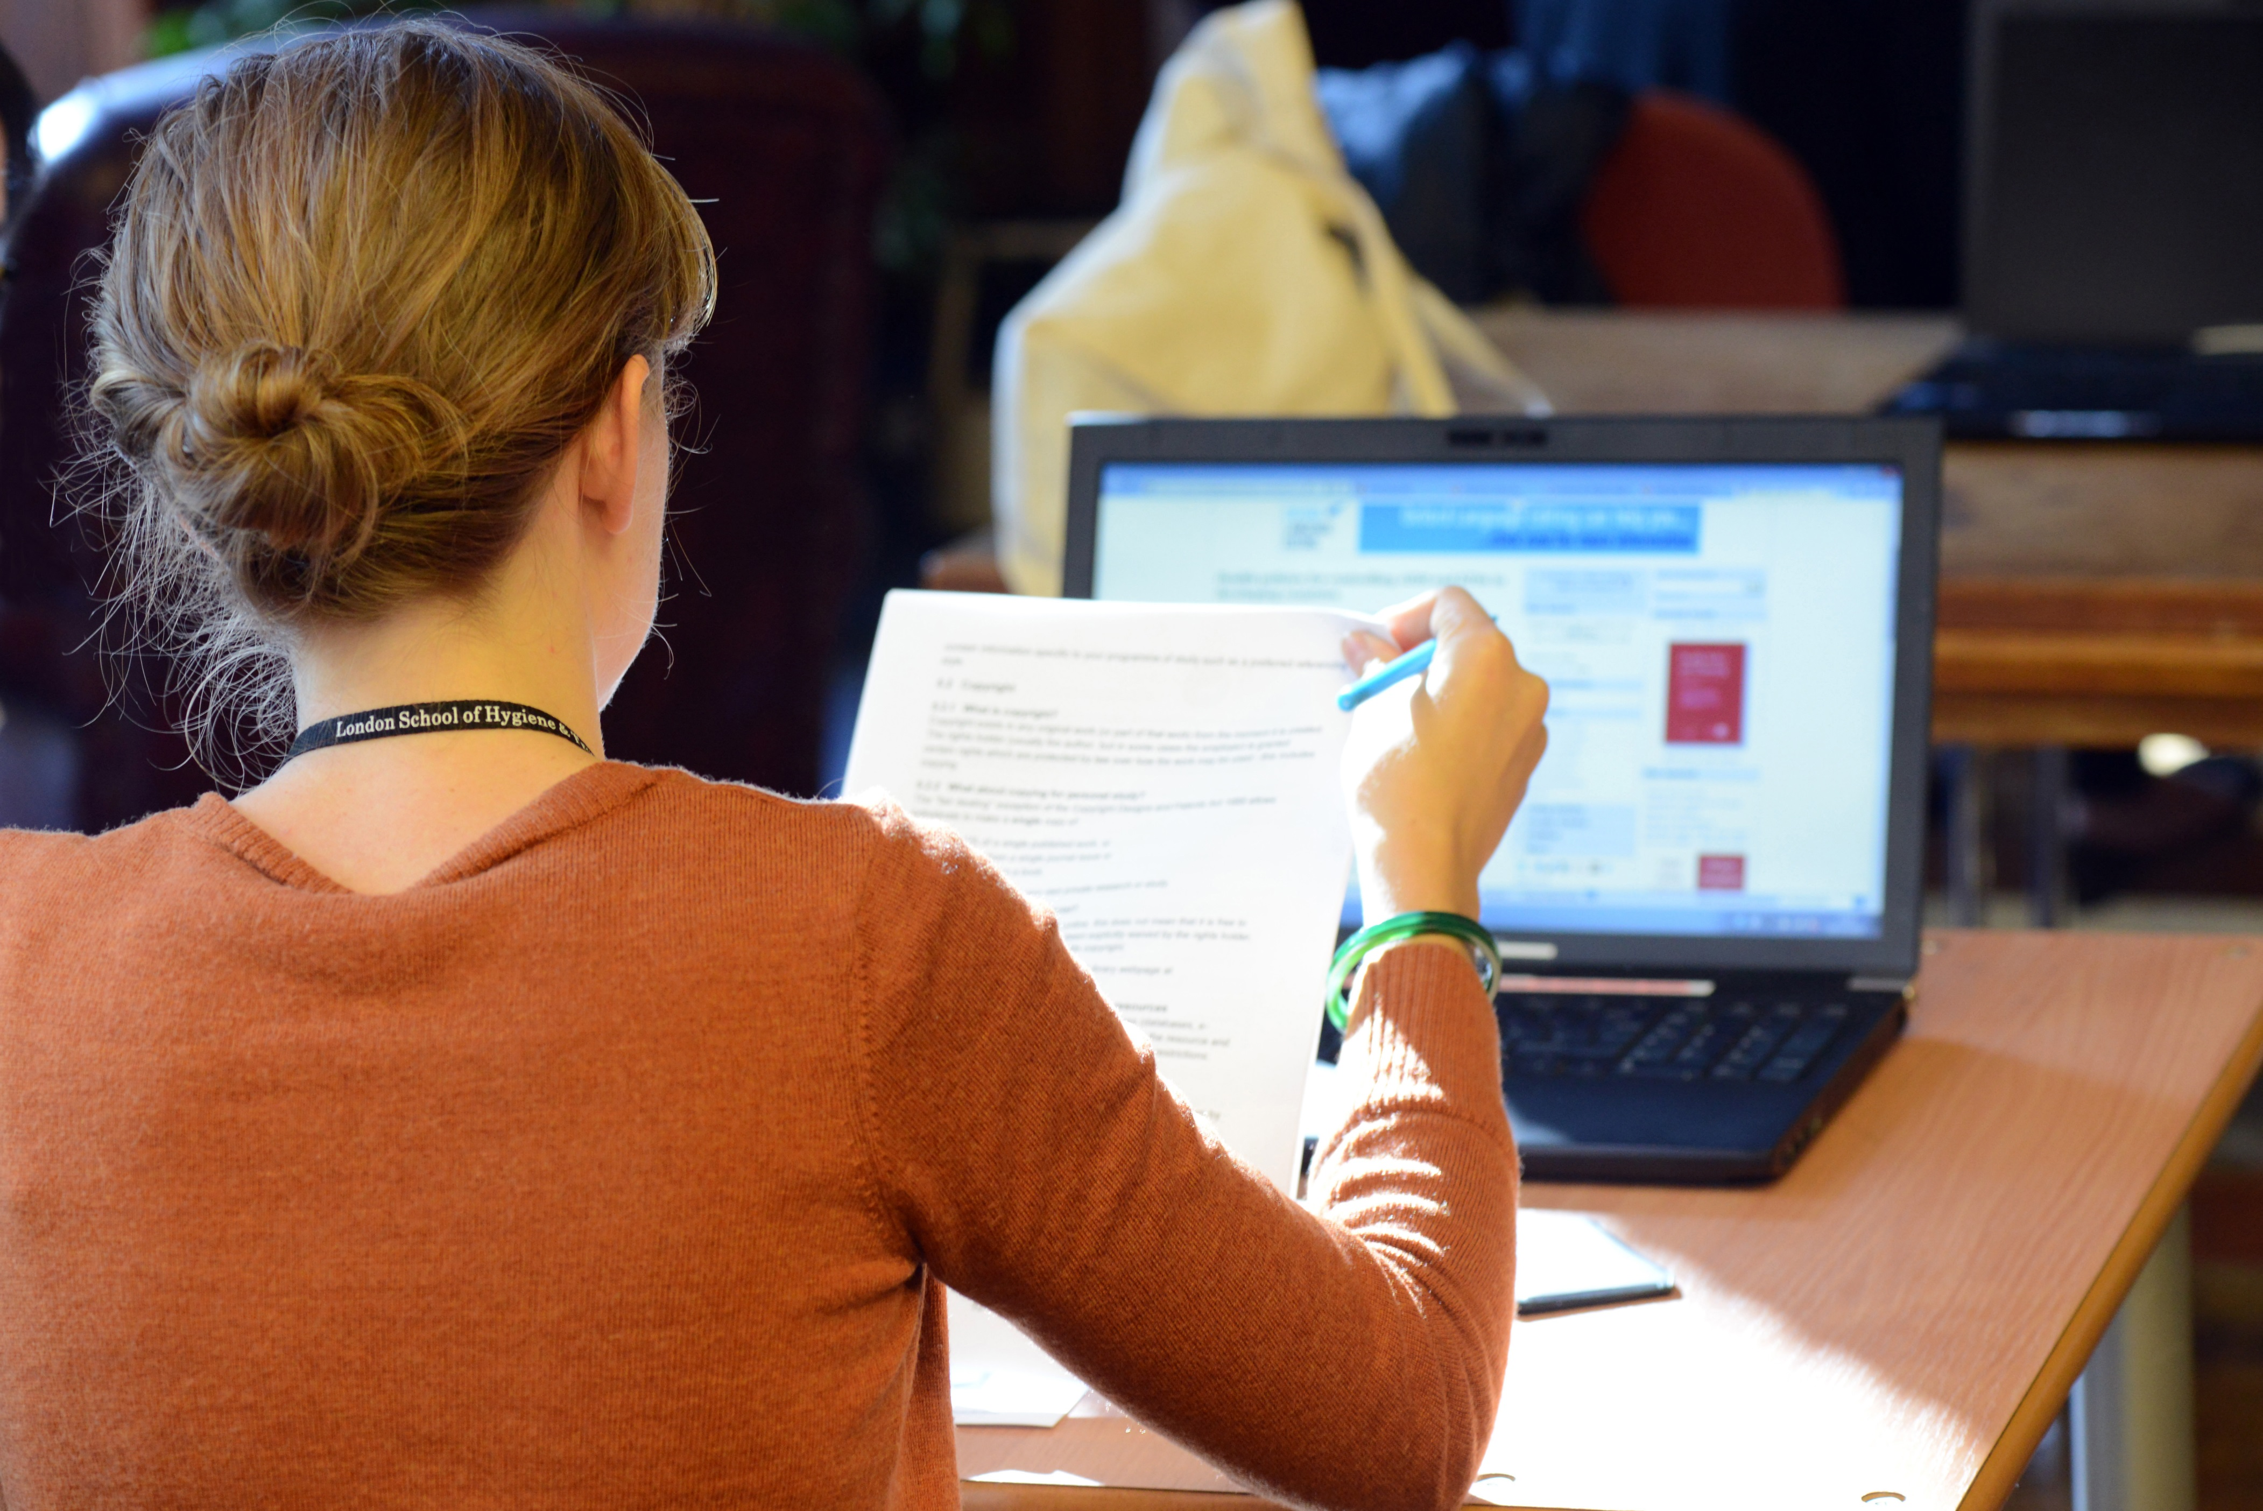
Need help with your Data Management Plan?
Find how-to guides and sample plans at:
https://servicedesk.lshtm.ac.uk
Sign-up for a training session at:
http://transferableskills.lshtm.ac.uk/schedule/

Slide 24
Keep your data safe and secure
Learn about the different storage options available and how to encrypt your data using our tutorials
https://servicedesk.lshtm.ac.uk
researchdatamanagement@lshtm.ac.uk

Slide 25
Copyright
Information and guidance available on ServiceDesk:
https://servicedesk.lshtm.ac.uk

Slide 26
How satisfied are you with your Library?
We want to know what you think
Check your School email account for our 1 question survey.

Slide 27
3
2
1
0
Very satisfied
Satisfied
Not satisfied
Not at all satisfied
Tell us what you think
How satisfied are you with your Library & Archives Service and Library resources?
Check your email for our quick 2 question survey

Slide 28
What do you think about the group study area?
We want to know what you think:
bit.ly/groupstudyarea

Slide 29
A beautiful literature search is only a lunchtime session away
May, June, July
Book online: http://bit.do/infoskills
Join Senate House Library
Free access to online resources, borrowing and study space.
1. Pre-register online at bit.ly/shlpre
2. Collect your card from
Senate House Library Reception
CC BY-SA 2.0 stevecadman
Sunrise by Nigel Howe. CC BY-NC. Flickr

Slide 30
Senate House Library
Membership event
Tuesday 4th December
13:00-15:00 @ Library
For free access to online resources, borrowing and study space.
Pre-register online at bit.ly/shlpre then come to the Library to complete registration
Public Domain An Siaach

Slide 31
Library & Archives
UP
Pop
Making your work open
Finding open resources
Tuesday 4th December / 12:00-14:00
Outside the Student Common Room

Slide 32
What do you think about the group study area?
bit.ly/groupstudyarea

Slide 33
Tell us what you think about Library resources
bit.ly/lshtmres

Slide 34
Tell us what you think about Library resources
bit.ly/lshtmresDL

Slide 35
Tell us what you think about Library resources
bit.ly/lshtmres

Slide 36
Tell us what you think about Library resources

Slide 37
You said
We did
?
?
?
Get in touch - bit.do/LASfeedback

Slide 38
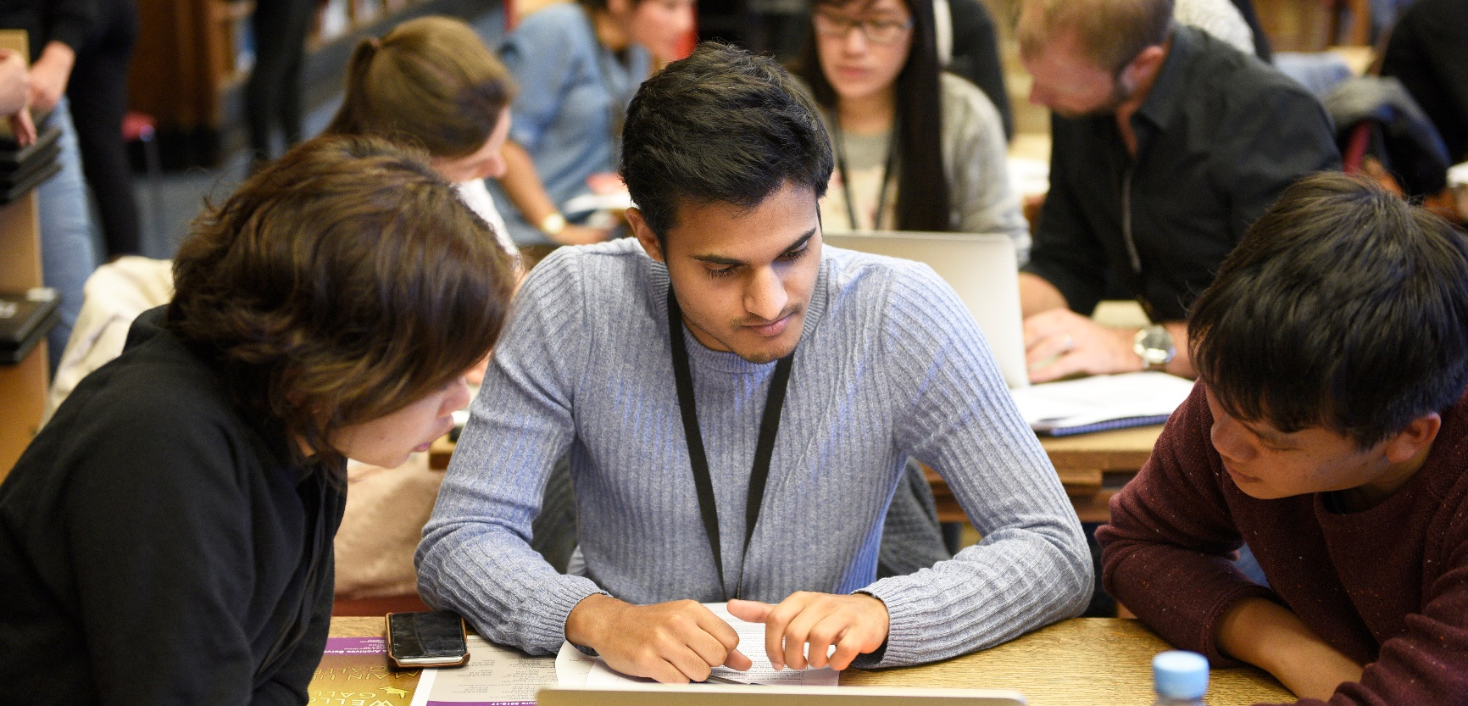
GET AHEAD
Book a library information skills session
SESSION 1: Finding items on your reading list / 1-5 October
SESSION 2: Introduction to literature searching / 8-12 October
BOOK ONLINE: bit.do/infoskills

Slide 39
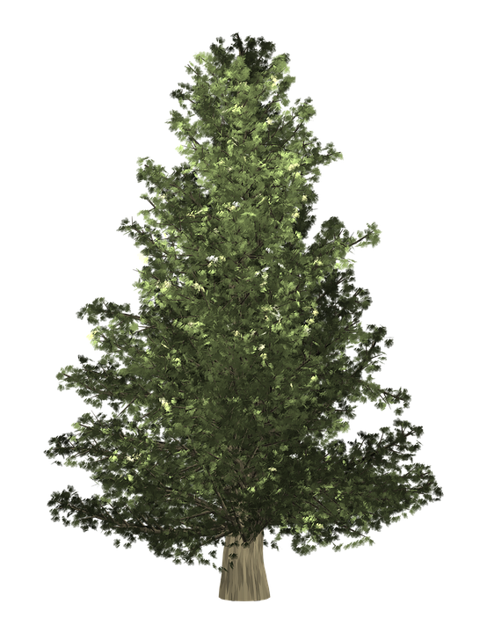
O Feedback Tree
O Feedback Tree
How lovely are
thy branches
Decorate our feedback tree
with ideas for the library

Slide 40
this year to save me from tears I gave my feedback to someone special…
Decorate our feedback tree
with ideas for the library

Slide 41
let the bells
ring out
for feedback…
Decorate our feedback tree
with ideas for the library

Slide 42
Simply having a wonderful feedback time…
Decorate our feedback tree
with ideas for the library

Slide 43
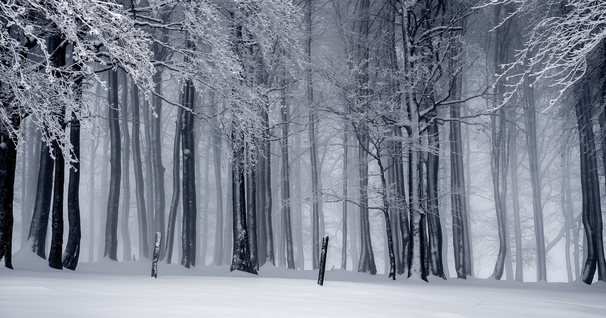
Happy holidays!
If you’re leaving London for the holidays please return books you don’t need before you leave.

Slide 44
A beautiful literature search is only a lunchtime session away
May, June, July
Book online: http://bit.do/infoskills
Sunrise by Nigel Howe. CC BY-NC. Flickr

Slide 45
Keep
Hydrated
#studywell
Refill your water bottle at the Refectory, North Courtyard or Library

Slide 46
Take
Regular
Breaks
#studywell
Try our ‘Colour in the Collection’ sheets or take a self-guided walk around the local gardens and parks.

Slide 47
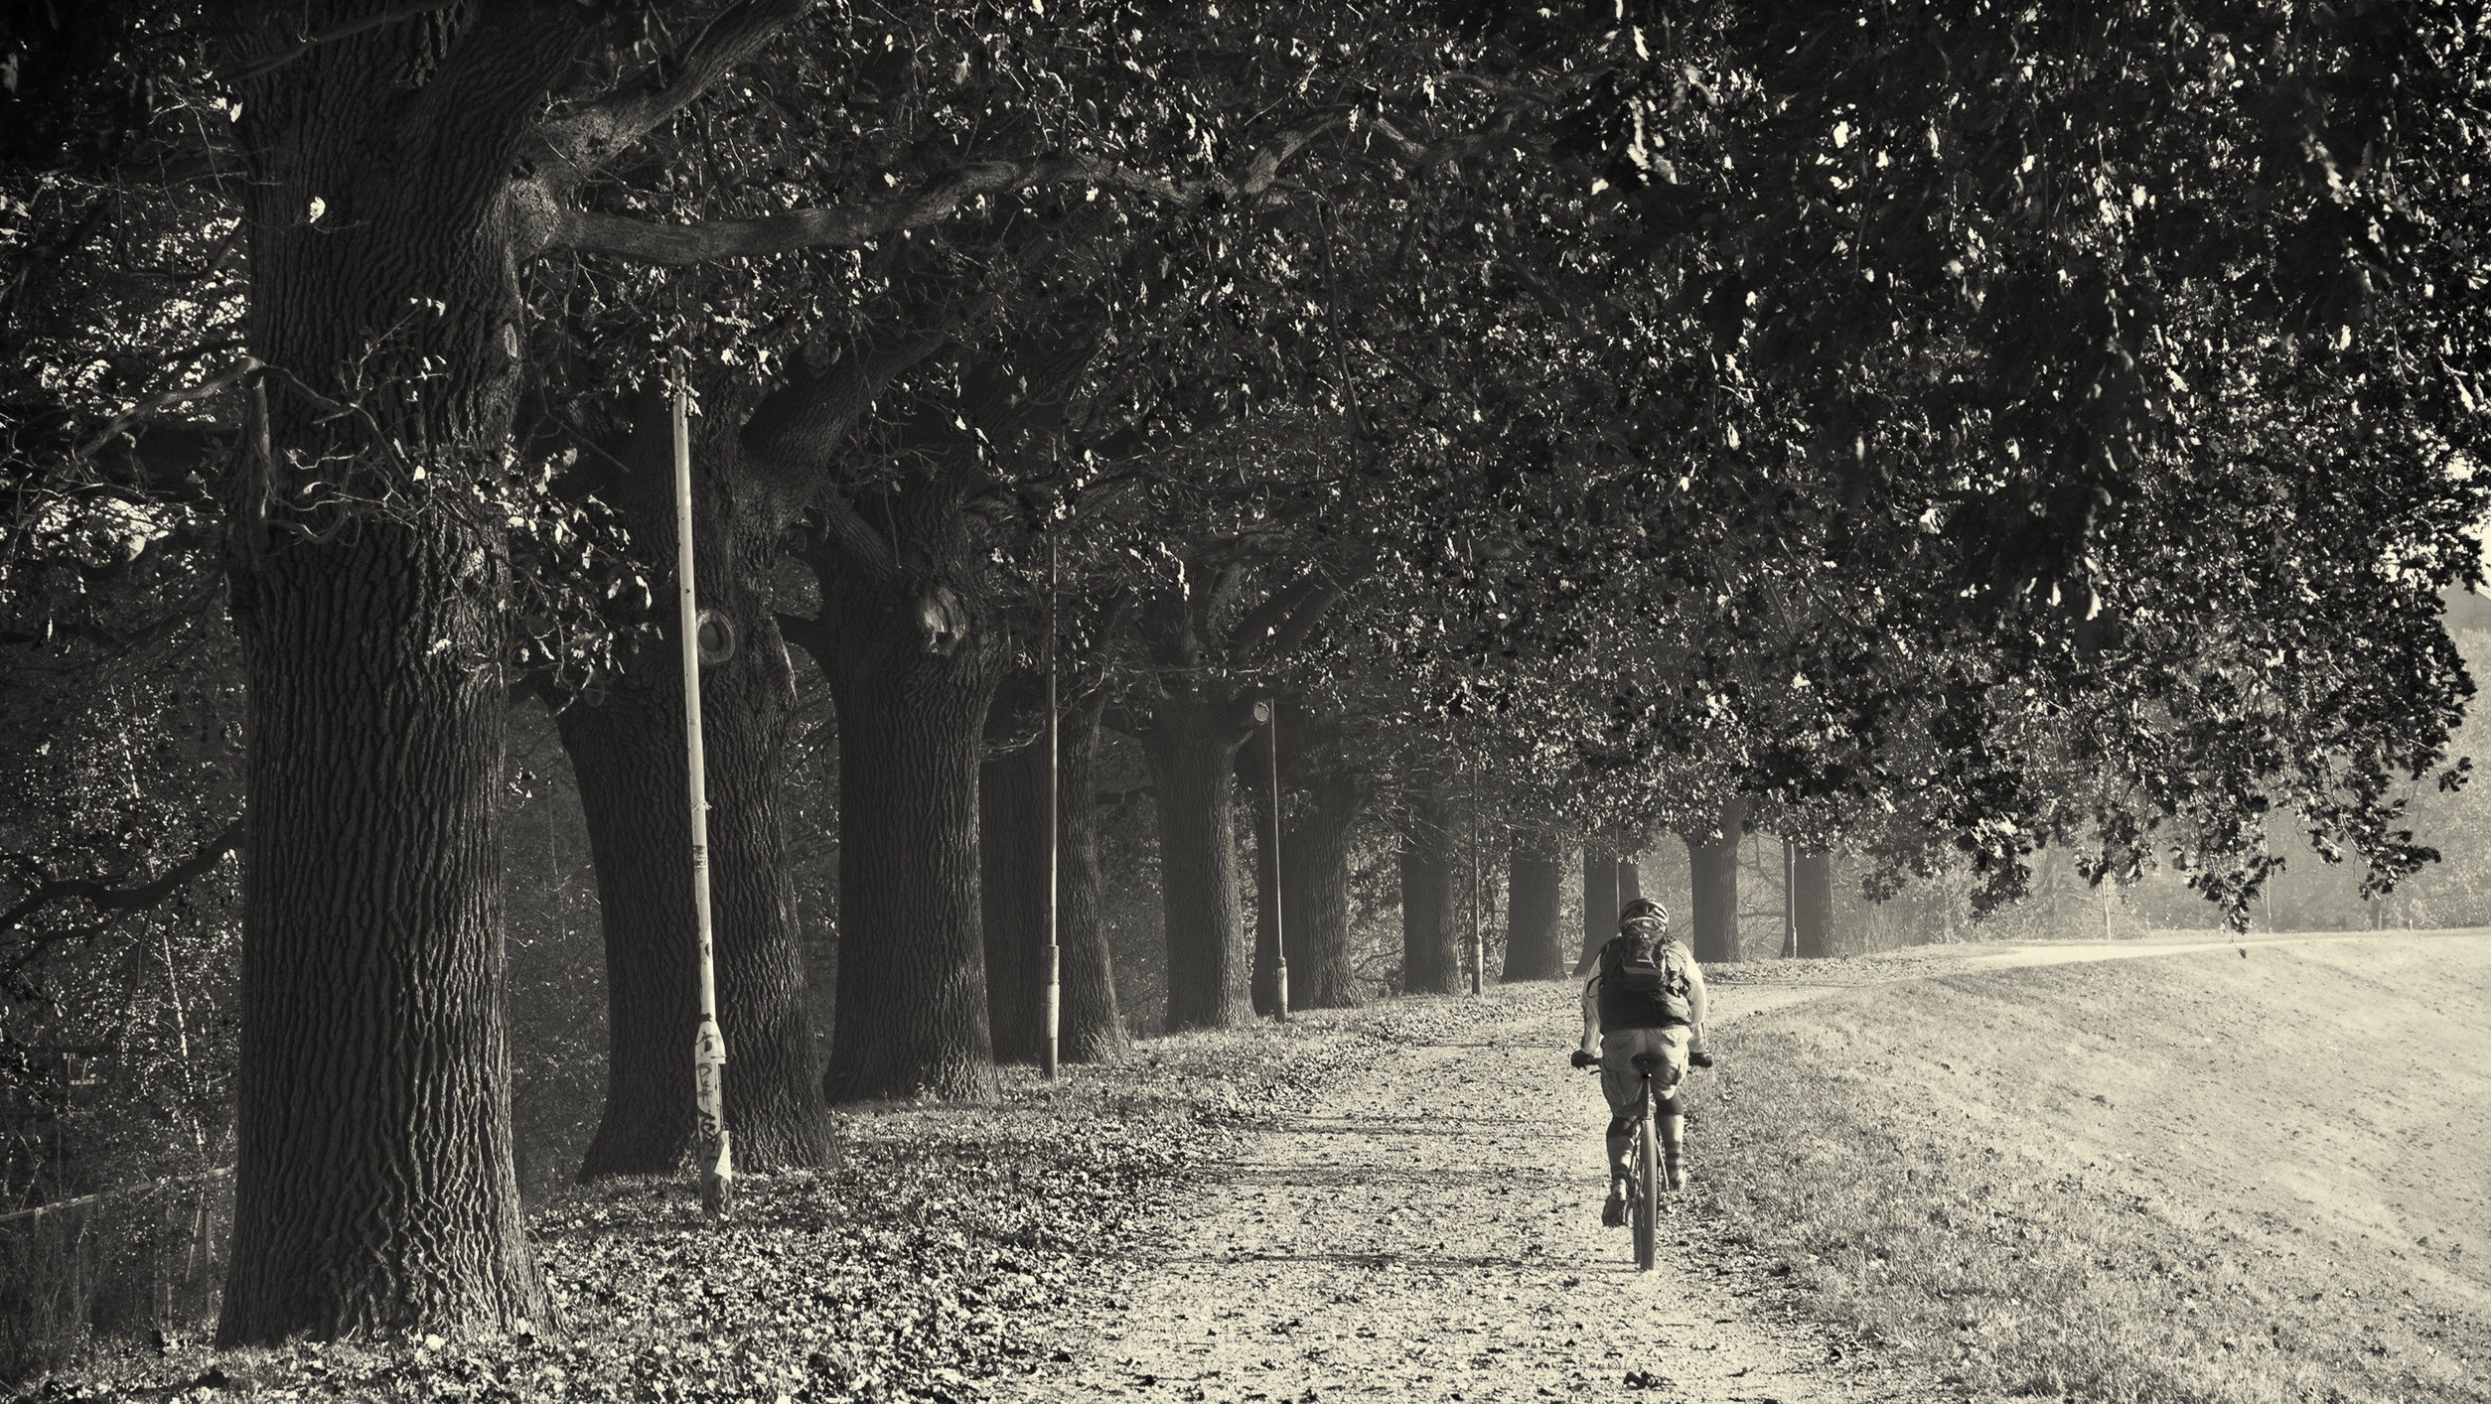
Take
Regular
Breaks
#studywell
Try our ‘Colour in the Collection’ sheets or take a self-guided walk around the local gardens and parks.

Slide 48
Library
Pop-Up
Study Space
28th May to 11th June
LG24

