Slide 1
LSHTM R users group
3/5/2023
Amy Macdougall

Slide 2
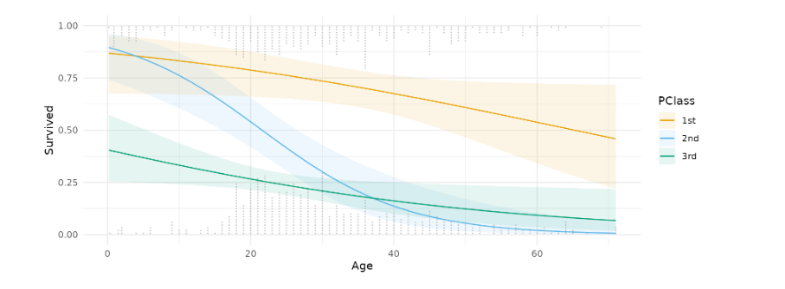
The aim is to make it easier to communicate results of regressions in meaningful terms.

Slide 3
Using:
Predictions
Comparisons
Slopes aka ‘marginal effects’

Slide 4
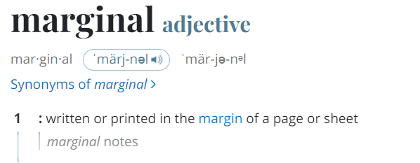
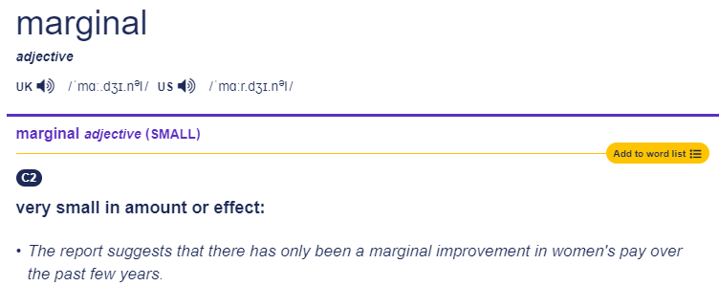
What does ‘marginal’ mean?

Slide 5
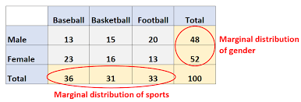
Marginal in statistics
Marginal mean = mean averaged over all covariates
vs
Conditional mean = mean conditional on covariates

Slide 6
Marginal in econometrics
Marginal effect = the slope
Partial derivative of the regression equation with respect to a regressor of interest

Slide 7
Marginal effects != marginal means
Marginal effect = the slope (derivative)
Marginal mean = average (integral)
Both can be calculated using the marginaleffects package.

Slide 8
Today I’ll illustrate some uses of the package using a data from an experiment carried out at the Dementia Research Centre.
A model including a non-linear term.
A logistic regression.
In both of these cases the regression coefficients may not be readily interpretable or the quantity of interest.

Slide 9
The colour spaces experiment

Slide 10
The colour spaces experiment
Continuous outcome: change in pupil size from baseline
Binary outcome: ‘like’ the colour or not

Slide 11
1. Marginal effects for a non-linear term Continuous outcome and predictor
Hypothesis: as time (‘trial index’) increases, pupil response may change.
Fit a cubic spline to ‘trial index’ to measure non-linear effect.
How to interpret the result?

Slide 12
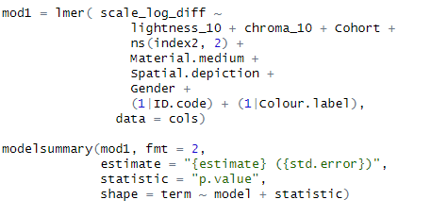

Slide 13
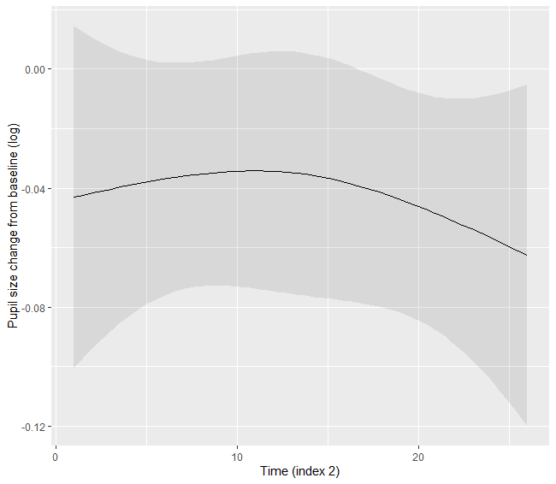
plot_predictions()
This could be done be done with predict() + ggplot(), or other packages.
These predictions are conditional on observed values of all other covariates.

Slide 14
slopes()

Slide 16
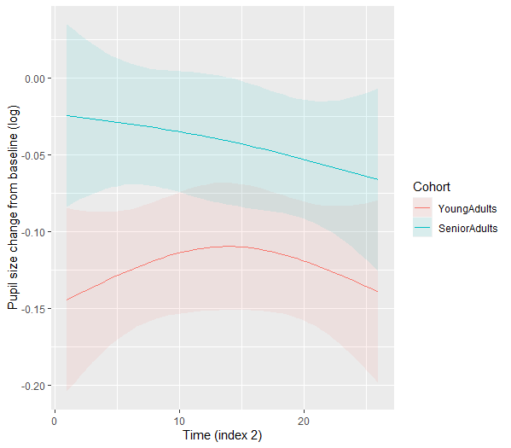
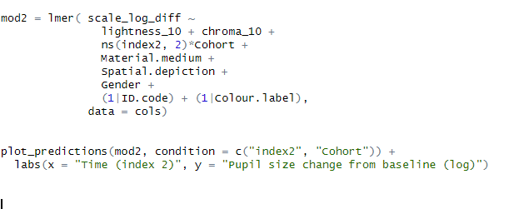

Slide 17
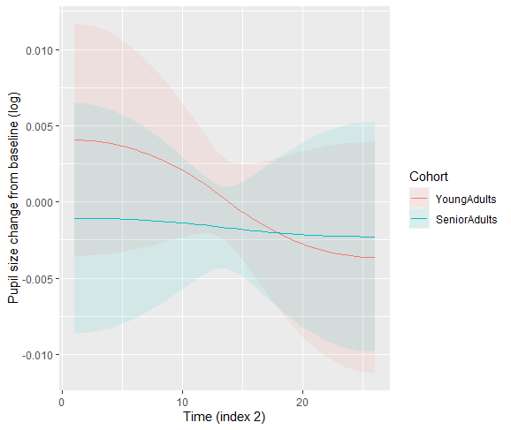

Slide 18
Functions used so far
predictions()
plot_predictions()
Makes it easy to obtain and plot predictions
slopes()
plot_slopes()
Uses automatic differentiation to find the ‘marginal effect’ aka slope and the delta method for standard errors.

Slide 19
Example 2: interpreting the results of a logistic regression
Outcome: ‘like’ the colour or not
With logistic regression, the default is to convert scale from odds to probability

Slide 20
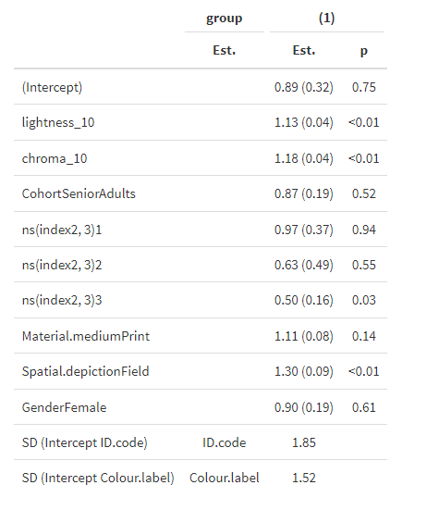
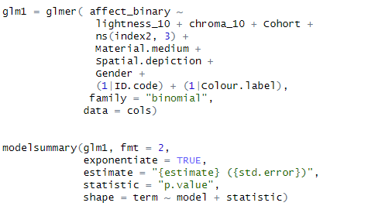

Slide 21
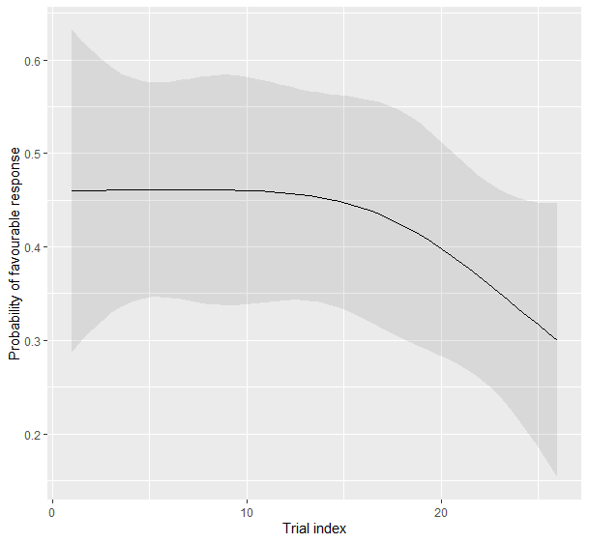
(i) Continuous predictor
Difference in scale: non-linearity on one scale does not imply non-linearity on another (interactions too).
These predictions are conditional on observed values of all other covariates.

Slide 22
(ii) Binary predictor
avg_comparisons() makes it easy to convert odds ratios to risk differences
Find predicted probabilities for all individuals under both levels of the binary predictor.
Find the difference between these probabilities.
Find the mean of these differences.
Standard error found using the delta method, there is also a bootstrap option.
This is the parametric g-formula
finding the average treatment effect
(a marginal mean)

Slide 23
Compare the effect of material medium and spatial depiction

Slide 24
Compare the effect of material medium and spatial depiction

Slide 25
Compare the effect of material medium and spatial depiction

Slide 26
Think about assumptions!

Slide 27
Functions used
slopes()
plot_slopes()
Uses automatic differentiation to find the ‘marginal effect’ aka slope.
comparisons()
avg_comparisons()
Compares predicted values at individual and marginal level.
predictions()
plot_predictions()
Makes it easy to obtain and plot predictions.

Slide 28
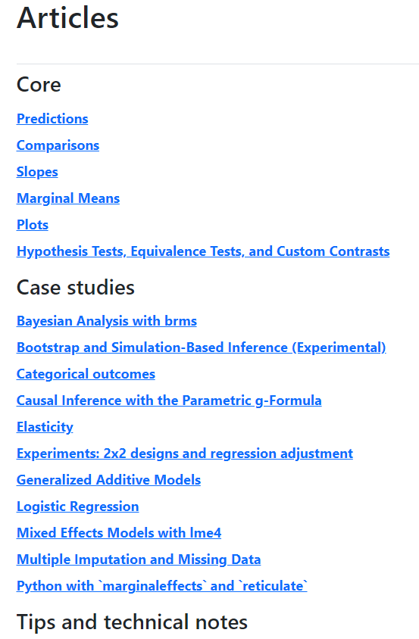
The package is extremely well documented
Marginal effects website
Solomon Kurt blog ‘causal inference with logistic regression’

Slide 29
End

