Slide 1
Google Earth Engine with R
R Users Group - 29/09/2023
Malcolm N. Mistry
Environment Health and Modelling (EHM) Lab, PHES
malcolm.mistry@lshtm.ac.uk
Acknowledgement: Giacomo Falchetta, Ca’ Foscari University of Venice, Italy

Slide 2
Outline
Geographic Information System (GIS)
Spatial Data
Raster/Vector
Google Earth Engine (GEE)
Cloud Computing
Available Data
Lexicon
RGEE
Installation
Demo

Slide 3
GIS and Spatial Data

Slide 4
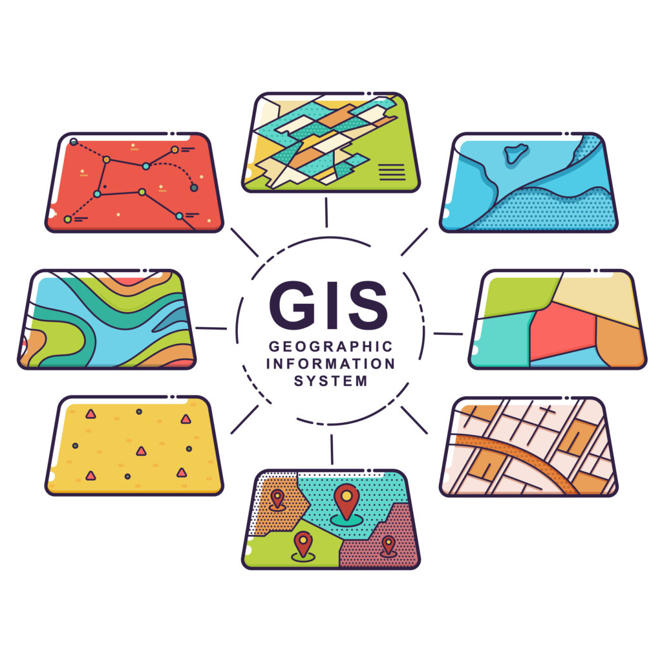
Introduction: Geographic Information System (GIS)
GIS is a system that creates, manages, analyzes, and maps all types of data.
GIS connects data to a map, integrating location data (where things are) with all types of descriptive information (what things are like there).
This provides a foundation for mapping and analysis that is used in science and almost every industry.
Source: https://www.esri.com/en-us/what-is-gis/overview

Slide 5
Introduction: GIS and spatial data
Plain data
GIS data
 | var_1 | var_n
obs_1 | v1_1 | v1_n
obs_n | vn_1 | v2_2
 | var_1 | var_n | geo
obs_1 | v1_1 | v1_n | GEO_1
obs_n | vn_1 | v2_2 | GEO_n
In general, spatial data can be represented as a conventional dataframe with an additional column containing the geographical information relative to each observation.

Slide 6
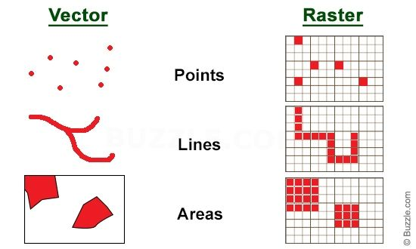
Introduction: raster and vector
Each “feature” (point, line, polygon) is linked to one measurement for one or more variables (columns) attached to it.
E.g., rivers shapefile contains a variable with the river name.
Each pixel (grid cell) is an independent entity with one or more variables (layers) attached to it.
E.g., the altitude or the temperature at each grid cell.

Slide 7
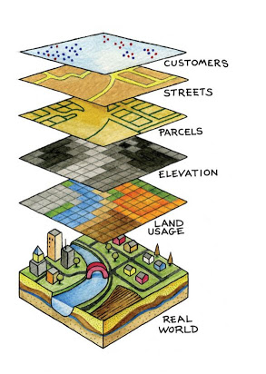
But some types of info is more suitably stored as either one or the other…
Raster
Continuous units in space, e.g. :
Population density
Temperature
Elevation
Wind speed
Vector
Discrete units in space, e.g. :
Rivers
Administrative boundaries
Lakes
Roads
Power stations

Slide 8
GIS: software and coding
Basically endless, but can be divided in 3 broad groups:
1. GUI software with programming capability:
ArcGIS (paid), QGIS (open source)
2. Programming languages' GIS libraries:
R, Python, Matlab, …
3. Online cloud-computing interfaces:
Google Earth Engine, Microsoft Planetary Computing
Not easily reproducible or combined with other code
Use local computer resources -> can be slow
Objective of this seminar:
show how to combine 2 and 3

Slide 9
Google Earth Engine (GEE)

Slide 10
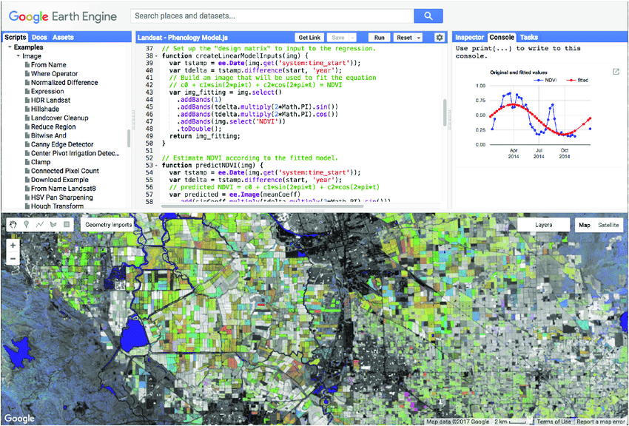
Google Earth Engine
FREE cloud-computing for GIS data!
Incomparable in speed when working with BIG DATA (e.g., large, high-resolution satellite raster data)
More popular in environmental science community
Entry barrier (learning it) may look substantial when coming from GUI e.g., ArcGIS
Currently, Google offers support only for JavaScript (in browser) and a Python API.
https://code.earthengine.google.com
However…(coming up -> ‘RGEE’)

Slide 11
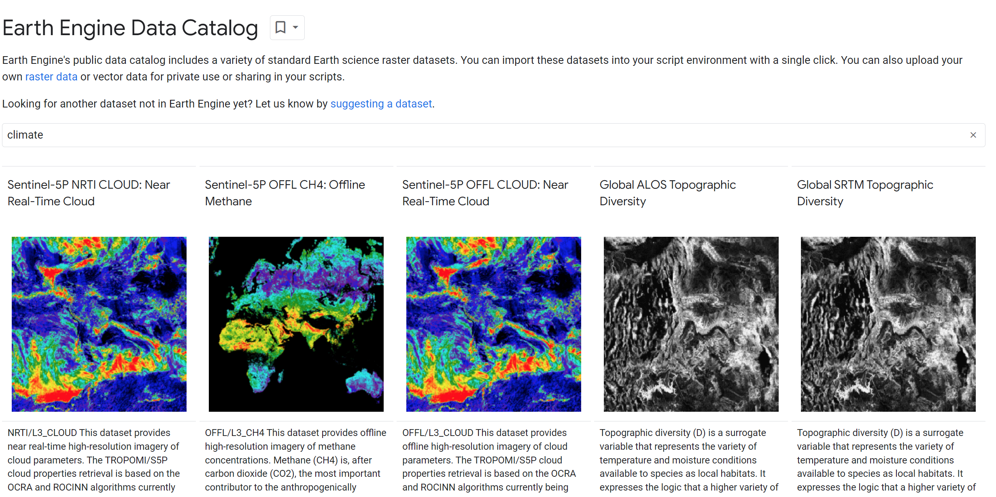
Data availability
Data catalogue https://developers.google.com/earth-engine/datasets

Slide 12
Google Earth Engine: lexicon
Images: gridded rasters containing pixels with values.
Bands: a raster can have multiple variables, e.g. tmax, tmin.
ImageCollections: stack of images, for different days/years
Features: a geometry, such as a polygon, line, or point, and its associated property fields. For example, a lake feature has a polygon and possibly an associated name and water quality value.
FeatureCollections: a collection of features, e.g. a vector containing many points with the same property fields, but with different position in space and property values

Slide 13
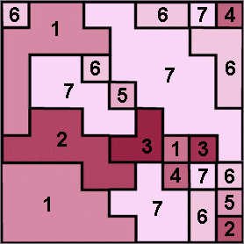
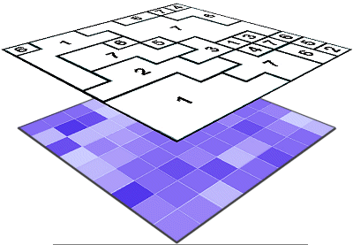
Google Earth Engine: lexicon
Reducer -> function to “collapse” e.g. image pixels into a polygons by a given function (e.g. mean/sum/sd) of pixels of raster inside given boundaries.

Slide 14
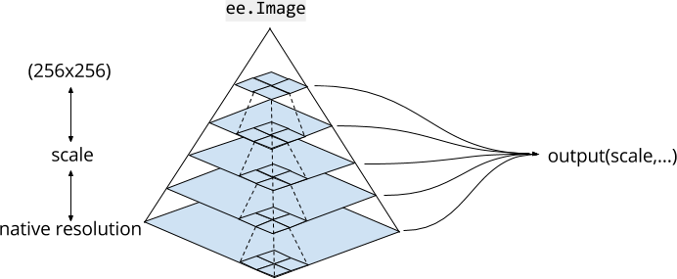
Google Earth Engine: scale
Unlike other GIS tools, in GEE the scale (i.e. resolution) of analysis is determined from the output (i.e. from the user request), rather than the input.
When we run a function e.g. a reducer or Image download, we need to specify a scale (always in meters) at which to process/download the data
GEE does automatically nearest neighbour resampling of the native data resolution to respond to our scale request
Bottom line: higer scale (= resolution) → increases accuracy of the results (up to the native resolution of the data) but slower processing

Slide 15
R + GEE = RGEE

Slide 16
rgee: Google Earth Engine for R
Exploit the cloud computing capability of GEE directly from R scripts
Use the petabyte-scale database of GEE without downloading any raw data on your local computer
Combine gee functions with your usual functions in R, e.g. from tidyverse or the raster/sf packages
→ fast, efficient, replicable GIS processing from your laptop
C Aybar, Q Wu, L Bautista, R Yali and A Barja (2020) rgee: An R package for interacting with Google Earth Engine Journal of Open Source Software URL https://github.com/r-spatial/rgee/.

Slide 17
Setting up and using (r)GEE
The installation and other useful scripts will be shared with these slides on R Users Group webpage. Detailed steps available here
https://github.com/r-spatial/rgee

Slide 18
Requirements
R version 4+ https://cran.r-project.org/bin/windows/base/
RStudio https://www.rstudio.com/products/rstudio/download/
Google account (also institution GMAIL account is fine)

Slide 19
Install rgee (script_configure.R)
install from CRAN with:
install.packages(c("rgee“, “geojsonio”, “tidyverse”, “mapview”, “googledrive”))
library(rgee)
Set up the environment and follow the wizard with:
rgee::ee_install()
→ Answer 'Y' and 1 when prompted
Check that everything went right with:
ee_check()

Slide 20
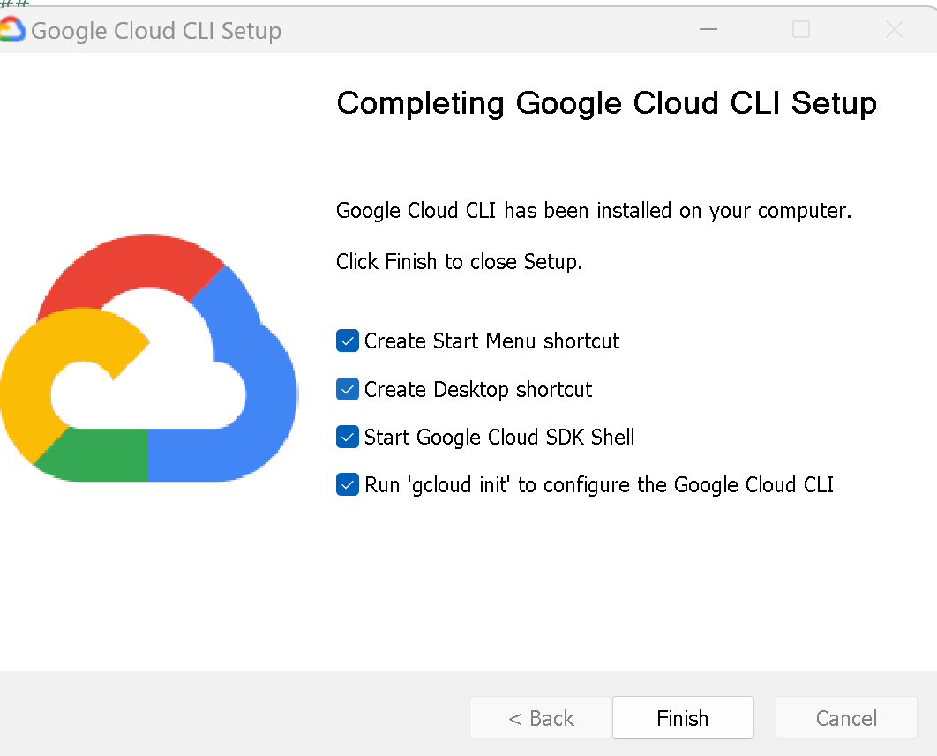
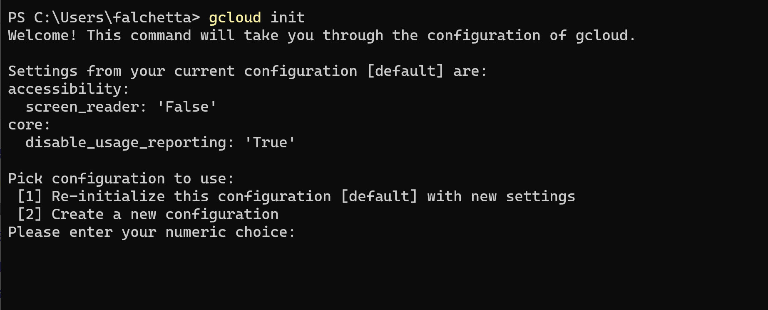
Install rgee (script_configure.R)
Install gcloud (now required for authentication) https://cloud.google.com/sdk/docs/install

Slide 21
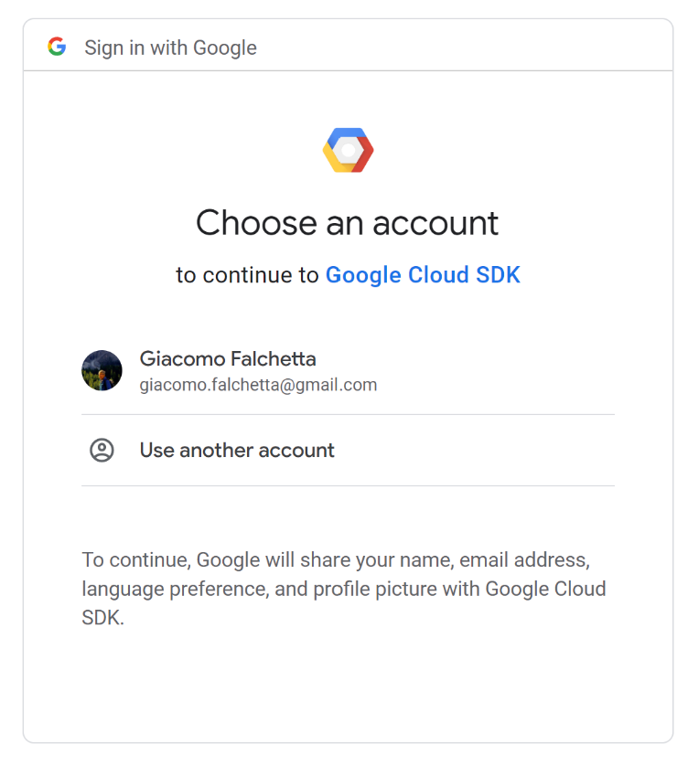
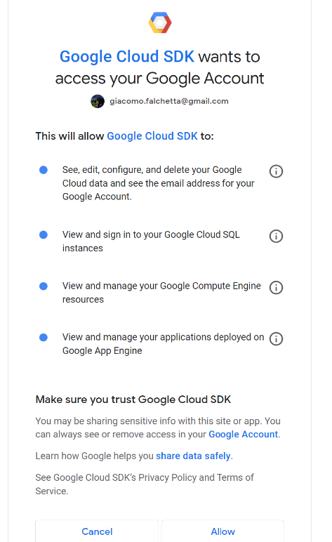
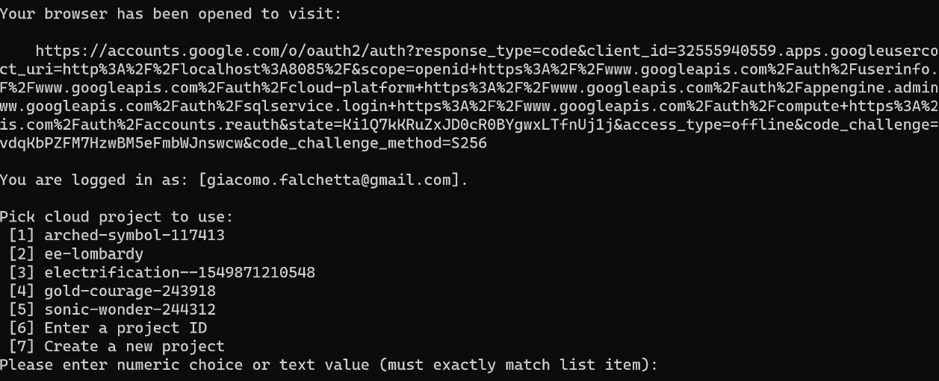
Install rgee (script_configure.R)
Install gcloud (now required for authentication) https://cloud.google.com/sdk/docs/install

Slide 22
Install rgee (script_configure.R)
Finally, in Rstudio load rgee package again and login:
library(rgee)
ee_Initialize(user=”malcolm@gmail.com", drive = TRUE, gcs = FALSE)
[NB: this is required at the beginning of every new R session, after loading the rgee package. Use the same gmail user id that was used to setup the gcloud]

Slide 23
Basic functionality
All rgee functions have the prefix ee_. Auto-completion is your friend…
Full access to the Earth Engine API with the prefix ee$...
rgee is "pipe-friendly” %>%
You can download GEE data (ee$Image / ee$FeatureCollection) and convert them to raster/sf objects in your local R session:
ee_as_sf() -> GEE FeatureCollection to sf Shapefile
ee_as_raster() -> GEE Image to Raster

Slide 24
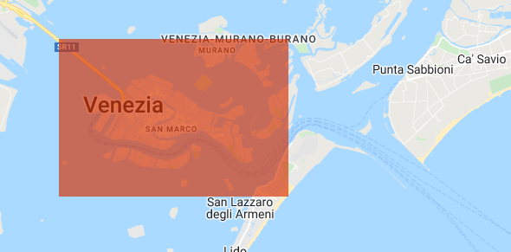
Example: precipitations time series (i)
# create a bounding box over Venice
geometry <- ee$Geometry$Polygon(coords = list(c(12.29, 45.45), c(12.29, 45.41), c(12.37, 45.41), c(12.37, 45.45)))

Slide 25
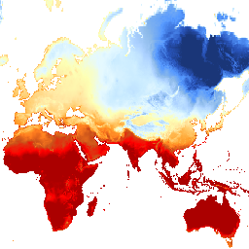
Example: precipitations time series (ii)
TerraClimate is a dataset of monthly climate and climatic water balance for global terrestrial surfaces from 1958-2019. These data provide important inputs for ecological and hydrological studies at global scales that require high spatial resolution and time-varying data. All data have monthly temporal resolution and a ~4-km (1/24th degree) spatial resolution.
Abatzoglou, J.T., S.Z. Dobrowski, S.A. Parks, K.C. Hegewisch, 2018, Terraclimate, a high-resolution global dataset of monthly climate and climatic water balance from 1958-2015, Scientific Data 5:170191, doi:10.1038/sdata.2017.191
https://developers.google.com/earth-engine/datasets/catalog/IDAHO_EPSCOR_TERRACLIMATE
Every dataset on GEE has a page where details are listed (variables, resolution, timestep, period covered, etc.). Worth checking it out before using any new dataset

Slide 26
Example: precipitations time series (iii)
Import terraclimate historical climate dataset
terraclimate <- ee$ImageCollection("IDAHO_EPSCOR/TERRACLIMATE") %>%
ee$ImageCollection$filterDate("2020-01-01", "2021-01-01") %>%
ee$ImageCollection$map(function(x) x$select("pr")) %>%
ee$ImageCollection$toBands() %>%
ee$Image$rename(sprintf("PP_%02d",1:12))

Slide 27
Example: precipitations time series (iv)
extract mean precipitations over Venice in 2020
ee_nc_rain <- ee_extract(x = terraclimate, y = geometry, fun=ee$Reducer$mean(), sf = FALSE)
Reshape the data
ee_nc_rain_long <- ee_nc_rain %>%
pivot_longer(1:12, names_to = "month", values_to = "pr") %>%
mutate(month, month=gsub("PP_", "", month))

Slide 28
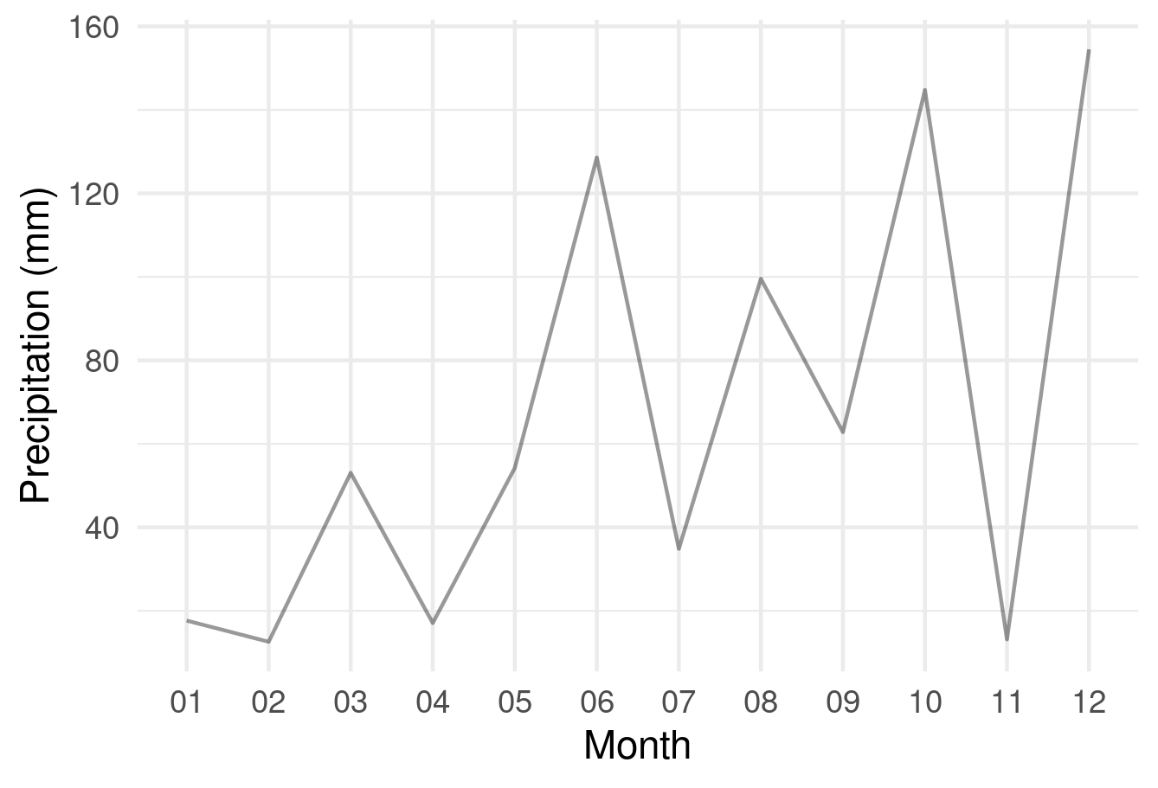
Example: precipitations time series (v)
# plot the data
ggplot(ee_nc_rain_long, aes(x = month, y = pr, group=1)) + geom_line(alpha = 0.4) + xlab("Month") + ylab("Precipitation (mm)") + theme_minimal()

Slide 29
Example: precipitations time series (vi)
# long run mean precipitations, by month
terraclimate_10yr <- ee$ImageCollection("IDAHO_EPSCOR/TERRACLIMATE") %>%
ee$ImageCollection$filterDate("2010-01-01", "2021-01-01") %>%
ee$ImageCollection$map(function(x) x$select("pr")) %>%
ee$ImageCollection$toBands()
ee_nc_rain <- ee_extract(x = terraclimate_10yr, y = geometry, fun=ee$Reducer$mean(), sf = FALSE)
ee_nc_rain_long <- ee_nc_rain %>%
pivot_longer(1:132, names_to = "date", values_to = "pr") %>%
mutate(month=substr(date, 6, 7), year=substr(date, 2, 5))

Slide 30
Documentation and learning
rgee Github page: https://github.com/r-spatial/rgee
rgee beginner manual: http://amazeone.com.br/barebra/pandora/rgeebookT1eng.pdf
rgee code examples catalogue: https://csaybar.github.io/rgee-examples/ and https://github.com/csaybar/rgee-examples
GEE Stack Overflow: https://gis.stackexchange.com/questions/tagged/google-earth-engine

Slide 31
When in doubt, ask you friend neighbourhood Climate/Geo-Spatial Data Geek
malcolm.mistry@lshtm.ac.uk

Slide 32
Advance!! Upload your own data
The GEE catalogue is very large, but what if you want to process data using your custom FeatureCollections (shapefiles) or Images (rasters) that are not available in the catalogue?
For shapefiles -> very straightforward
my_shapefile <- read_sf("shape.shp")
my_shapefile_gee <- sf_as_ee(my_shapefile)
For rasters -> Less straightforward (see the script_upload_your_assets.R example file), or upload manually via https://code.earthengine.google.com
my_raster <- raster("myraster.tif")
my_raster_gee <- raster_as_ee(my_raster, assetId = "my_raster", bucket=X)
To use this function, you need to create a Google Cloud Storage bucket

