Slide 1
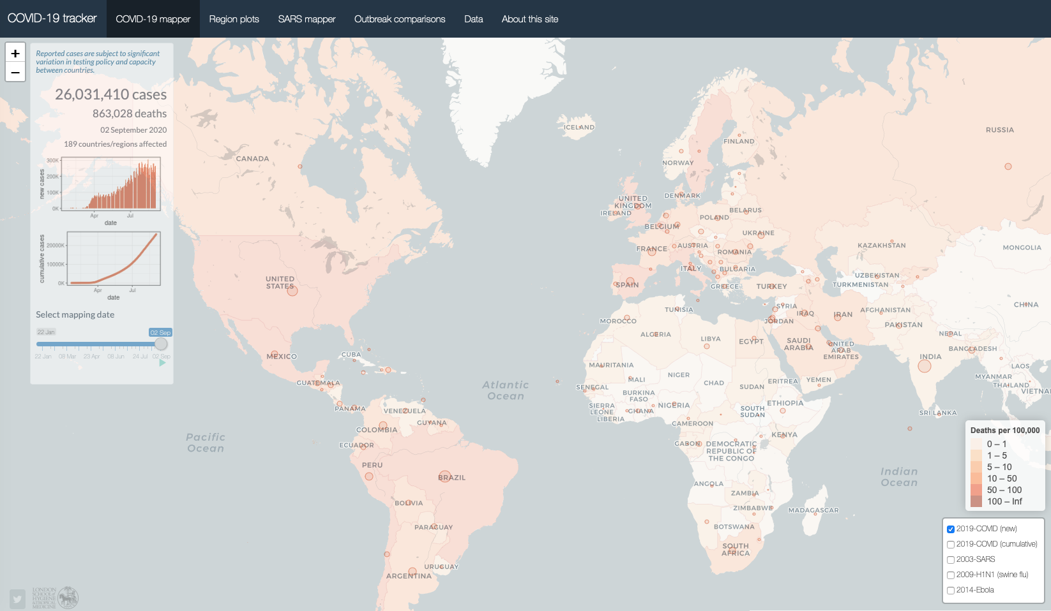
How to build a Shiny app in 10 days
Edward Parker
London School of Hygiene & Tropical Medicine
Notes:
Good afternoon
It’s a pleasure to be joining you for today’s session on interactive data visualization and dashboards
I’m very much looking forward to the upcoming presentations in the session, and what I plan to offer in this opening talk is a case study of my experience developing a COVID-19 case tracker

Slide 2
Key messages
If you are an R coder, give Shiny a try (if I can do it, anyone can!)
Stand on the shoulders of giants – the Shiny Gallery (https://shiny.rstudio.com/gallery/) is full of amazing apps, each linked to a repository of code
Notes:
And with that in mind the key messages I hope to convey are simply ones of encouragement
If you are an R coder, give Shiny a try, however experienced you are – it’s a very powerful way to build elegant data visualisations, and I certainly hope that Shiny and equivalent platforms become an increasing part of how we communicate data in the future
And second, don’t be afraid to stand on the shoulders of giants – the Shiny Gallery is absolutely full of amazing apps with linked code
And if I’m completely honest with you, the case tracker I developed is in many ways a hybrid of borrowed parts from existing apps that I’ve bolted together in a new way
I should add a brief disclaimer that because the app is made in Shiny, the talk becomes a little bit centred on R coding when we get into the nuts and bolts, although I do hope some of the general ideas will be interesting to a broader audience that isn’t familiar with R

Slide 3
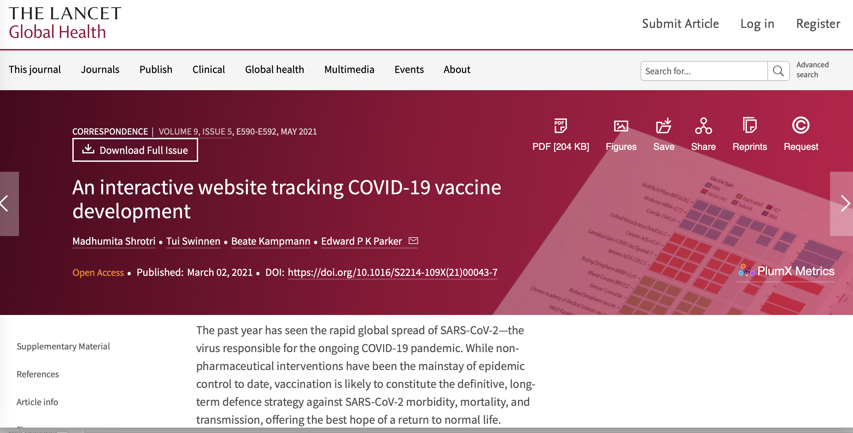
COVID-19 case tracker – launched Feb 2020
https://vac-lshtm.shinyapps.io/ncov_tracker/
Code: https://github.com/eparker12/nCoV_tracker
COVID-19 vaccine tracker – launched April 2020
https://vac-lshtm.shinyapps.io/ncov_vaccine_landscape/
Code: https://github.com/vac-lshtm/VaC_tracker
Notes:
Right, so without further ado, let’s take a look at the app
Since this is a session on interactive data, I’m going to attempt to switch seamlessly away from powerpoint and interact with some data…
So here is the app
As you can see, the main page features a world map which you can scroll round and zoom in and out
The circles display the extent of the COVID pandemic within the last 24 hours
You can hover over any country to see the number of newly-diagnosed cases and COVID-related deaths
So for example, Spain recorded X new cases and X deaths
While the UK recorded X new cases and X deaths, and that corresponds to X cases per 100,000 individuals
And as I’ll discuss later these numbers are extracted daily from the data curated by Johns Hopkins University who have really been at the forefront of mapping the COVID pandemic from the outset
There are a few other key features
Using the checkboxes in the bottom right you can switch between new and cumulative cases, and you also have the option to overlay past outbreaks – for example, SARS, H1N1 and Ebola
When I launched the app in February the idea of these was to help give context to the daily headlines on case counts, although to be honest the numbers have been dwarfed by COVID as the pandemic took hold, so the comparisons are perhaps a bit less informative now
Another key feature that remains relatively unique to this dashboard is the ability to wind back the clock and visualize the state of the pandemic on any given date
And I think this offers valuable insight into some of the key windows in which the pandemic accelerated – for example, you can see how important the month of March was… discuss
So this interactive map is really the foundation of the dashboard
But while maps are certainly good at representing some kinds of data, they do struggle to capture trends through time
So with this in mind, I added the ‘Region plots’ tab about a month after launching the dashboard
Here you can plot various outcomes …
Based on the dropdown menus on the left-hand side…
And you also the option to plot either the date on the x axis or to normalize the start date…
And I think it’s worth mentioning that the app has grown over time
I put my contact details in the final tab, and various researchers and members of the public have got in touch with suggestions for new features
So there are a few other tabs but those are really the key parts of the app. Do go on and check it out for yourself
The address is in the slides, and the app is also featured in the Shiny gallery
Notably, I’ve published all the code required to generate the app on Github, so do go on there and please try to be forgiving and don’t judge the poorly annotated code too harshly
App has evolved over time – code was quite succinct when I launched it in February but has become more and more unwieldy as I’ve bolted on more and more features

Slide 4
Building the case tracker
Notes:
Switch back to powerpoint
Talk through the key nuts and bolts of how the app operates

Slide 5
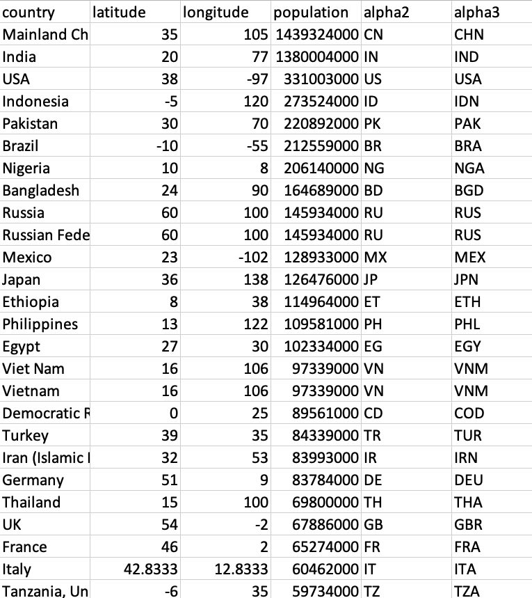
Country data
Latitude/longitude
Population
Continent
Notes:
First building block is data-frame containing a few basic parameters for each country
This includes the latitude and longitude, which act as the centre points of the circles in the map
And it also includes population size according to recent to data from the UN, which are used to calculate the normalized case counts per 100,000 individuals

Slide 6
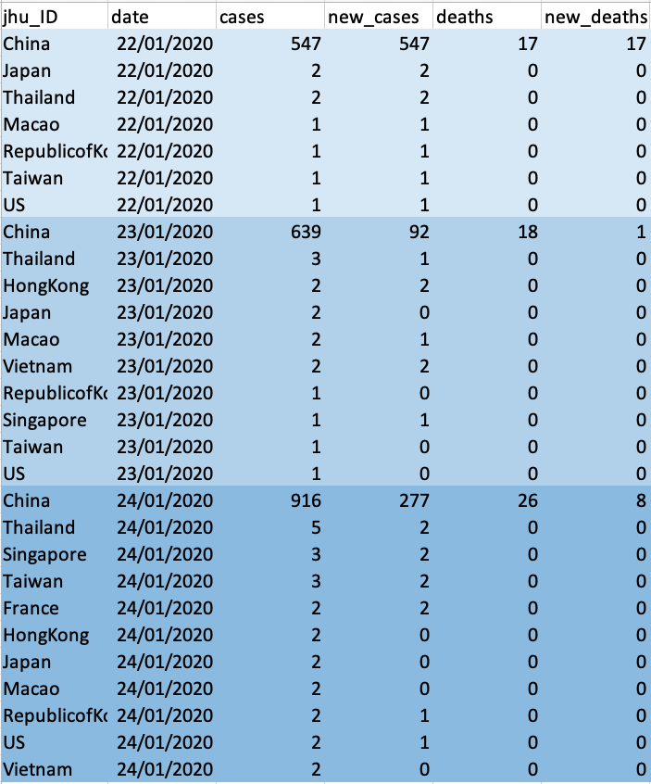
Case data
Country
Date
Cases (new/cumulative)
Deaths (new/cumulative)
Notes:
Second building block is a data frame of COVID-related cases and deaths by date
So here I’ve show the top of the data frame with the data for the 22nd, 23rd and 24th of January
But of course these data aren’t static, so a key challenge for the app is how to keep it up to date, and this is a process that has certainly refined over time

Slide 7
WHO COVID-19 situation report, 29 Feb 2020
(3) Updates
The slow way…
https://www.who.int/emergencies/diseases/novel-coronavirus-2019/situation-reports
Notes:
From the outset of the COVID pandemic, institutes including the WHO and Johns Hopkins University have done an incredible job of making the latest data on case counts publicly available
When I started the app, I used to start every day by downloading the latest PDF from the WHO, manually extracting the latest numbers and bolting on that day’s data to the bottom of the data frame
But obviously this is a job that became harder and harder as the virus spread

Slide 8
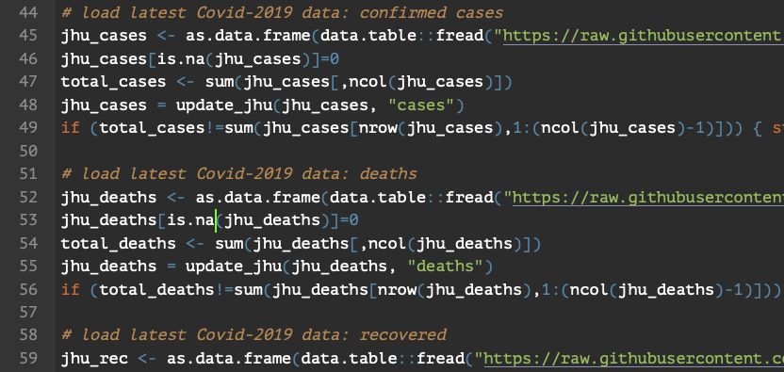
WHO COVID-19 situation report, 29 Feb 2020
(3) Updates
The slow way…
…then the fast*
* Thanks to Quentin Leclerc for co-authoring the automation script
Notes:
So at the end of February I worked with a PhD student at the London School to develop a script that automatically downloads the latest daily data from the github page run curated by Johns Hopkins University
And this effectively automated the daily updates
Ever since we finished the script, the app has been updating itself daily and I just leave it to do its thing

Slide 9
(4) The base map… the leaflet package does all the hard work
https://rstudio.github.io/leaflet/
Notes:
Now it’s one thing to have the data but of course the next thing is to map it
This is where the leaflet package comes in
And in terms of the interactive elements of the dashboard, such as the scrolling and zooming, it’s really the leaflet package that is doing all the hard work
I’ve shown the chunk of code for the basemap at the top of this slide; as you can see it’s about 10 lines
And this code is doing a few key things

Slide 10
(4) The base map… the leaflet package does all the hard work
https://rstudio.github.io/leaflet/
Notes:
And this code is doing a few key things, including adding the checkbox in the bottom right

Slide 11
(4) The base map… the leaflet package does all the hard work
https://rstudio.github.io/leaflet/
Notes:
Choosing the style of map from the options available in the leaflet package

Slide 12
(4) The base map… the leaflet package does all the hard work
https://rstudio.github.io/leaflet/
Notes:
And adding the legend coloured by cumulative deaths per 100,000 individuals

Slide 13
(5) The visualised case counts: ui server
https://github.com/eparker12/nCoV_tracker
Notes:
Finally, we get to the real internal cogs of the dashboard
Now I don’t want to get too caught up in the details of Shiny apps
There are fantastic tutorials for this online
But the basic principle is that you have two interacting chunks of code – one for the user interface or ‘ui’, which is basically the bit you can see
And one for the server, which is the bit that you can’t see running in the background
And in essence, the server is reacting to changes you make in the user interface, and updating the maps, plots and figures accordingly

Slide 14
(5) The visualised case counts: ui server
ui:
absolutePanel() containing sliderInput()
https://github.com/eparker12/nCoV_tracker
Notes:
So I thought I’d illustrate this cycle of interaction for one of the key interactive elements of the COVID case tracker
As shown here, on the main mapping page of the user interface has a slider which you can use to select the date
This is coded by a slider input function in the Shiny package, which I’ve shown here on the right
So that gives you the interactive element on the user interface

Slide 15
(5) The visualised case counts: ui server
server
(i) subset data to selected date
https://github.com/eparker12/nCoV_tracker
Notes:
Now when you change the date, two key things happen in the server
The first is very simple: a subset of the input data is created corresponding to the selected date – so that’s pretty simple; one line of code

Slide 16
(5) The visualised case counts: ui server
server
(i) subset data to selected date
(ii) add circle markers to map
https://github.com/eparker12/nCoV_tracker
Notes:
Next, we need to add the circles for that date to the leaflet base map, and I’ve shown some of the key code for this here
And this is doing a couple of key things

Slide 17
(5) The visualised case counts: ui server
server
(i) subset data to selected date
(ii) add circle markers to map
https://github.com/eparker12/nCoV_tracker
Notes:
It’s clearing the existing circles from the map

Slide 18
(5) The visualised case counts: ui server
server
(i) subset data to selected date
(ii) add circle markers to map
https://github.com/eparker12/nCoV_tracker
Notes:
It’s then reading in the new data subset that was just created

Slide 19
(5) The visualised case counts: ui server
server
(i) subset data to selected date
(ii) add circle markers to map
circle location
size
label
https://github.com/eparker12/nCoV_tracker
Notes:
And adding circles, and here you simply need to specify the location of the circles based on the latitude and longitude
The size of the circle based on the case count
And the lab that appears when you hover over the circle

Slide 20
(5) The visualised case counts: ui server
ui:
renders circles for selected date
https://github.com/eparker12/nCoV_tracker
Notes:
And these updates are then being rendered in the user interface
Now I’ve simplified things slightly in this example, but those are the basic mechanics underlying the dashboard
And if you are keen for more details, you can look at the complete code on github

Slide 21
A few final tips
Start from a blank slate and build the dashboard piece by piece
Learn by doing, and use the tutorials and Shiny gallery to help
Get creative!
Notes:
Finally, get creative! It’s not very often that we think of science or data visualization as an artistic endeavor, but I really think it should be
And I really think that these interactive dashboards offer a chance to flex our creative muscles as researchers

Slide 22
Thanks!
Notes:
And with that, I’d like to to thank you all for your time, and I look forward to joining you live for the Q&A

