Slide 1
R Markdown for Dashboard Creation and Publishing to Posit Cloud R Users Group talks
William Jones-Warner
London Applied and Spatial Epidemiology Research Group
Department of Disease Control
Faculty of Infectious and Tropical Diseases

Slide 2
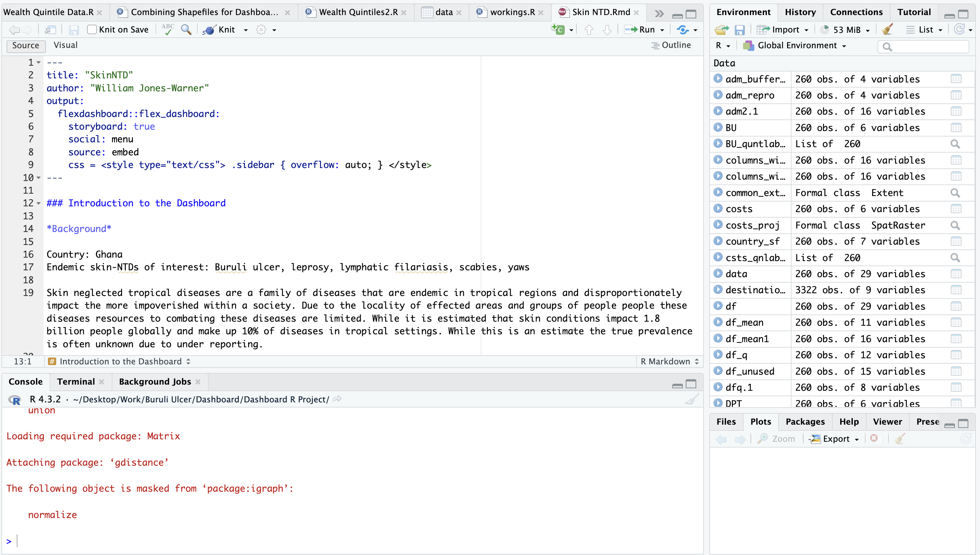
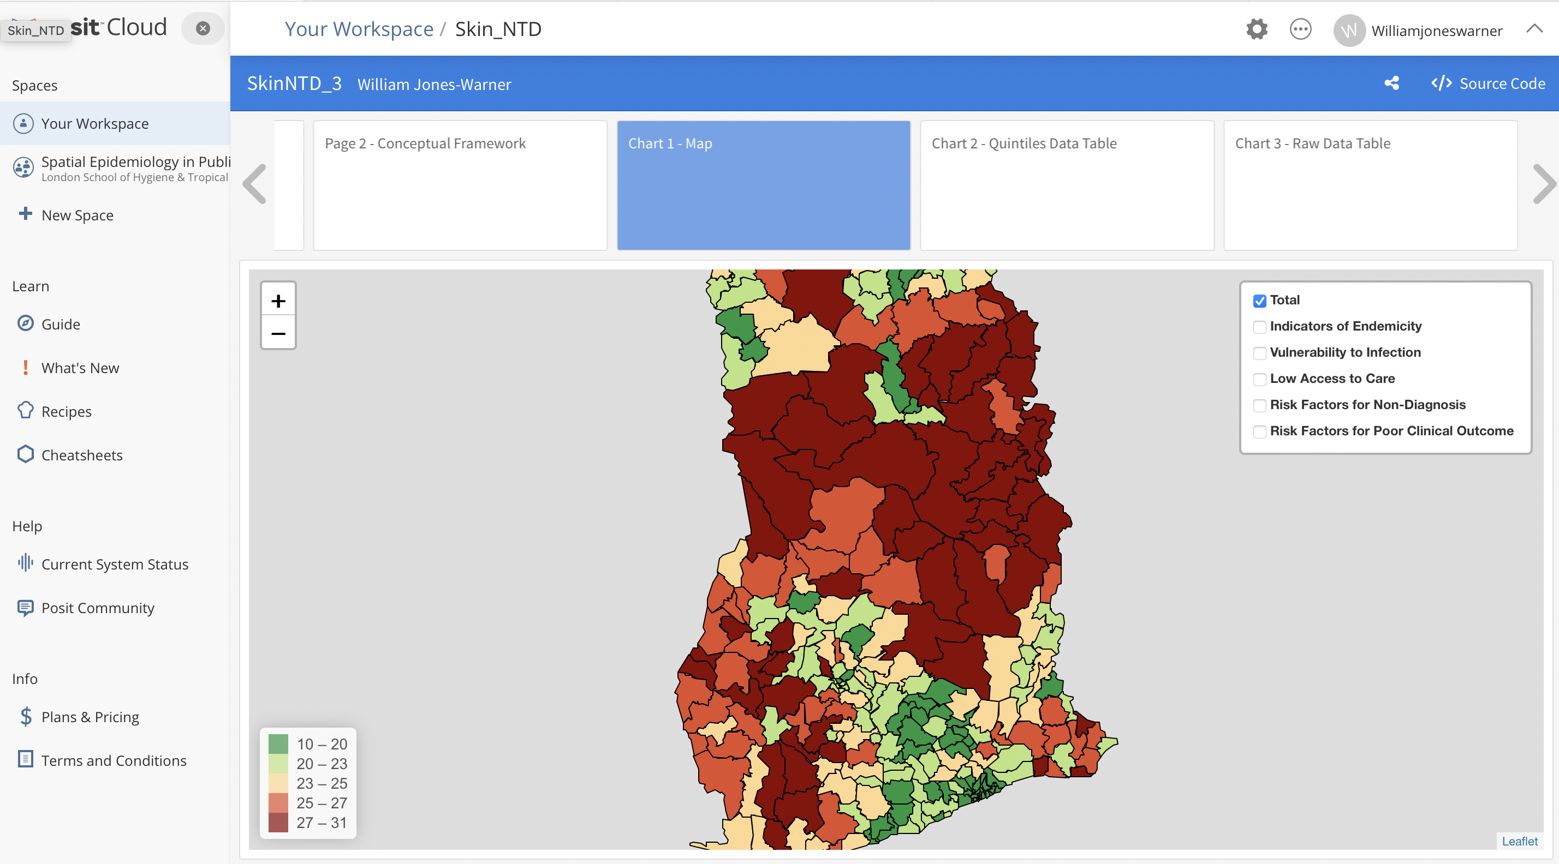
What is Markdown?
Powerful tool for integrating data analysis and report generation directly from R code.
Create dynamic documents, presentations, and reports that combine code, its output, and explanatory text in a single document.
Integrate Multiple R outputs such as graphs, maps, plots into a single document that one can make interactive.
Publish these documents online to share publicly or with stakeholders
Updated Version of Markdown now available: Quarto

Slide 3
Our Aim for the Markdown
Objective: Develop a tool grounded in an evidence-based consensus framework that guides stakeholders and decision-makers in identifying optimal locations for active case detection of Skin NTDs in Ghana.
Why was Markdown used?
Sharable
Interactive
Easy to use
Steps required;
Build Consensus Framework outlining process and justification for Proxies/indicators
Collate open-source datasets that work as proxies/indicators
Prepare datasets and raster to use in R
Extract data at IU Level (district) for each indicators
Process Proxies and indicators in Tables, charts and maps on markdown.

Slide 4
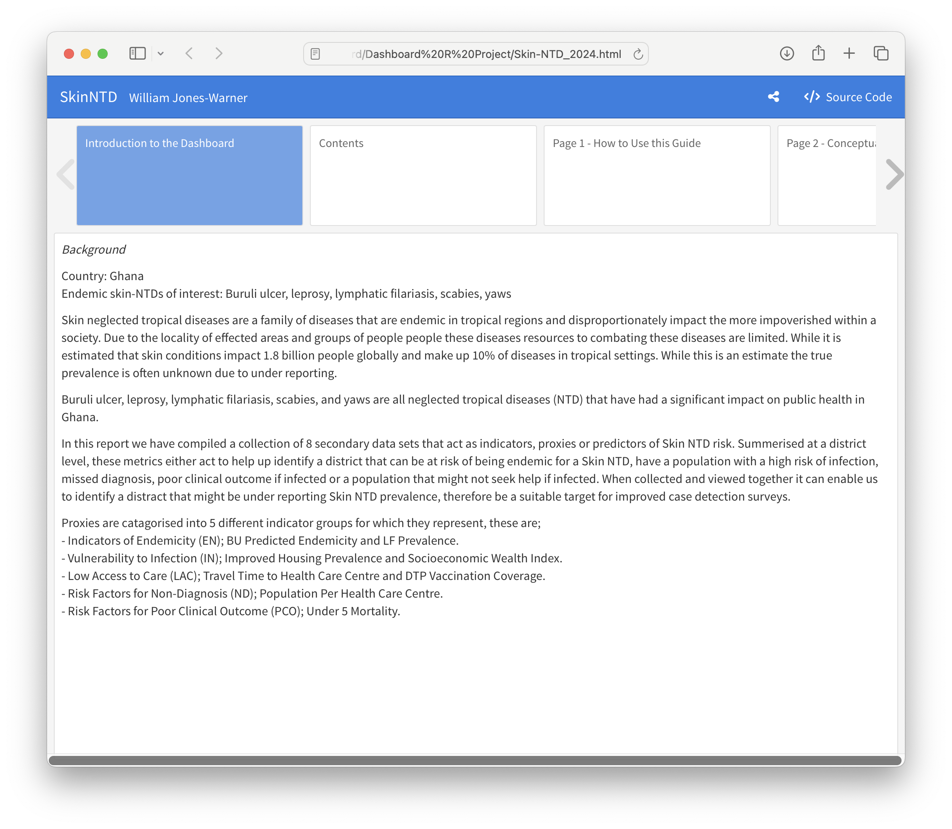
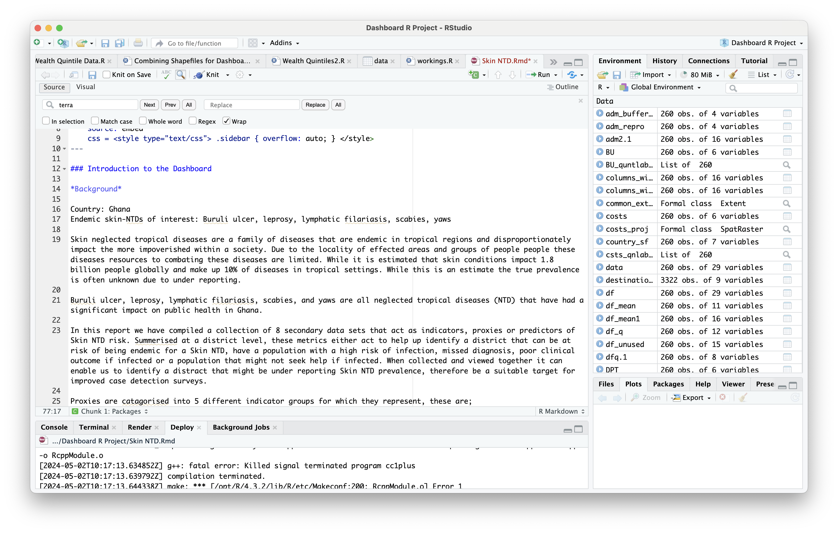
Sections of the Dashboard – Text pages

Slide 5
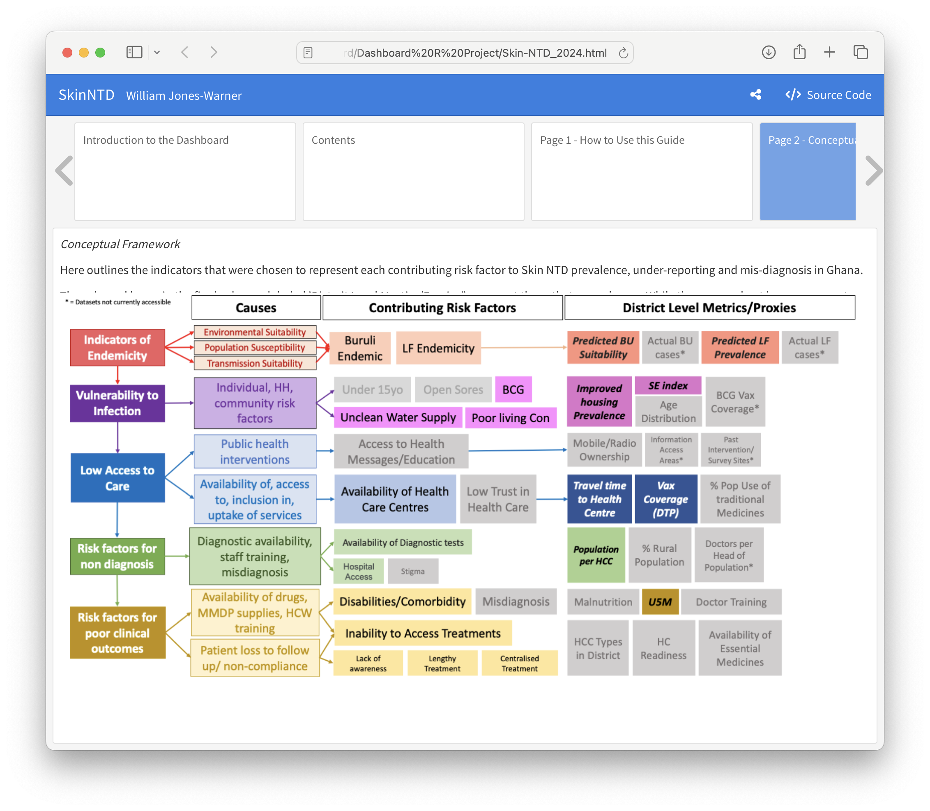
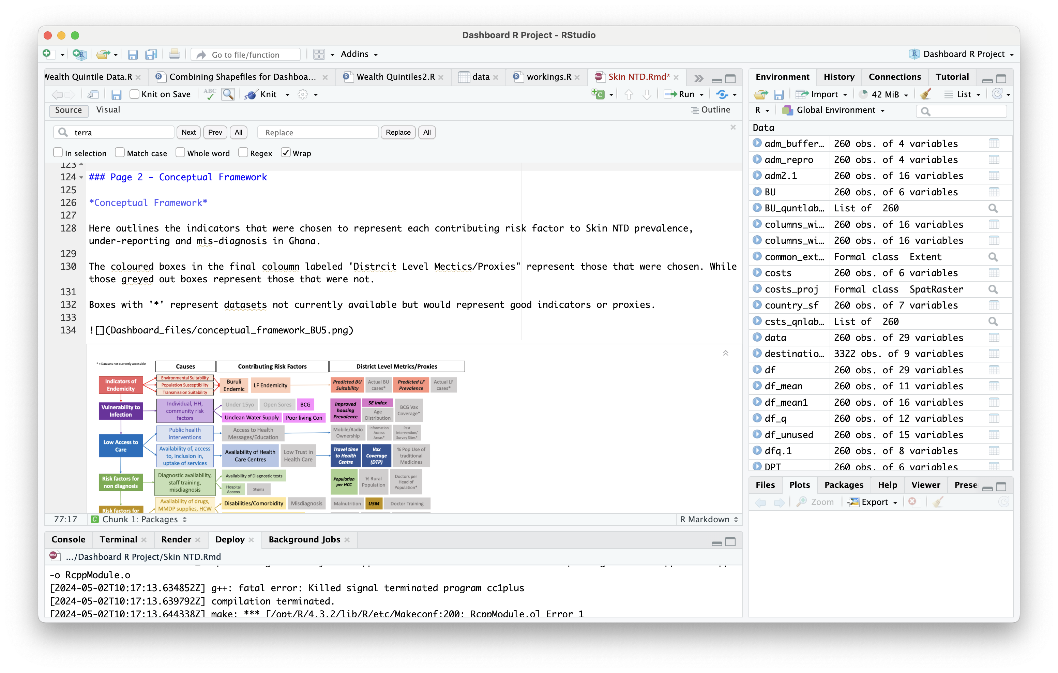
Sections of the Dashboard – Image Pages

Slide 6
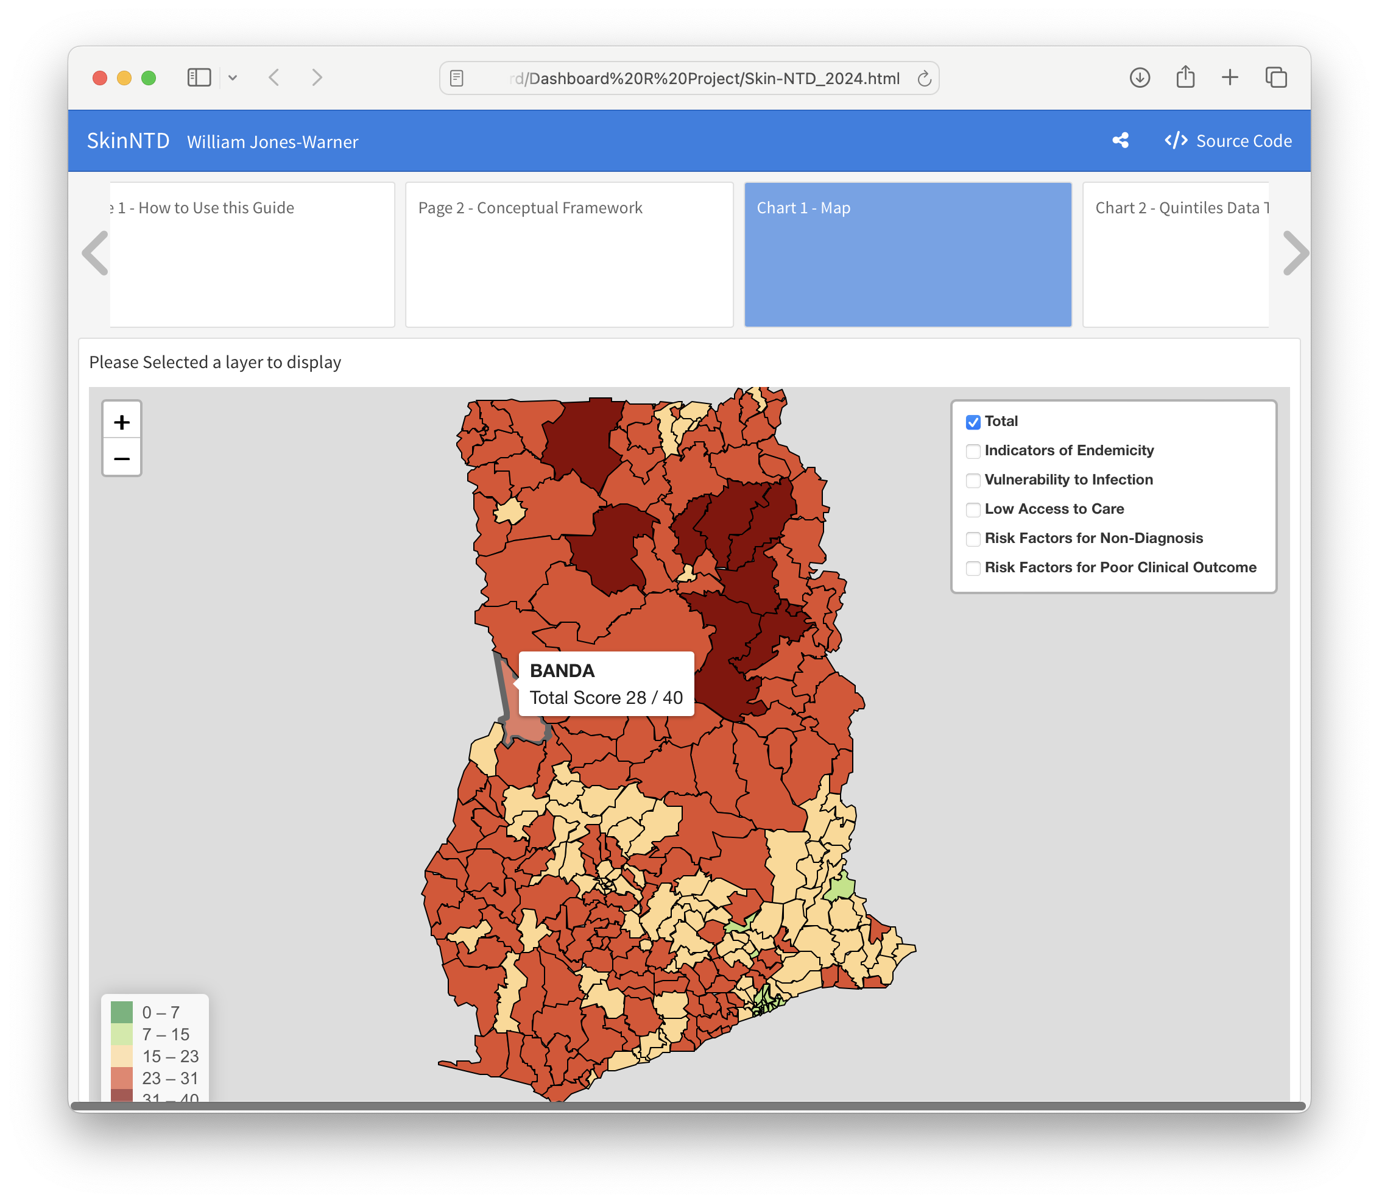
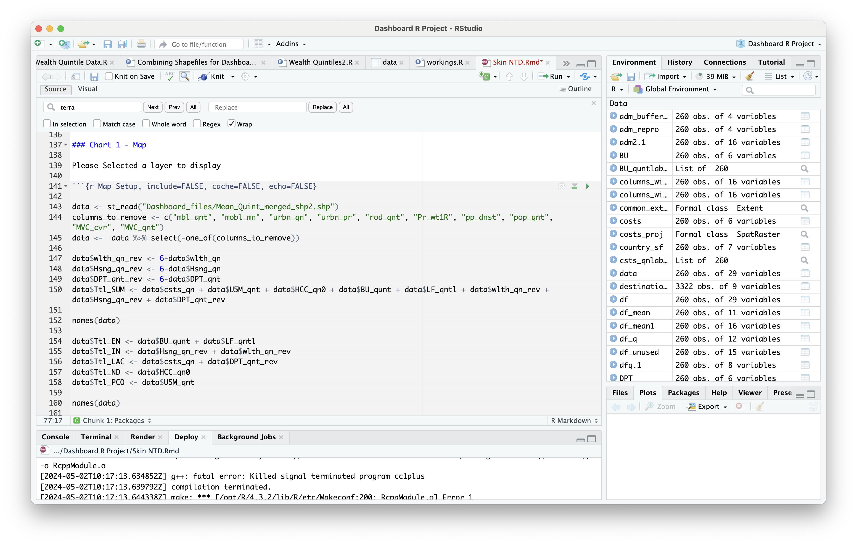
Sections of the Dashboard – Interactive Map
Used Package: leaflet()

Slide 7
Why Posit Cloud?
Wanted a location that one will be able to share the output of the report directly with stakeholders and decision makers via an online link.
Wanted in interactive report – therefore R markdown was an ideal candidate so required somewhere we could share R mark down inputs. Posit cloud allows for this.
Posit Cloud can host larger files than github. >100mb

Slide 8
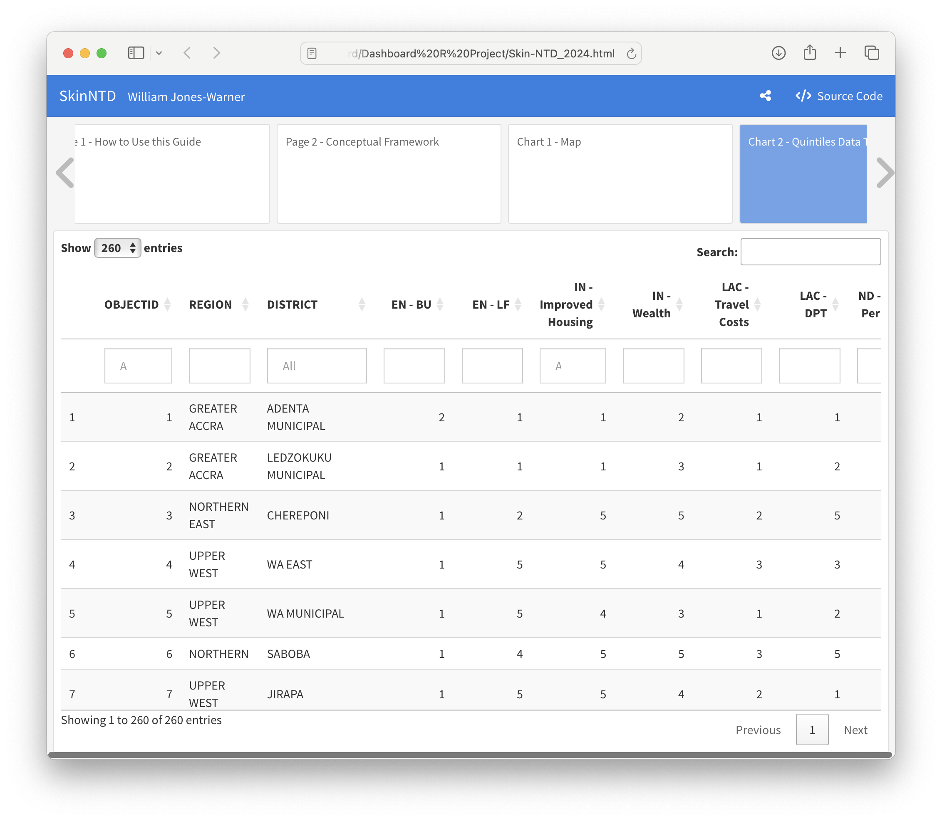
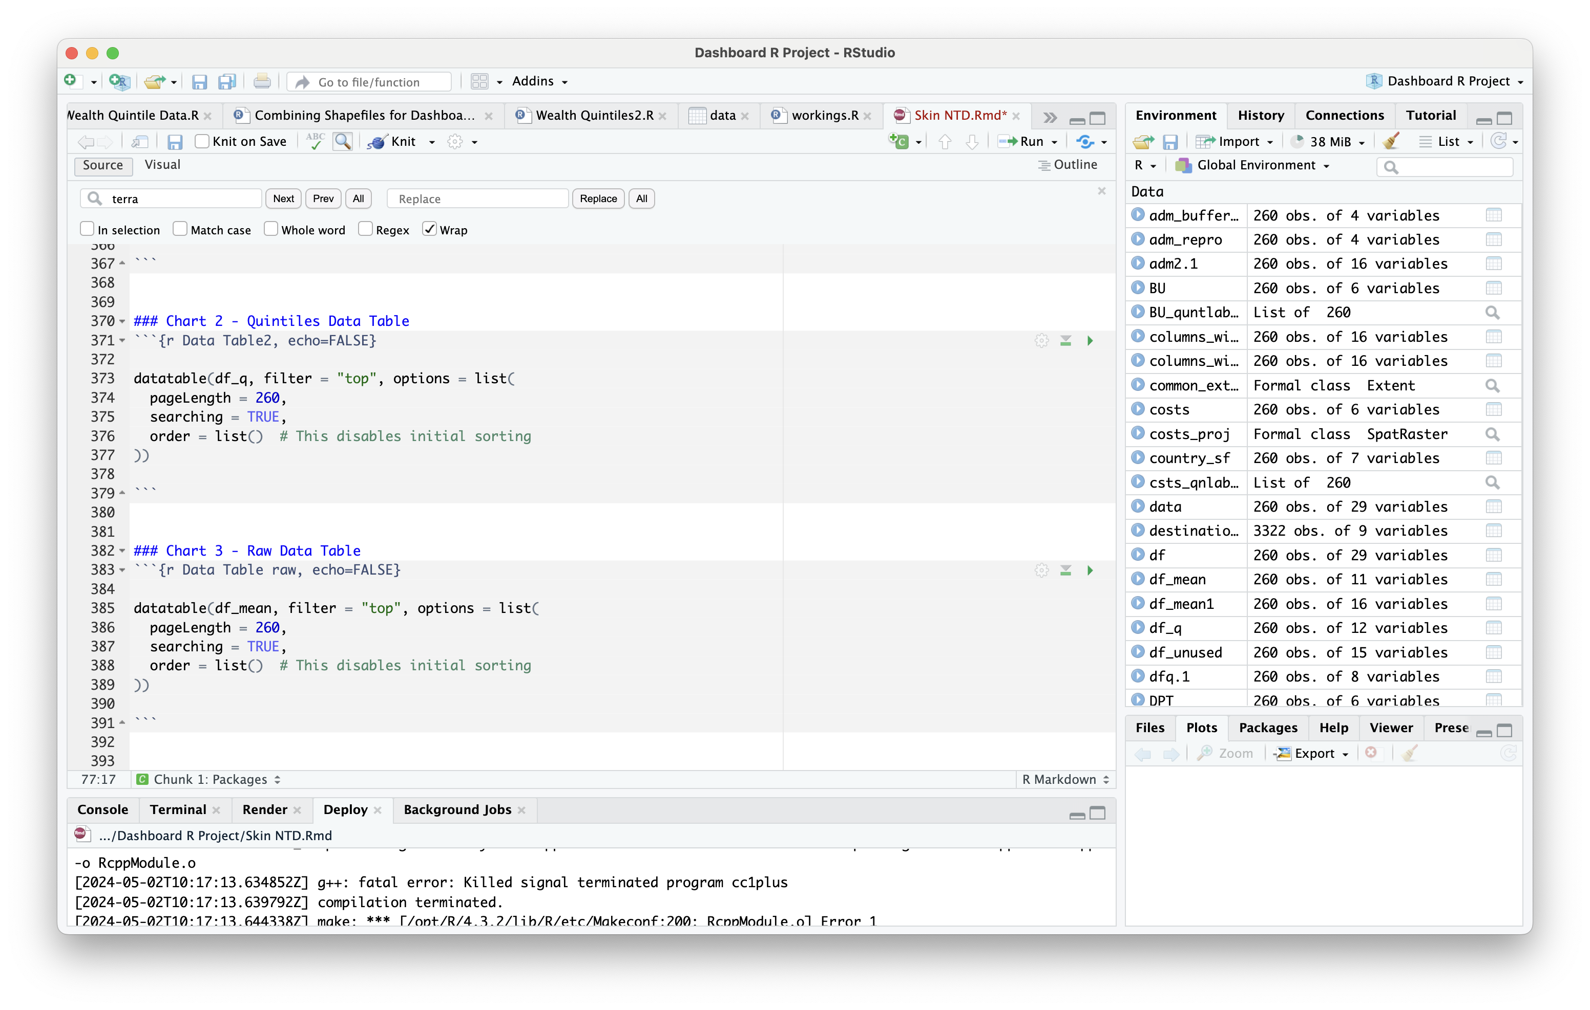
Sections of the Dashboard – Data Tables
Used Package: datatable()

Slide 9
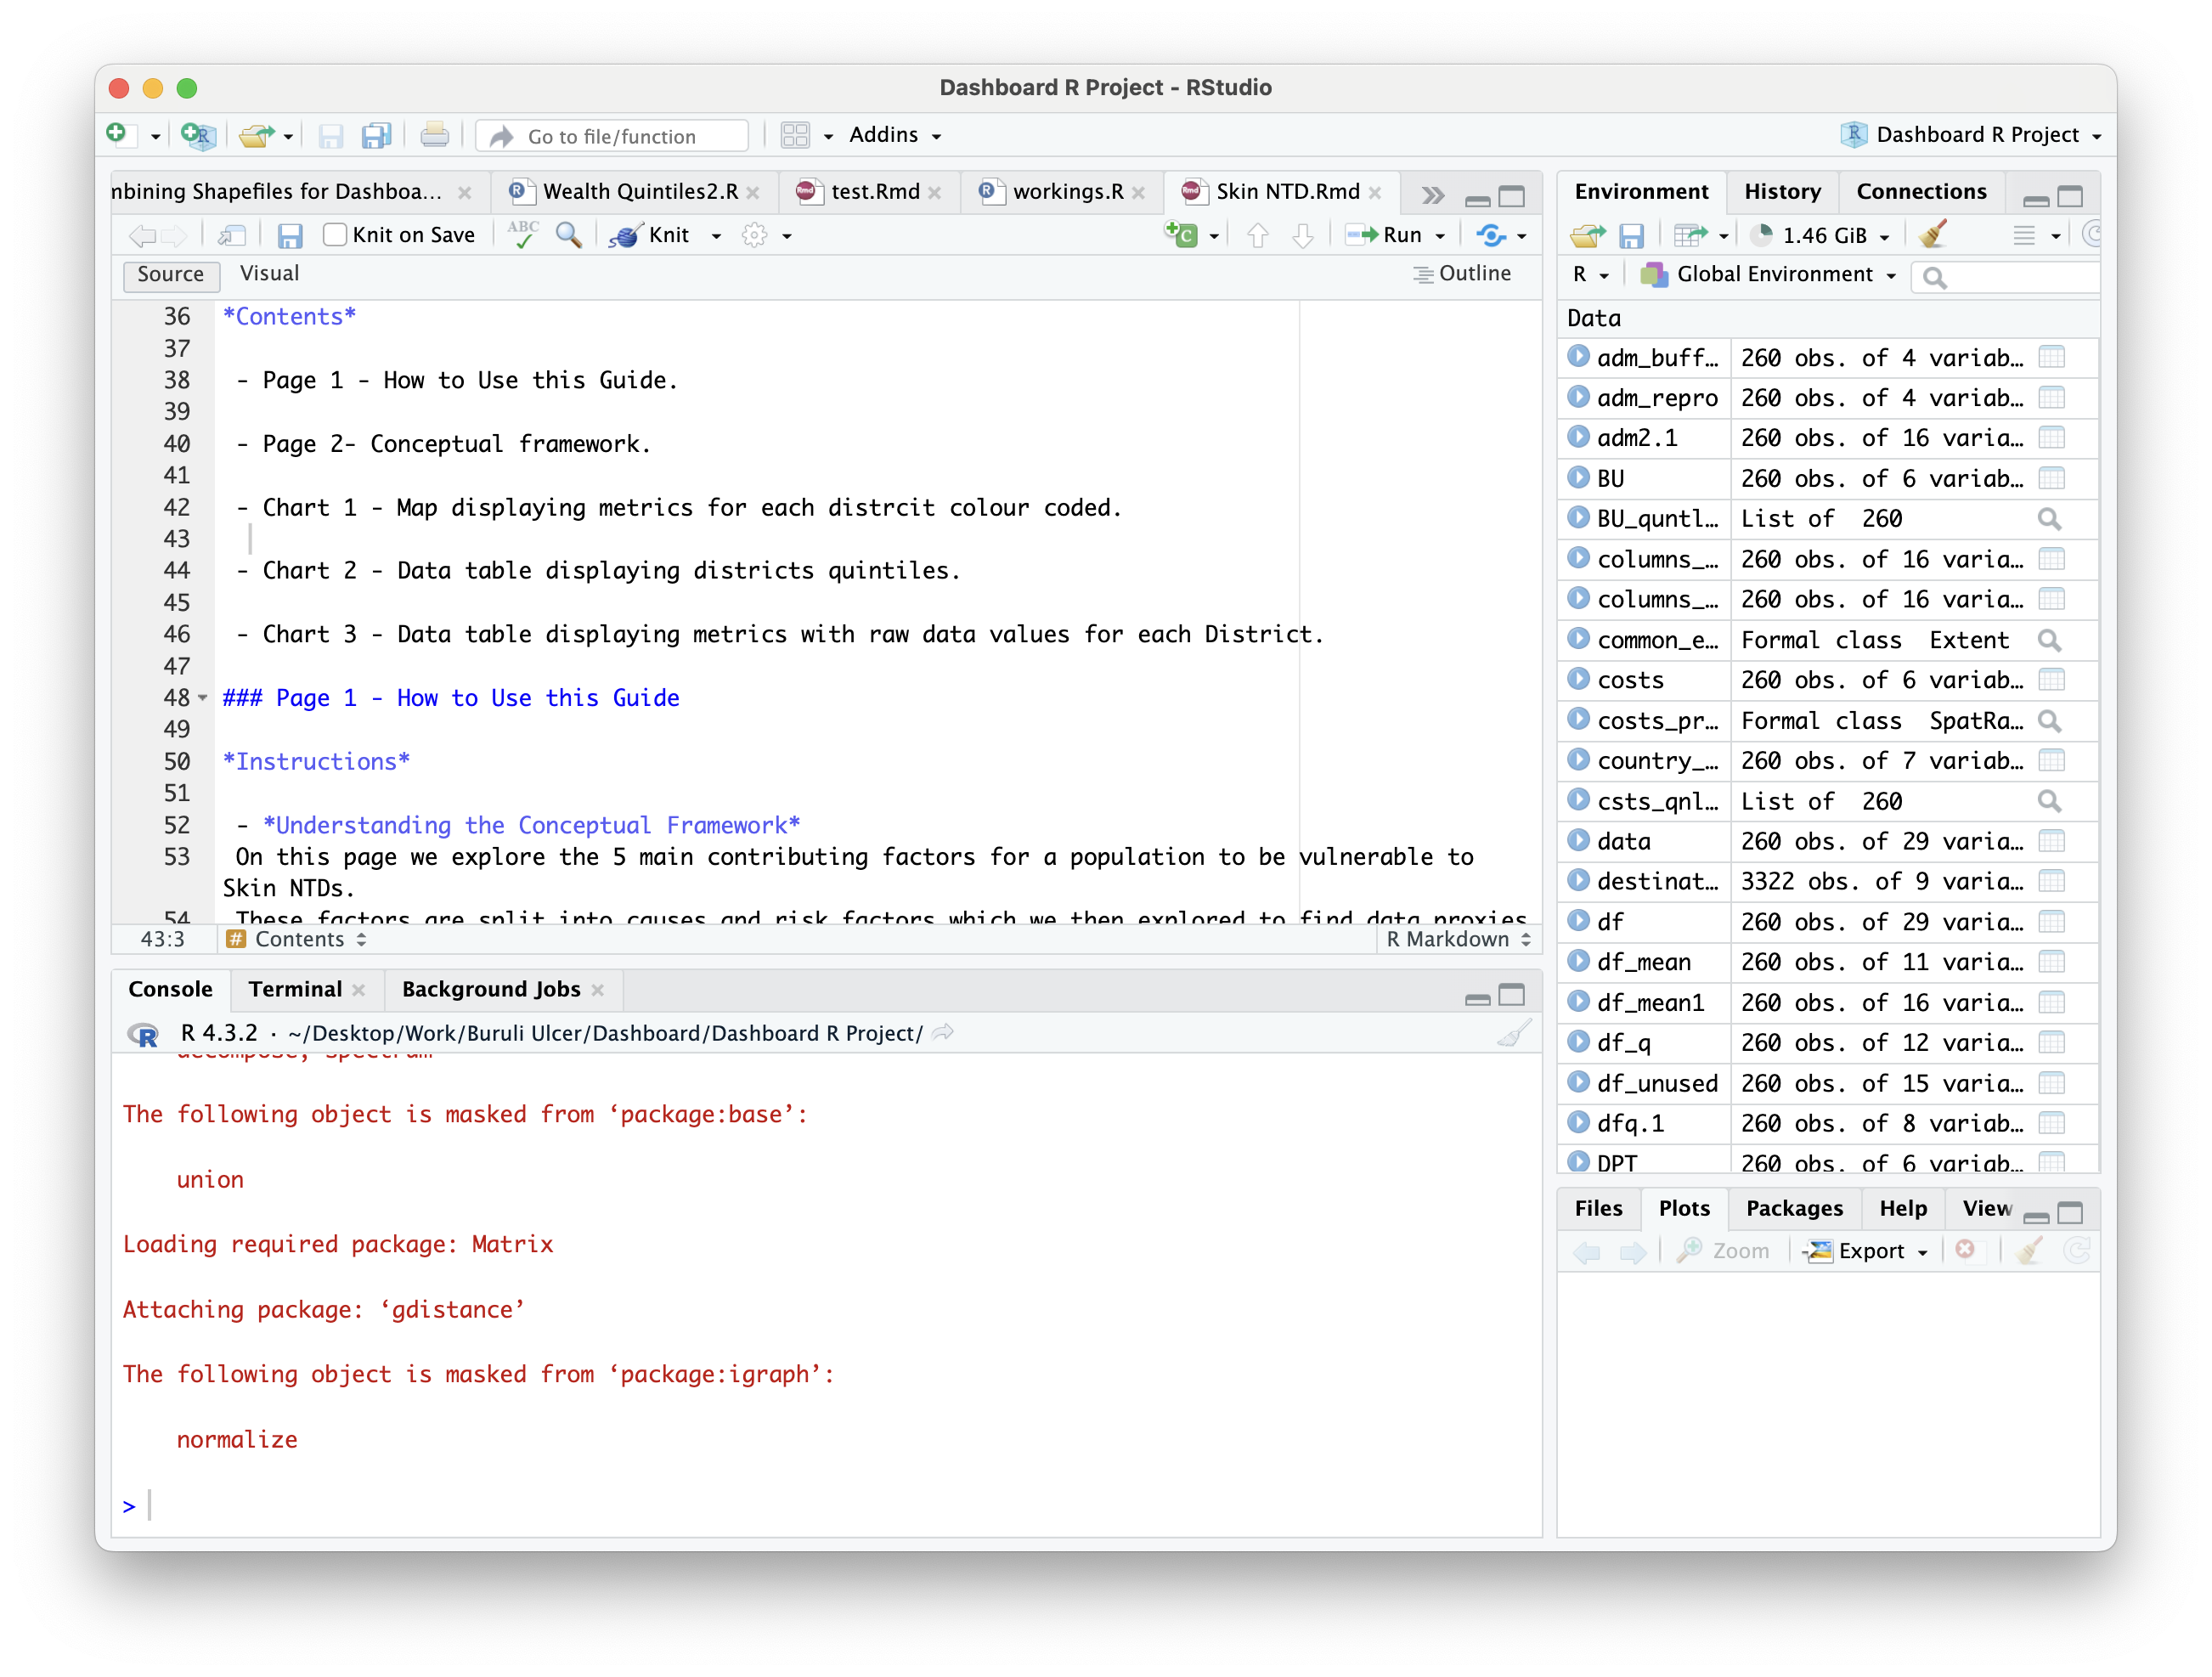
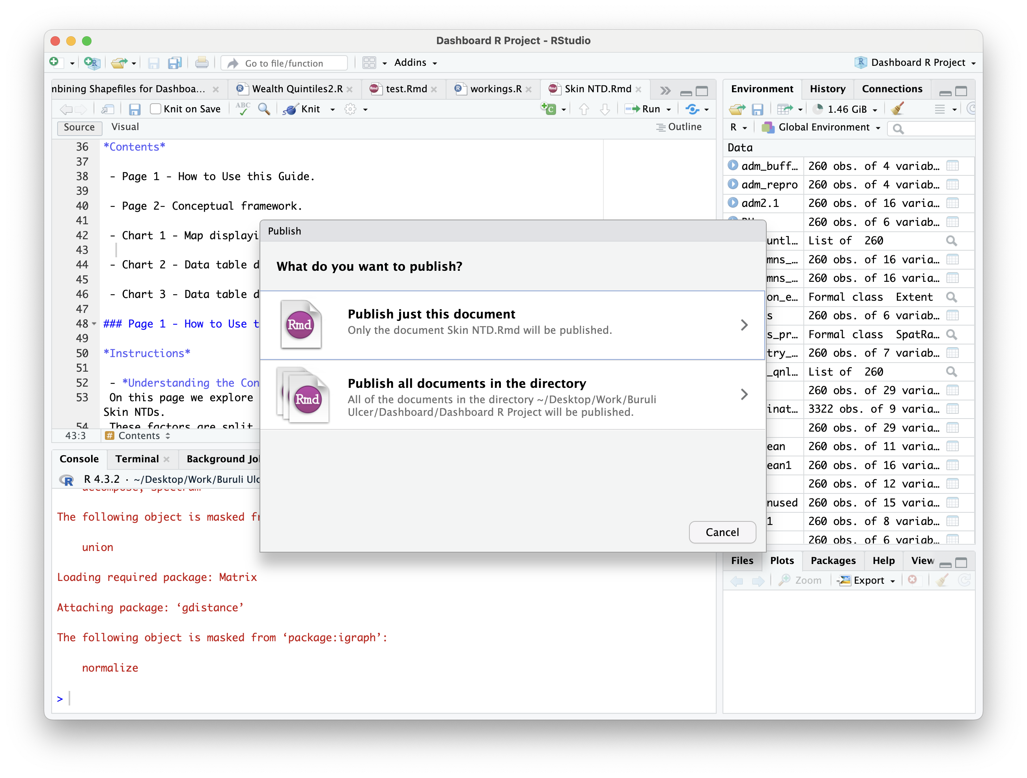
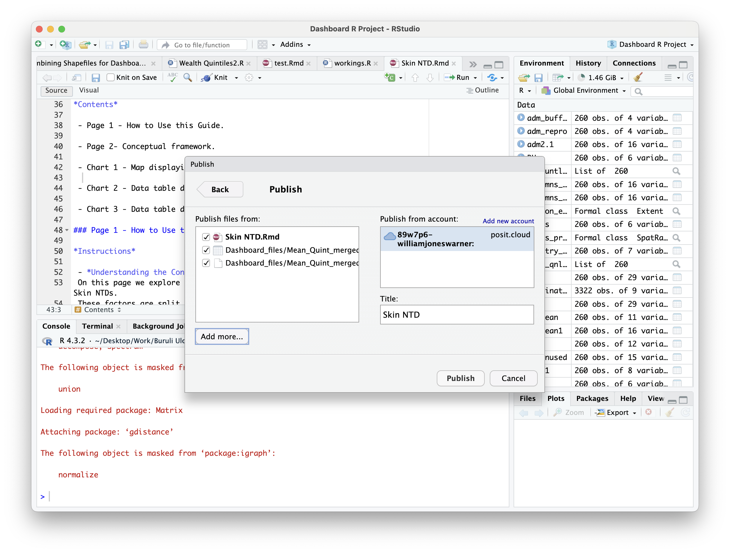
Publishing to Posit Cloud
1) Press the publish dropdown button
2) Typically, just press publish just this document unless wanting to publish all file from the directory to Posit
3) Press add new account to add your Posit account to R studio

Slide 10
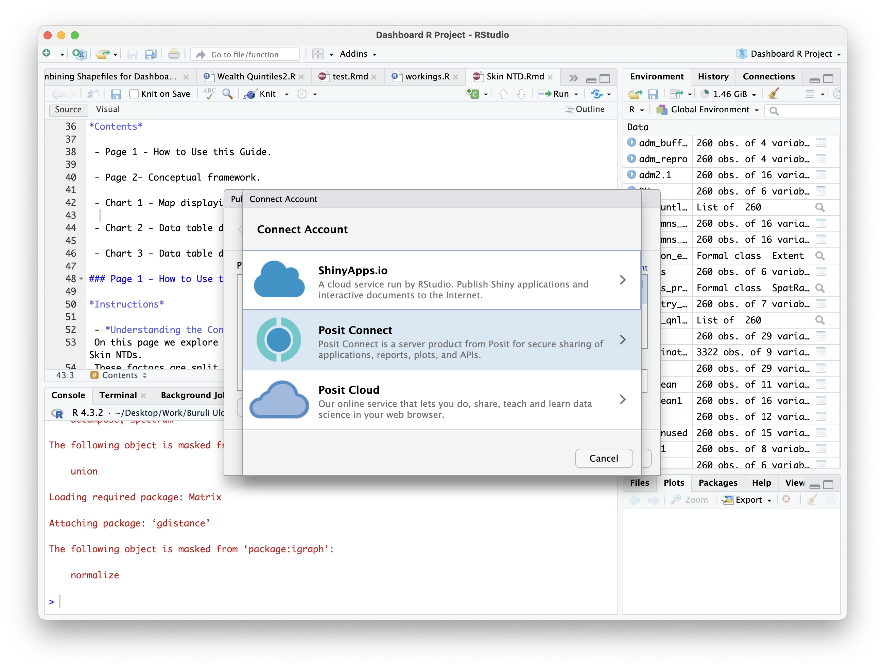
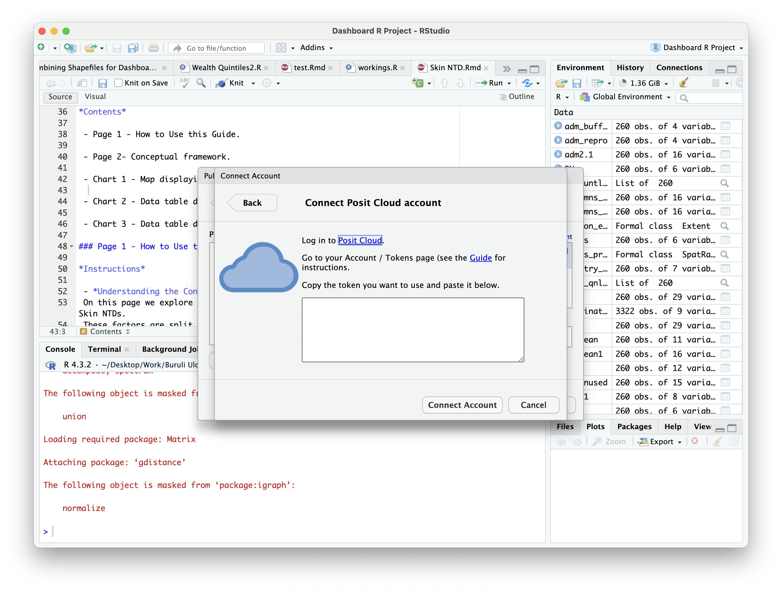
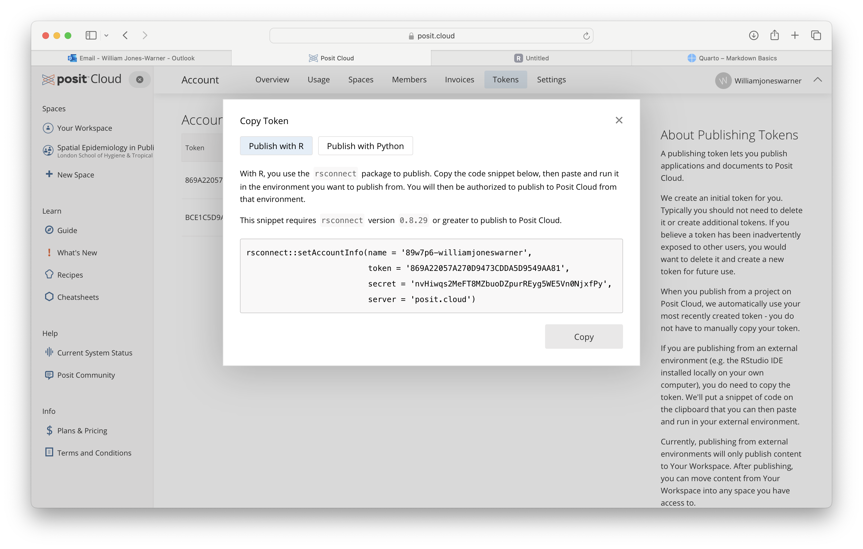
Publishing to Posit Cloud
4) Press Posit Cloud
5) Here you you need to go onto you posit cloud account online to obtain your token (see next step)
6) Click on your name at the top right and then onto the “account”. From here you can see at the panel at the top “Tokens”. Click new token and then copy and paste this into the box from the previous step

Slide 11
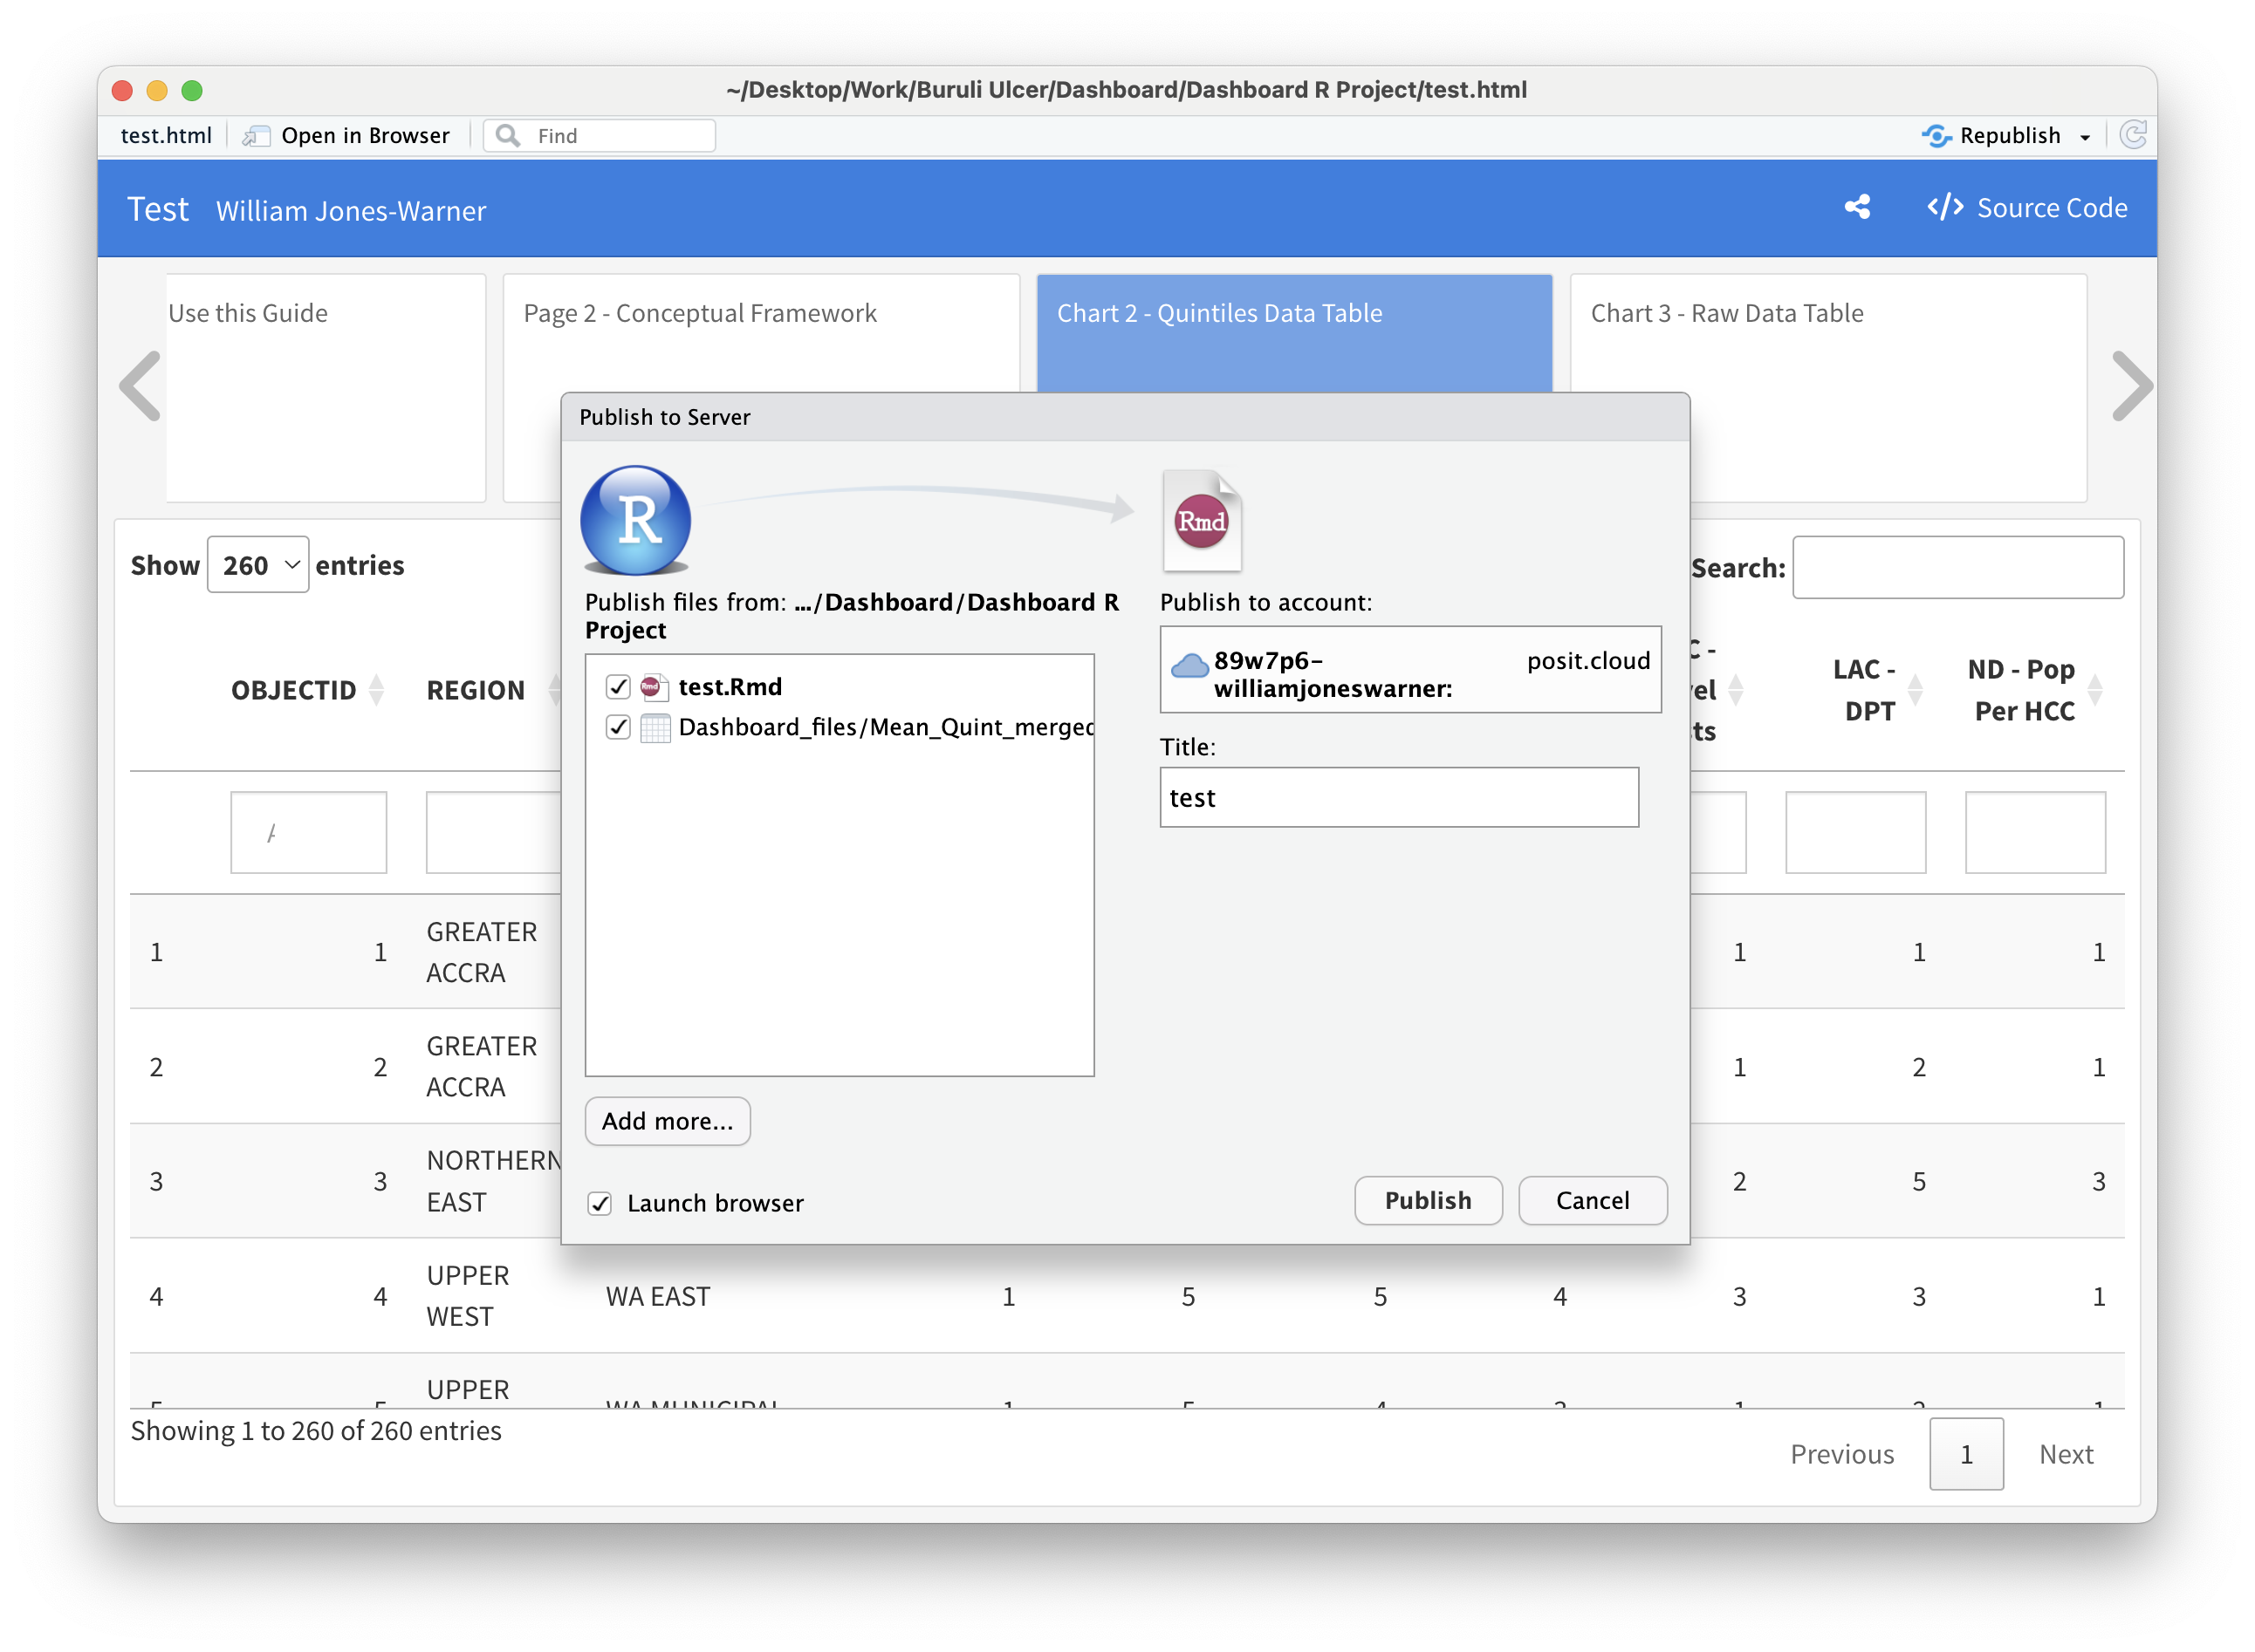
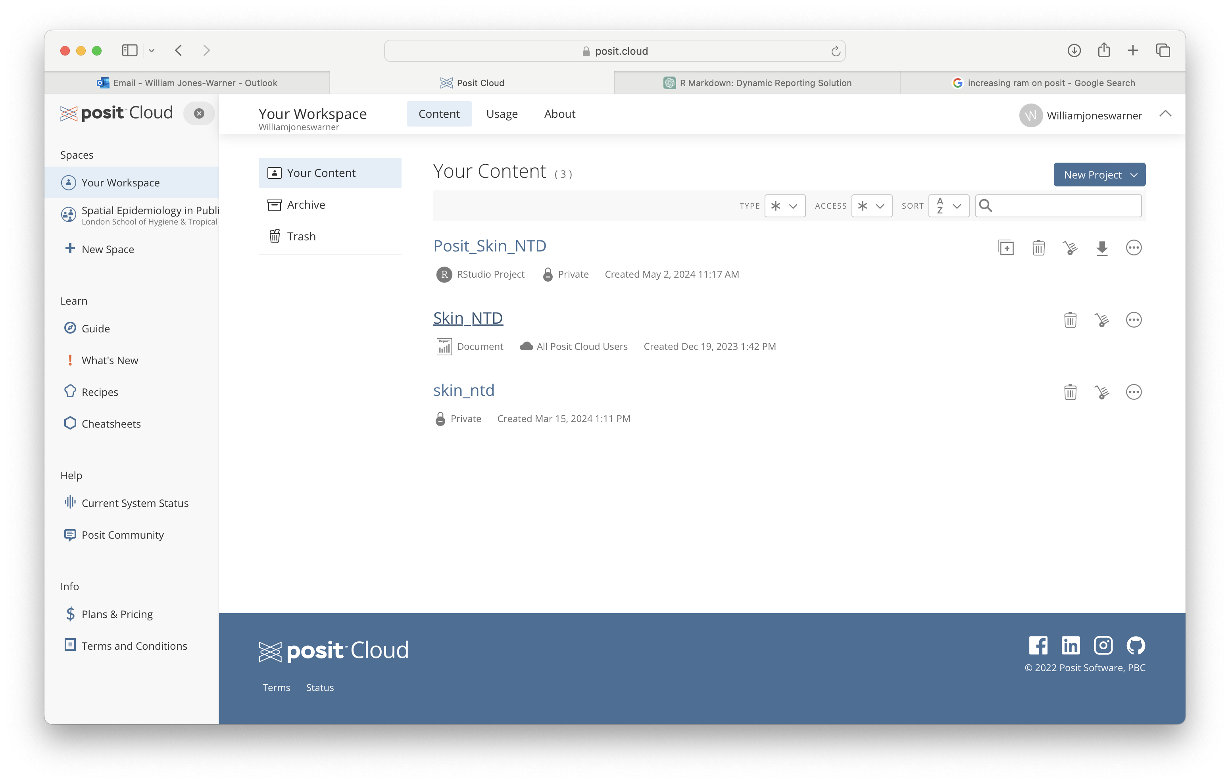
Publishing to Posit Cloud
7) From here you can now publish to your posit cloud account
8) Then you will see the document and the .rmd available in your workspace on Posit cloud

Slide 12
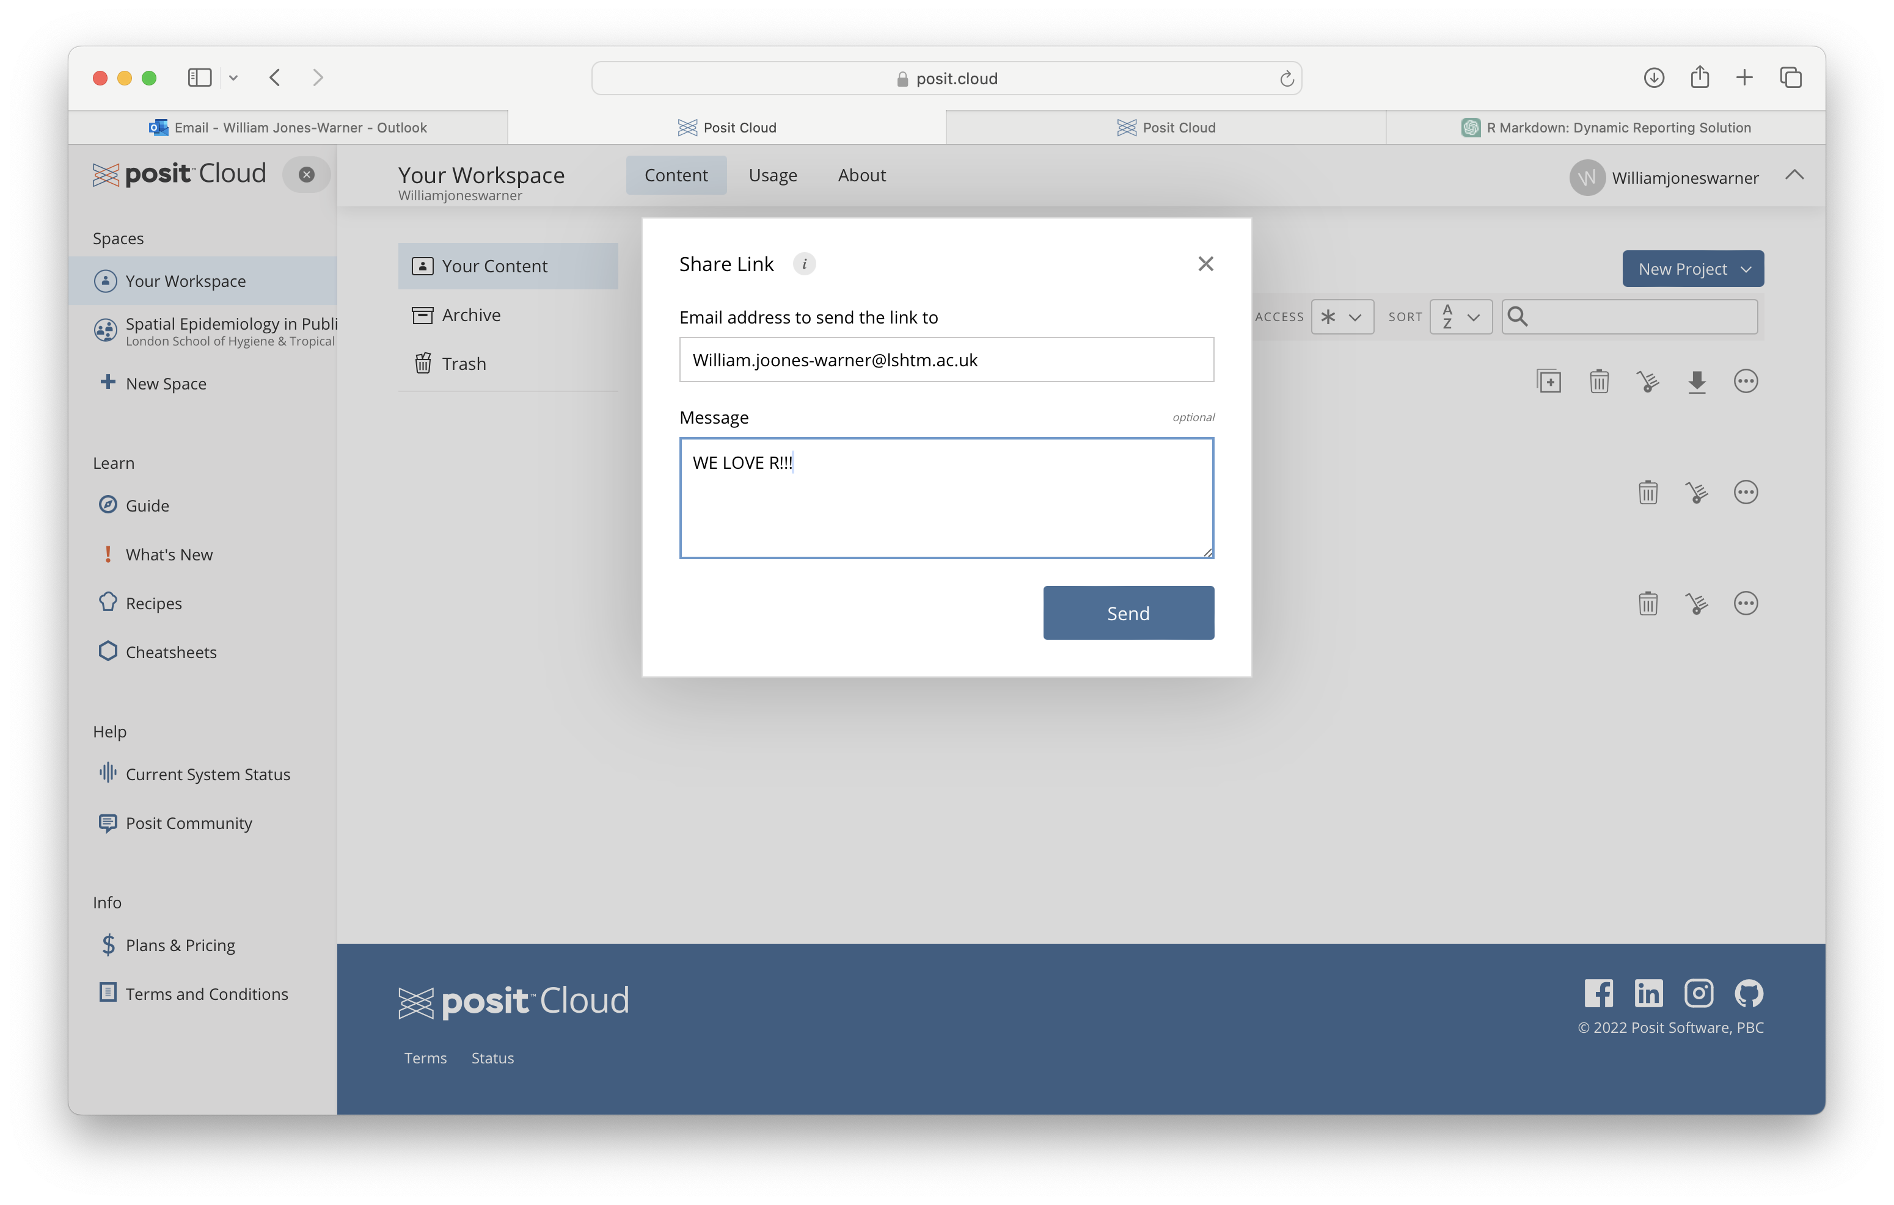
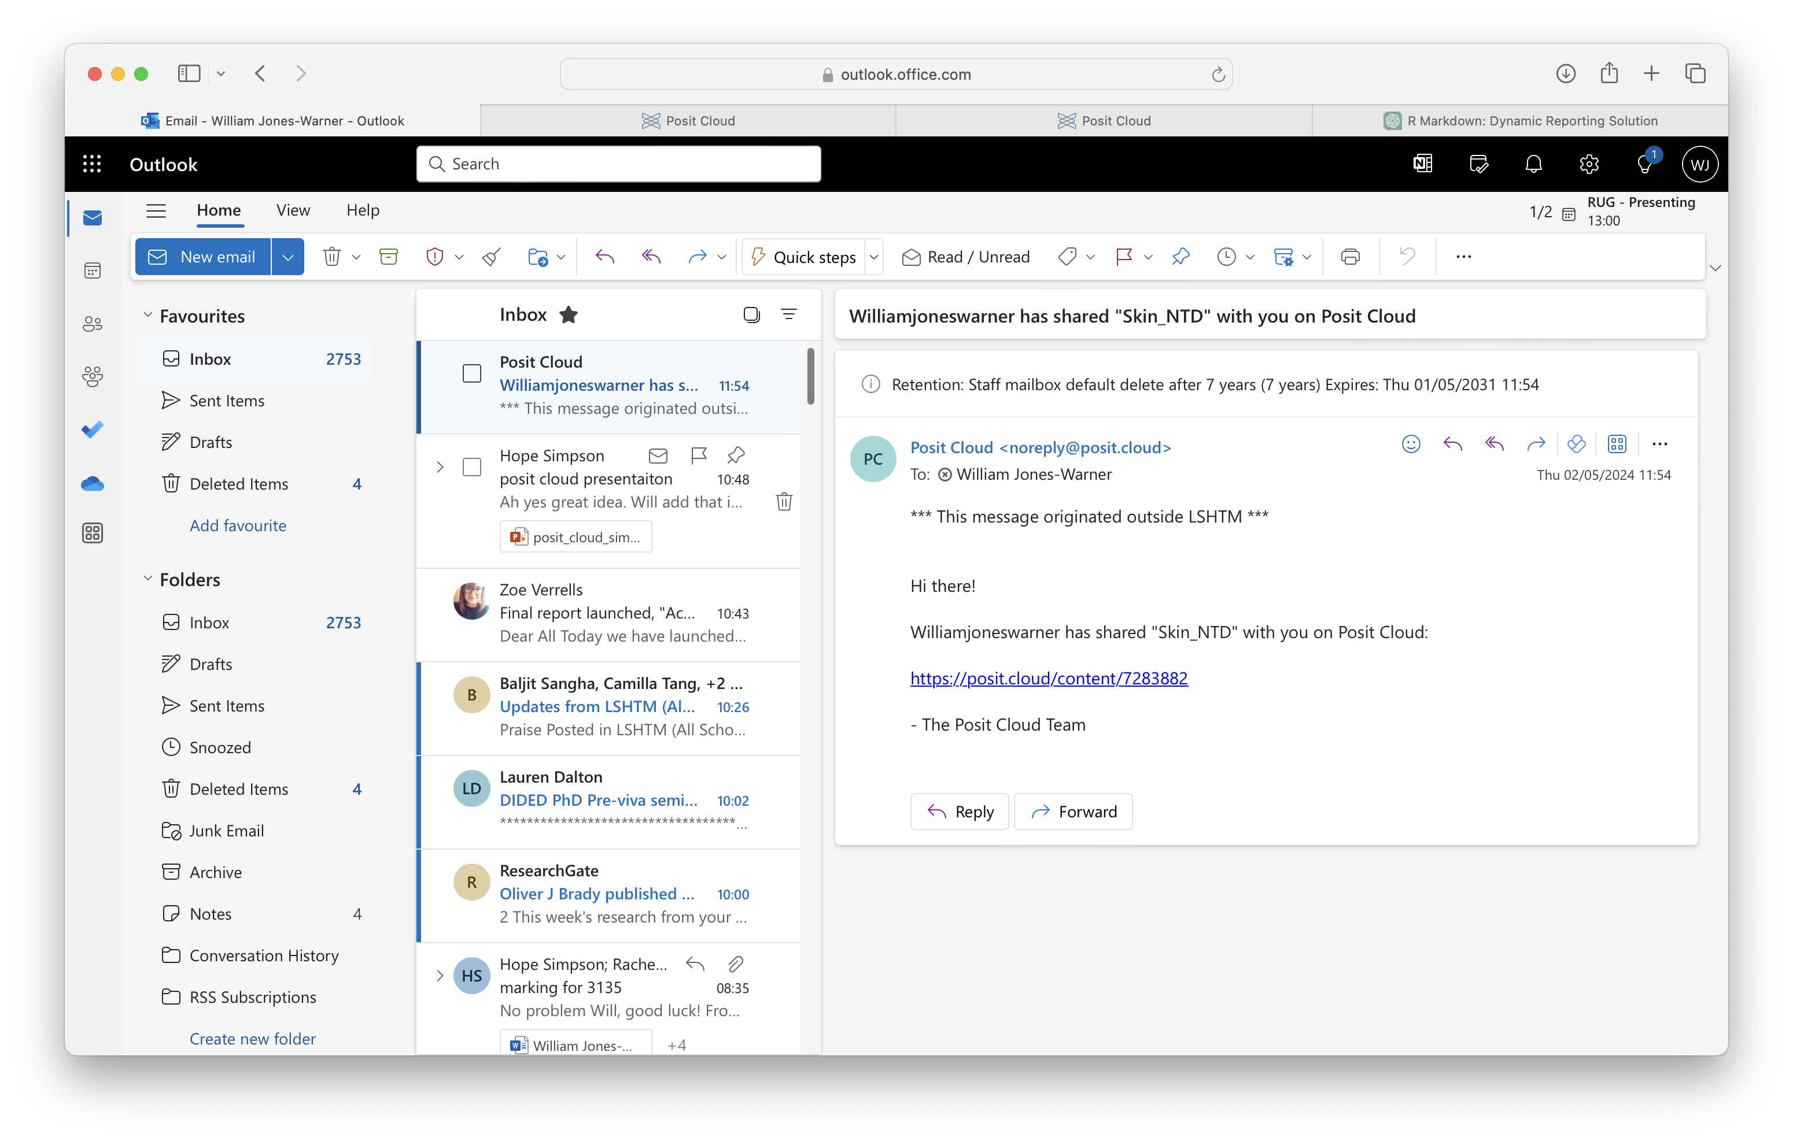
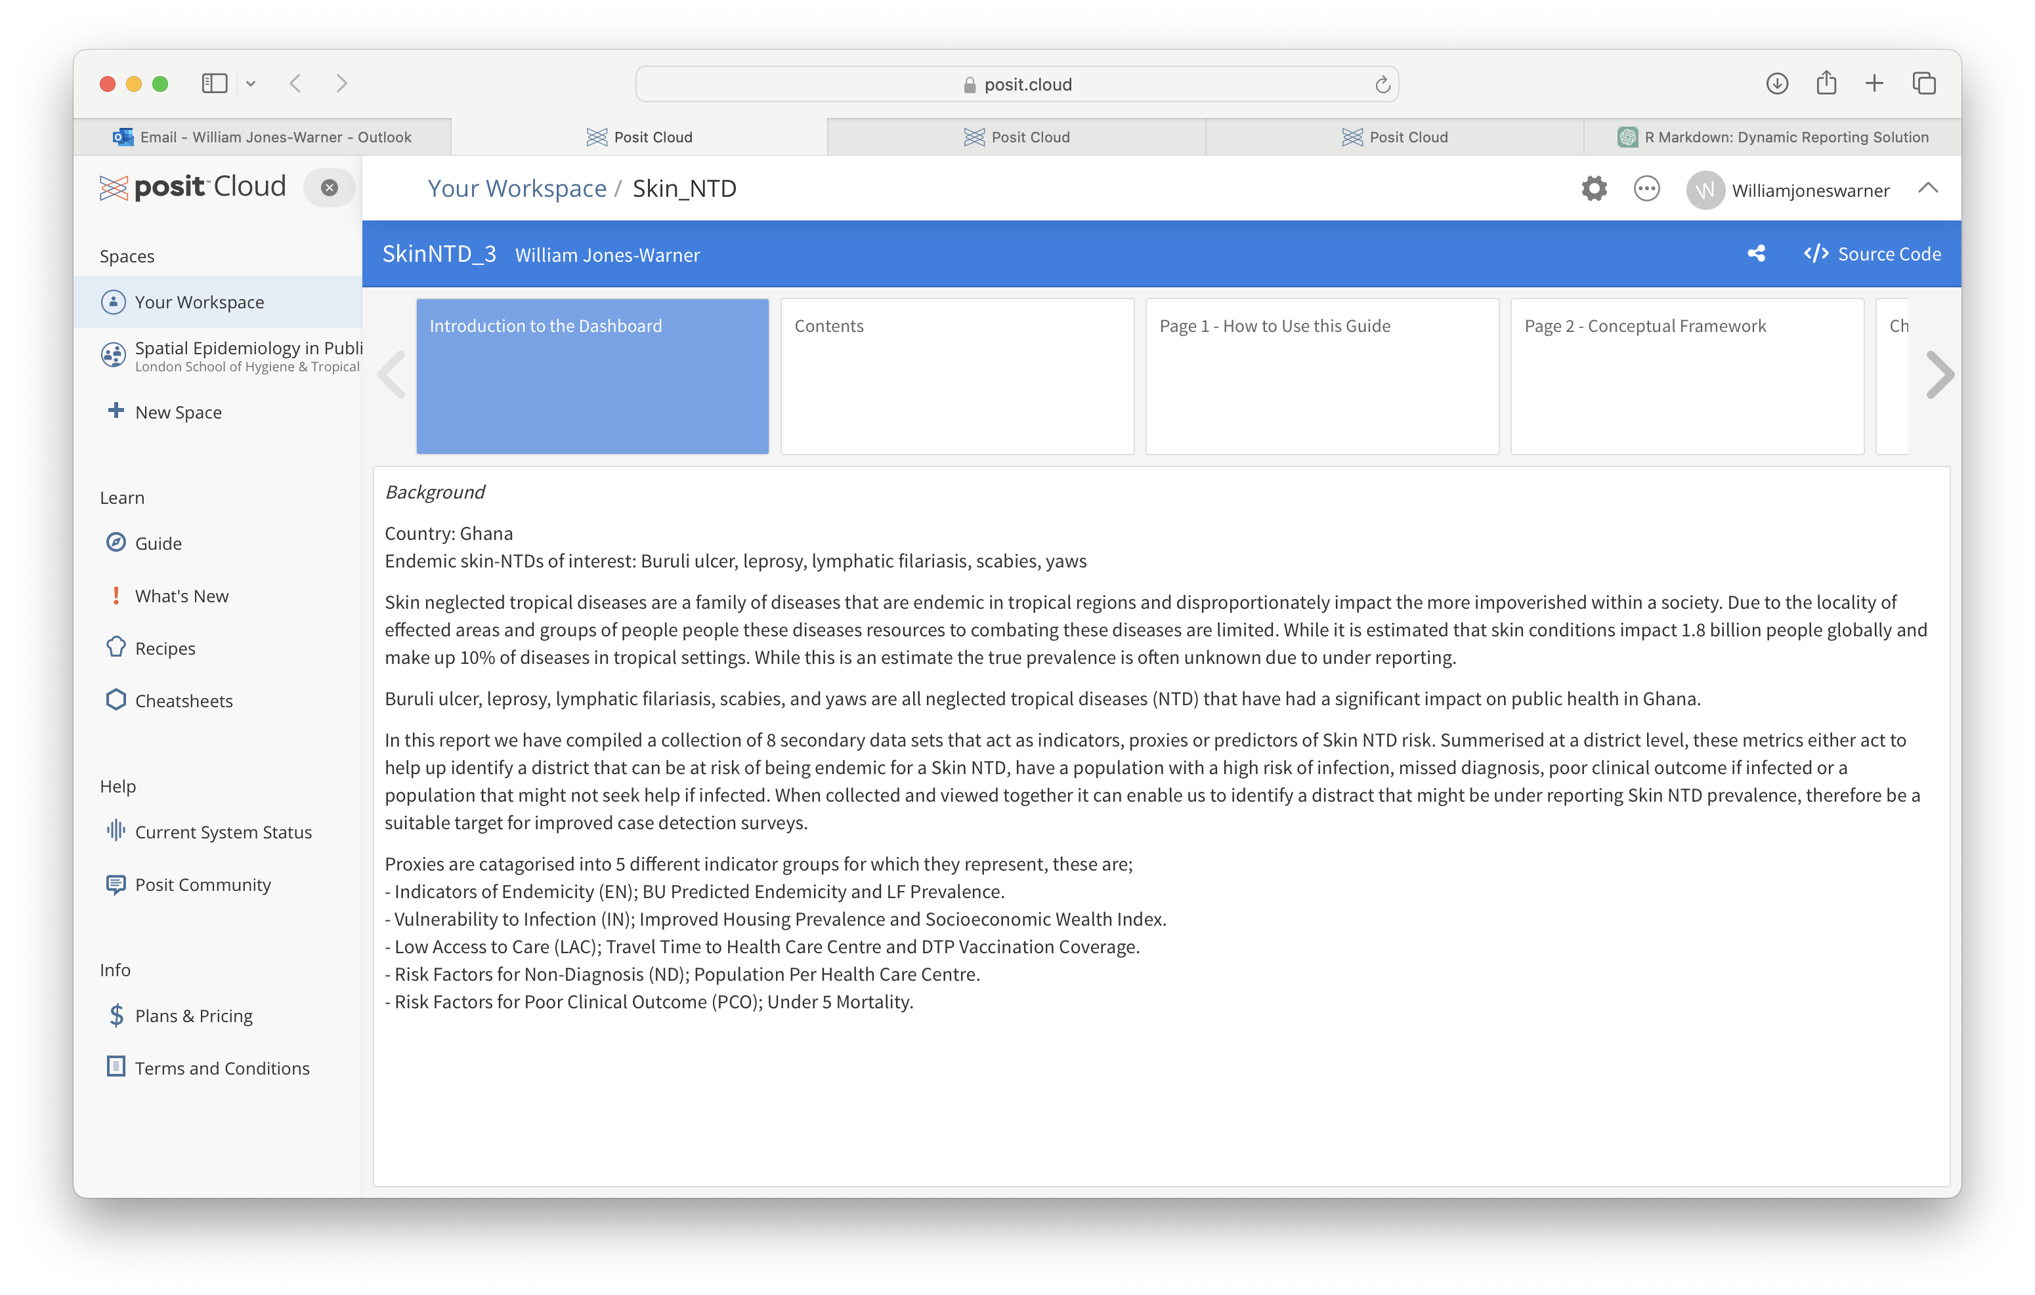
Sharing your wonderful dashboard for everyone to enjoy!
2
1
3
4

Slide 13
Now to see the dashboard

