Slide 1
Posit Cloud as a platform for teaching R
Hope Simpson

Slide 2
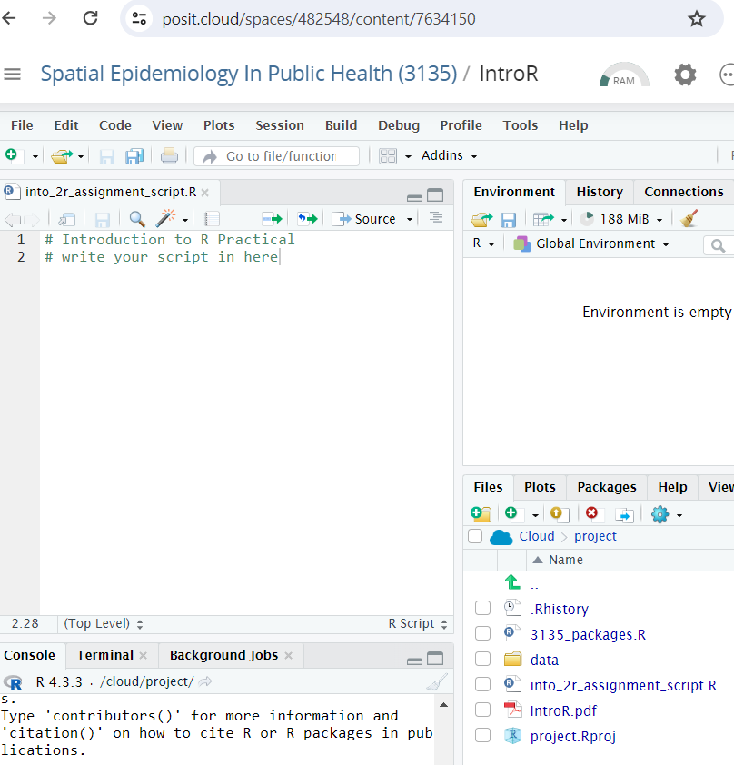
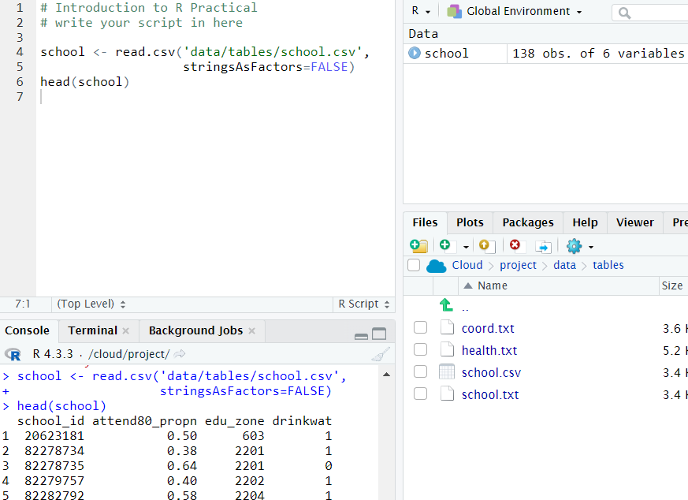
What is Posit Cloud?
A web platform replicating Rstudio.
This removes installation issues which slow down teaching/learning
Computations are run on remote servers and outputs returned to the user window.
It looks very similar to Rstudio, so students should be able to transition smoothly to the desktop version after the course.

Slide 3
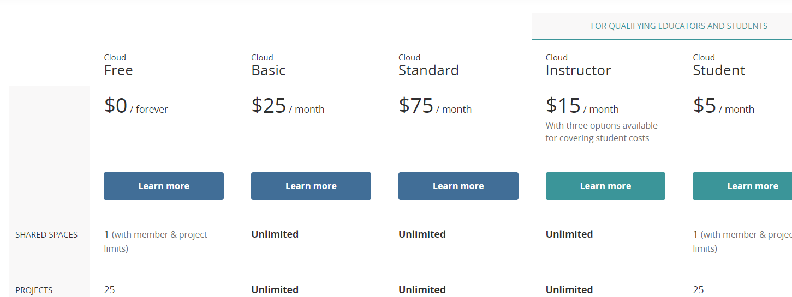
How much does it cost?
There are different subscription levels:
We use this:

Slide 4
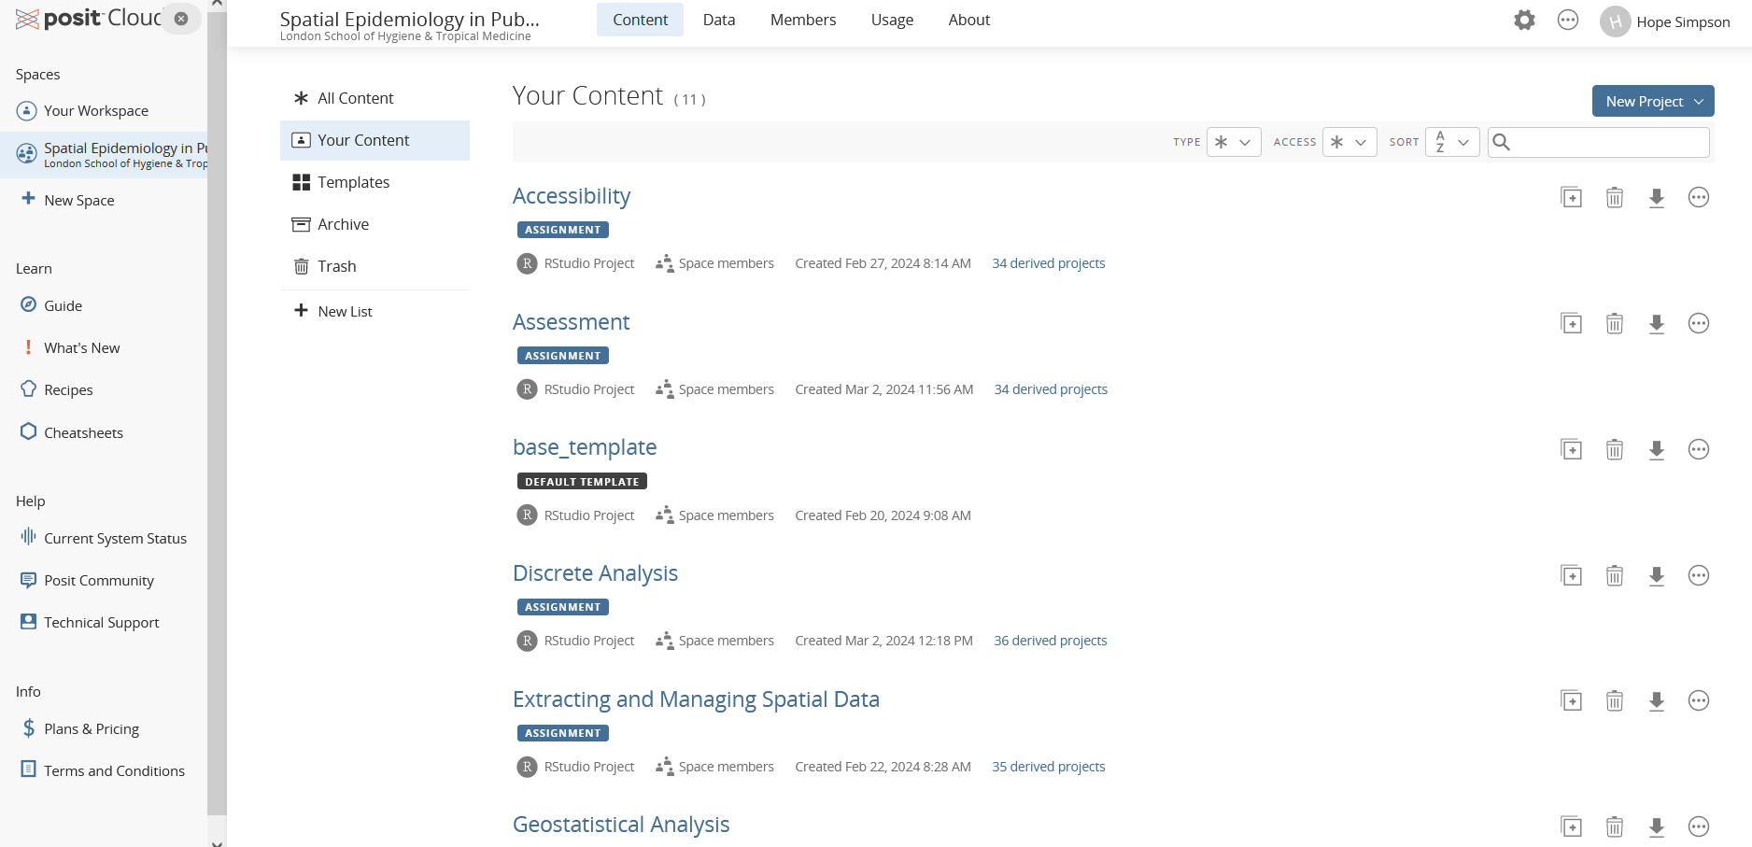
How do we use it?
We have a workspace (Spatial Epi) consisting of projects:

Slide 5
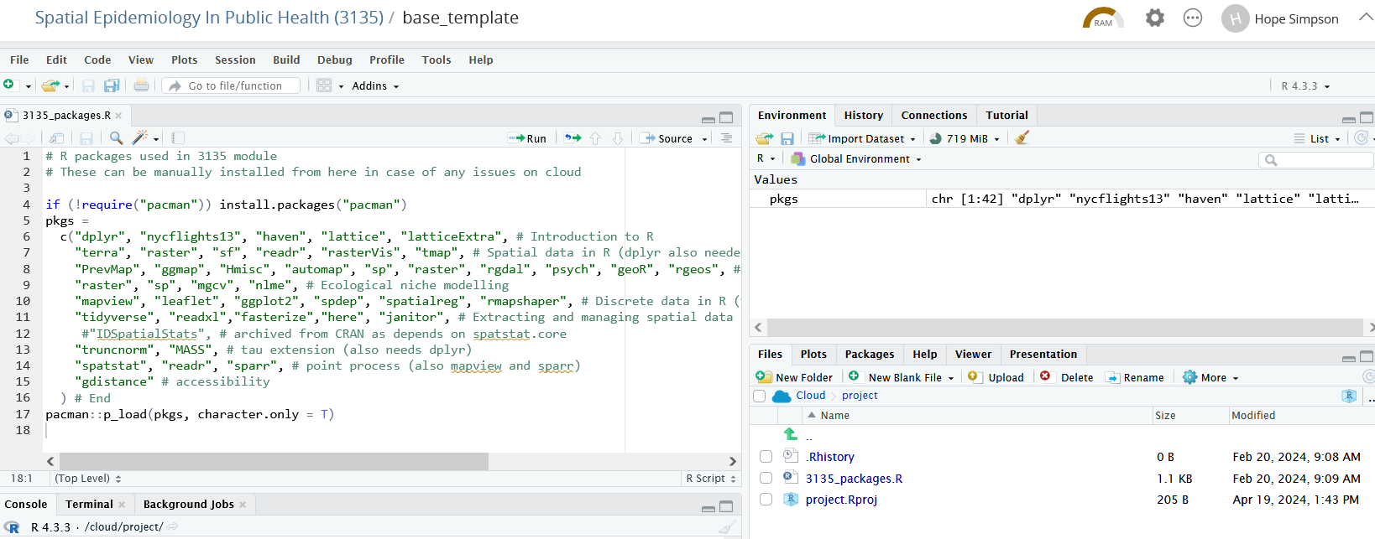
How do we use it?
The first project we set up is the base project. This simply installs and loads the packages we use in the course practicals:

Slide 6
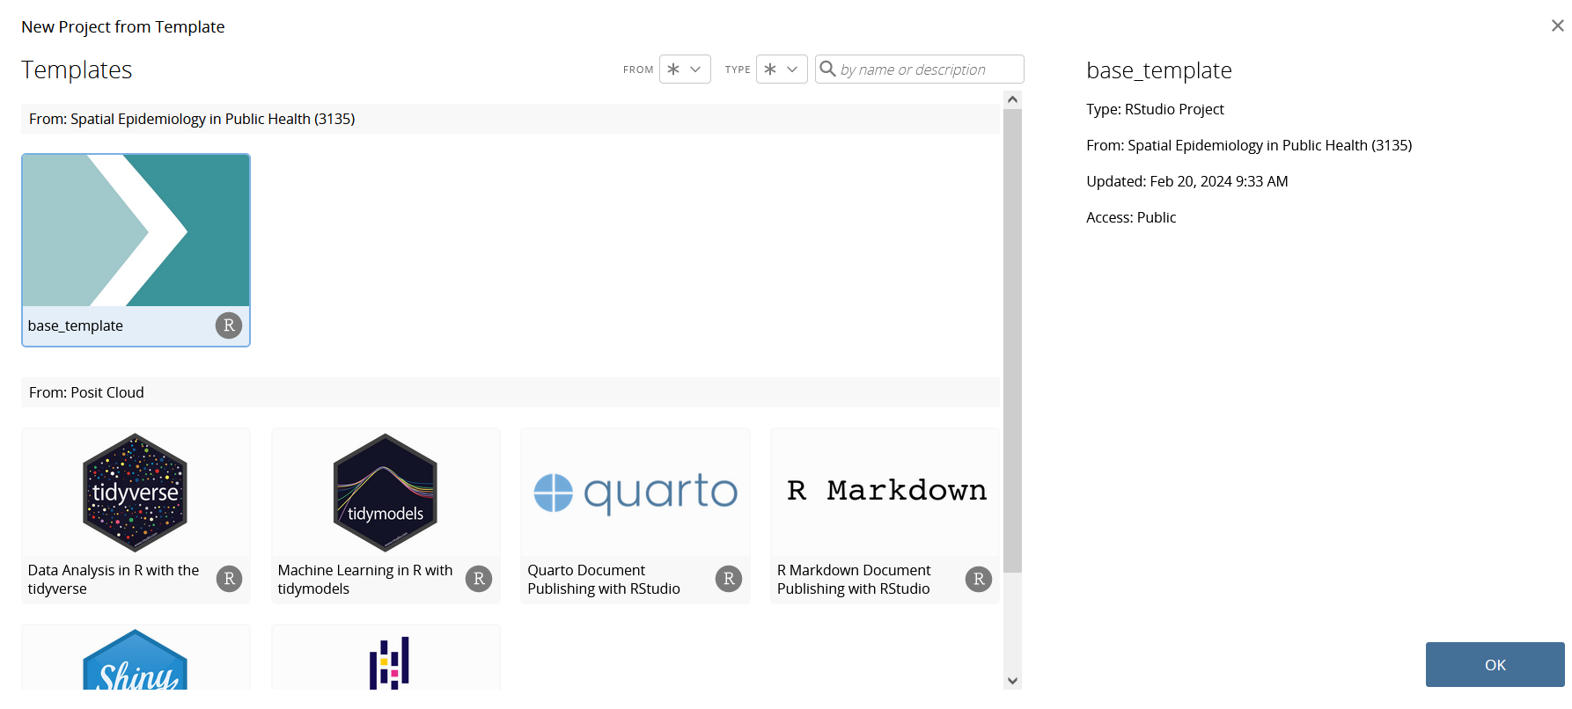
How do we use it?
We use the base project as a template for all the practical projects we set up:

Slide 7
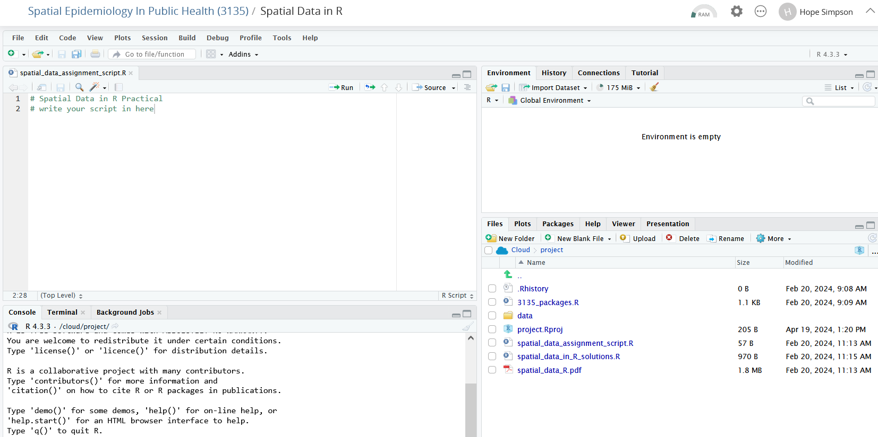
How do we use it?
This is a practical assignment project:
This means the packages are pre-loaded (from the base template) for each practical
We also upload the data and PDF guide for each practical

Slide 8
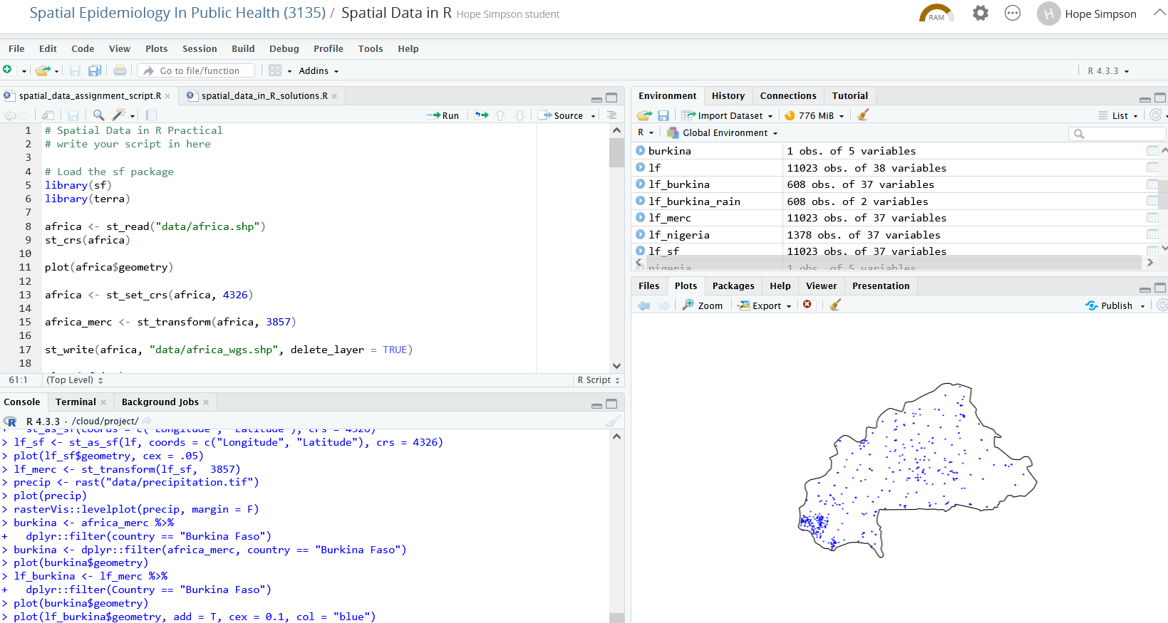
How do we use it?
This is a practical assignment project:
Posit cloud behaves like RStudio

Slide 9
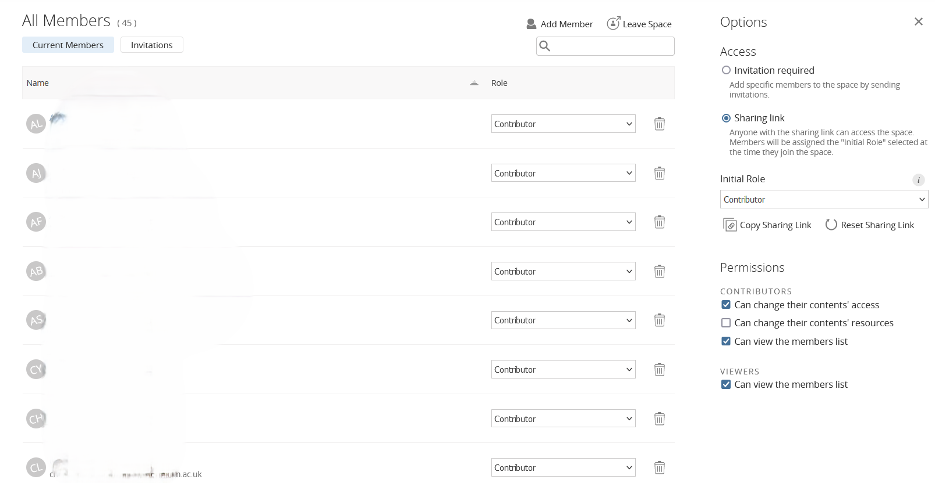
How do students use it?
We create a sharing link assigned to a ‘collaborator’ role and send this to students

Slide 10
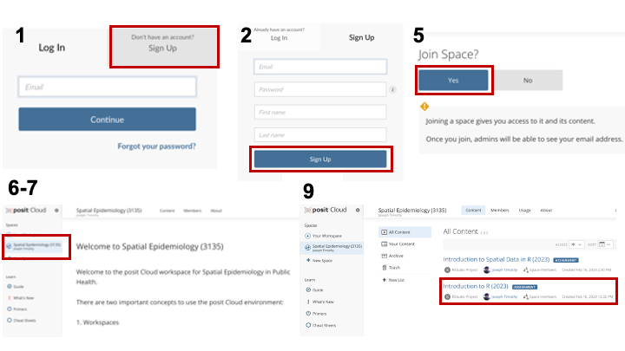
How do students use it?
Students use the link to create accounts and access to the module workspace
3
4
5

Slide 11
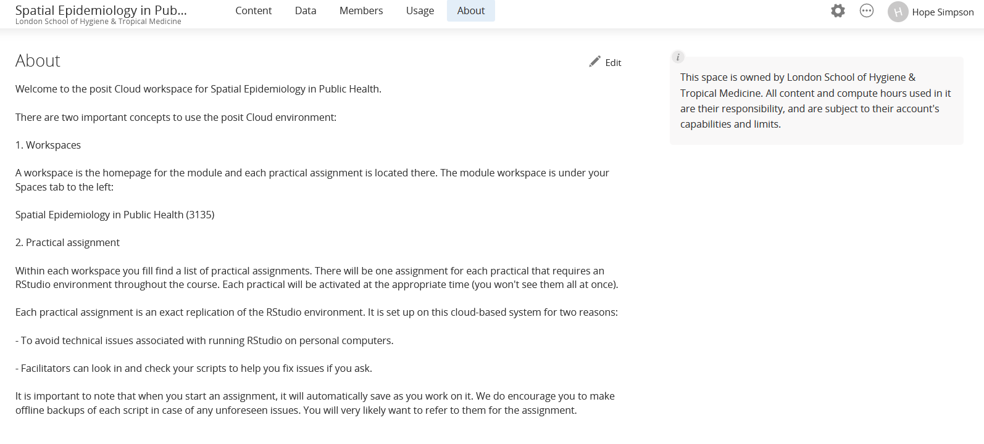
How do students use it?
The workspace has different tabs- this is the About tab

Slide 12
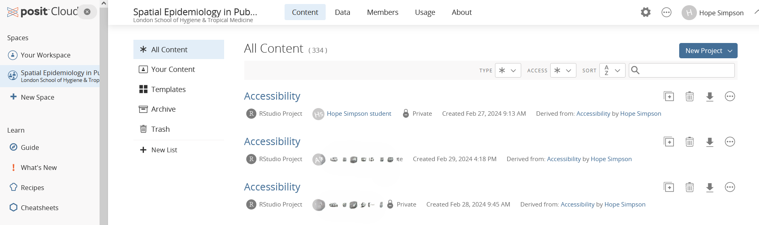
How do students use it?
When students start a project, instructors can see (and access and edit) their copy in the workspace:
We tell students at the start of the course that we can see what they put in their projects and use this to troubleshoot issues.

Slide 13
Monitoring students’ progress
We can also track total usage hours and hours per user →
We tell students for transparency that we can see this but do not monitor it.

Slide 14
Possible issues
Projects occasionally crash and if the student has not saved then work can be lost
Occasionally we had issues with RAM exceedance even when we assigned the max RAM (16GB) and CPU (4).
Sometimes data structures (e.g. of csvs) were lost when students read in work. Resolved by uploading a new copy.
Sometimes data did not load properly in projects (resolved by deleting the student’s project and start again)
It’s very important to keep the instructor’s copy of each project clean. Don’t code in the file, use a student account for testing.
Anything else?

Slide 15
Summary
Is Posit Cloud essential for teaching R?
Does it save time and stress?
The biggest benefit is being able to quickly (and remotely) check students’ scripts, and having access to the same data they are using and objects created.
Another pro is that students are not limited by their machines’ computing power. We had a student running practicals from a tablet this year.

Slide 16
Demo

